Slide 1



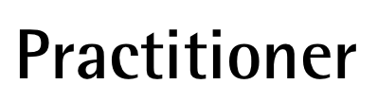
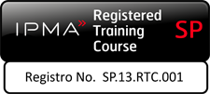
Introduction
Release 6

Slide 2
About the presenter
Industrial Engineer MBA, GPM-M, PMP with more than 25 years of experience in Electrical Companies: Telecomanded electric grid, Marketing and Communications, Corporate Social Responsibility.
Implementation and improvement of Organizational Management Systems according to ISO 9001, ISO 14001, ISO 26000, OHSAS 18001 y Argentinean Resolucion ENRE 057/2003 Public Safety for Electric Power Transmission in High and Medium Voltage (Since 2000).
She was part of the Communication Committee and Environmental and Sustainable Development Committee of Electricité de France (EDF) Branch America along with colleagues from France, Brazil and Mexico (2002-2004).
As independent contractor, she is Organizational System Manager at Baresi SRL a Polyolefin Recycling Company (2005-2015); and Professor of CSR and Sustainable Development at GSPM, University for International Cooperation –UCI- Costa Rica (since 2013).
Founder member and volunteer of PMI Nuevo Cuyo Argentina Chapter ( 2008-2013). Liaison of PMI Educational Foundation in PMINC (2010-2012).
Council member in PMI Global Sustainability Community of Practice (2010-2012)
Countributor member of the PC/ISO 236 Project Committee: Project Management, and then ISO/TC 258 – Technical Committee: Project, Program, Portfolio Management. (Since 2011)
Member of the GPM Global Leadership Executive Team for Latin America. Main Assesor for the GPM® y GPM-m® Certifications in Latin America and Spain (Since oct2012).
Co-autor: The GPM® Reference Guide to Sustainability in Project Management and The GPM Global P5 Standard for Sustainability in Project Management.
Monica can be contacted at: monica.gonzalez@greenprojectmanagement.org
Mónica González

Slide 3
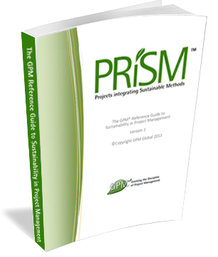
Course Kit
  You will be provided with:
  A complimentary one year Membership to with access to:
    The GPM Reference Guide to Sustainability in Project Management eBook
    Responsible Management Education eBooks
    The GPM Sustainability Calculator and other PM Templates
      Visit members.greenprojectmanagement.org and select “partner discounted membership”
      USE CODE 2018agentofchange
  At the end of this course:
    A certificate of completion will be given
    The GPM-b Certification exam will be given for those who quality
*If Partner is a PMI REP, a code shall be provided, if not, Class B PDUs can be elected.
Notes:
Have the participants go to http://members.greenprojectmanagement.org and sign in using the PARTNER DISCOUNT MEMBERSHIP and add the code to receive a year for free.

Slide 4
Course Introduction
Module 1 | Module Covers | Learning outcomes
Introduction | Course Introduction | This module introduces GPM and sets course expectations
Version
6.0

Slide 5
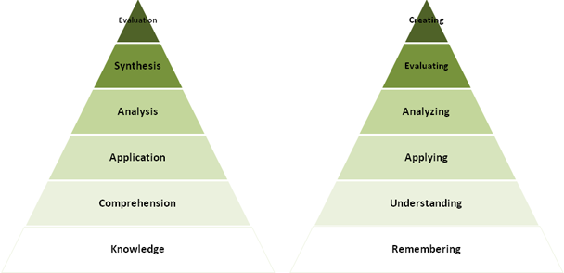
We will cover
This course will impart the knowledge and skills for
Project management using sustainable methods.
Where many training courses focus on knowledge, or memorization, we use an andragogical approach to ensure retention with a strong emphasis on “hands on”.
Course Modules
Sustainability Drivers
Systems Thinking - ISO
Ethics Principles and Values
Governance, Portfolio and Program Management
Organizational Capacity for Change
Business Case, Benefits and Value Management
Requirements Management
Project Management
Life Cycles and PRiSM
The P5 Standard
Project Controls
Issue and Risk Management
Organizational Structures and Roles
Sponsorship
Stakeholder Engagement
Performance and Quality
Information Management and Reporting
Situational Leadership and Communication
Conflict and Negotiation
Notes:
We just covered a lot. Time for a quick break.

Slide 6
Learning Objectives
PRiSM™ Practitioner is a project management course that incorporates best practices, sustainability principles and governance in order to maximize value. The course places an emphasis on aligning benefits with strategic objectives to ensure that each project positions the organization for long-term growth and success through positive impacts to the economic, environmental, and social bottom lines.
The aim of PRiSM™ Practitioner is to train, educate, and develop individuals in project management and sustainability to improve the management and delivery of all types of projects within the set performance, time, cost and integration criteria throughout their own organization and to show how these changes can best be integrated into business as usual and become the normal embedded practices for the organization.

Slide 7

About GPM?
Sustainable Project Management or “Change Delivery” Professional Development Organization
Services in over 145 Countries
  Training through partners (Corp., University, Associations)
  Certification of individuals (GPM-b™, GPM®, and GPM-m™)
  Sustainable PM Methodology (PRiSM™)
  Organizational Sustainability Materiality Assessments (PSM3™)
  Sustainability Centre of Excellence
  Standards (P5 Standards for Sustainability in Project Management)
Notes:
As you saw from my title slide, I am with GPM. Who or what is that? We are a certified social enterprise (we believe in paying taxes and putting into practice what we preach… We funciton like a non-profit in all other aspects.

Slide 8
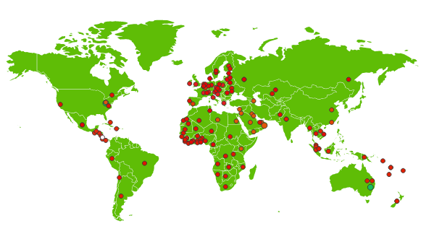
Active in over 145 countries and growing
GPM is the largest sustainability training organization in the world.
(The Sustainable Project Management Organization.)

Slide 9





Our Sustainability Affiliations
United Nations Global Compact
  First Project Management Professional Development Organization or Member Association to become a signatory (2013) and still are.
United Nations PRME (Principles for Responsible Management Education) Supporting Organization
  One of only 14 worldwide
The Earth Charter Endorsers
  GPM founders have taken part since the initial 2001 Summit
UN Business for Peace Initiative
  GPM is a founding signatory

Slide 10
We are making a difference
Mbabane. Swaziland Shanty Town
“LEDtek’s attention to managing the aspects of the design phase, with particular emphasis on the incorporation of sustainability methodologies as per PRiSM, combined to produce the effective outcome of the project, meeting all the criteria.”
Notes:
Absolutely. This project was taken on to reduce crime in one of the most violent places in the world. They used our method PRISM to solve night time crime in shanty towns and rather than using the low cost approach, invested in solar powered high LED lights and are seeing results!

Slide 11

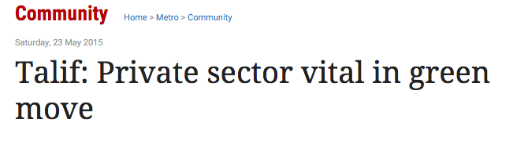
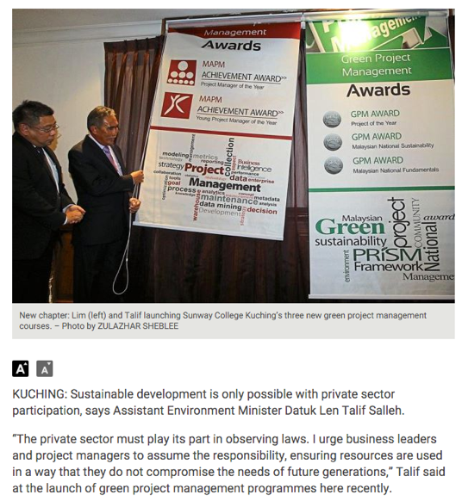
Borneo - Sarawak
Tackling Deforestation and Air Pollution in Malaysia and Borneo
“The private sector must play its part in observing laws. I urge business leaders and project managers to assume the responsibility, ensuring resources are used in a way that they do not compromise the needs of future generations,” Talif said at the launch of green project management programs here recently.
He said the business community tended to focus on “one P” when considering the health of a company. “They only look at the P representing profit at the expense of the planet and the people living on it.”
A recent survey showed that up to 64% of business leaders did not understand how to improve project sustainability, he said.
Notes:
State and Federal Governments in Malaysia and Borneo have combined our awards and IPMA Awards together to encourage rain forest protection and climate change mitigation among organizations. As a result, maybank, petronas, ssi-schaefer and some of the other large Malay corporations have adopted GPM and our certification system.

Slide 12


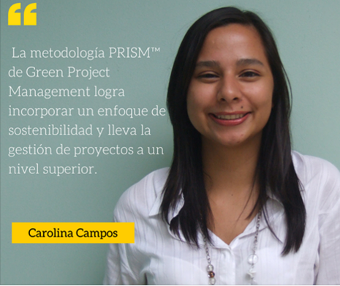
Impacting the future through our University Partner Program and the UN PRME initiative
UN
Notes:
As one of 14 UN PRME organizations, GPM partner Universities are using our program to provide students with the tools they need in the field that are in line with what is important to them, sustainability. The program is customized to the University’s needs and allows them to join and submit progress reports to UN PRME.

Slide 13

Our Focus – Change Delivery
Certification
  GPM-b™
  GPM®
  GPM-m™
Methodology
  PRiSM™
Assessments
  PSM3™
Training
  PRiSM™ Courses
  SP2™
  SAPM™
Notes:
What is SAPM?

Slide 14
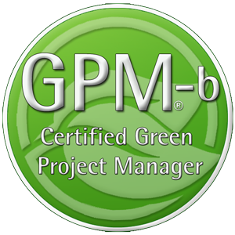
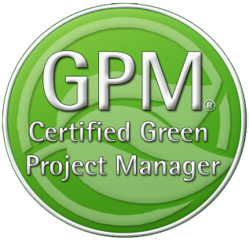

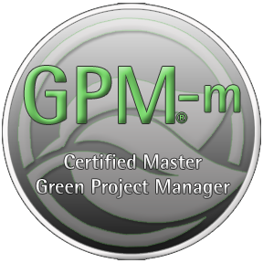
GPM Certifications
The GPM-b - Knowledge based foundational
Certification
The GPM® - Proficiency based Practitioner
Level Certification
The GPM-m - Proficiency Based Master
Level Certification
Notes:
GPM Adheres to ISO 17024, Certification of Professionals. All GPM Certifications are issued by the GPMG Accreditation Board, A semi-autonomous organization that provides governance and oversight

Slide 15
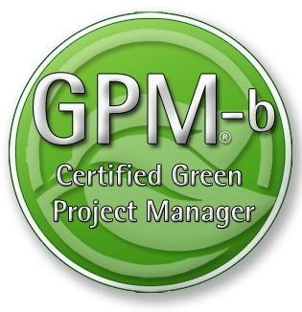
Certification
This course will prepare you for the GPM-b Certification.
The Certification Exam Format
To earn the Green Project Manager level B (GPM-b) credential, candidates must have 2,000 hours of project experience, and pass the 150 multiple choice question examination with a minimum passing score of 75%. The Exam is broken down into two primary sections as listed below.
1. Project Management
1.1. Project Management Standards based on ISO 21500
1.2. Project Management Competencies
1.3. Project management Knowledge Areas
1.4. Key Terms and Concepts

Slide 16
Certification
This course will prepare you for the GPM-b Certification.
The Certification Exam Format
To earn the Green Project Manager level B (GPM-b) credential, candidates must have 2,000 hours of project experience, and pass the 150 multiple choice question examination with a minimum passing score of 75%. The Exam is broken down into two primary sections as listed below.
2. Sustainability Integration
2.1. Why Sustainability
2.2. PRiSM™
2.2.1. P5™
2.2.2. Sustainability Management Planning
2.2.3. Phases, inputs and outputs
2.3. Sustainability ISOs
2.3.1. The Energy Management Standard ISO 50001
2.3.2. The Environmental Management Standard ISO 14001
2.3.3. The Guidance on Social Responsibility ISO 26000
2.3.4. The Quality Management Standard ISO 9001
This course will also prepare you for the IPMA Level D Certification

Slide 17
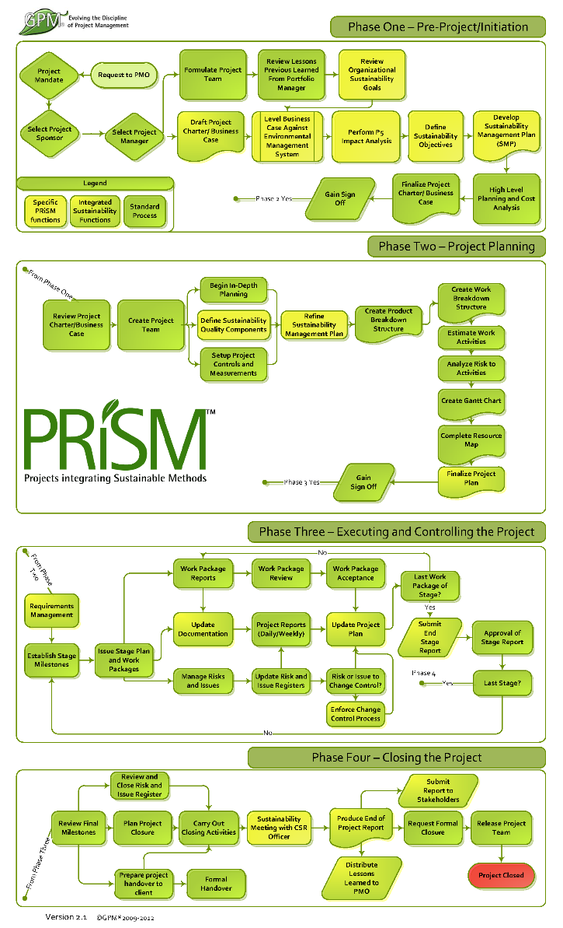
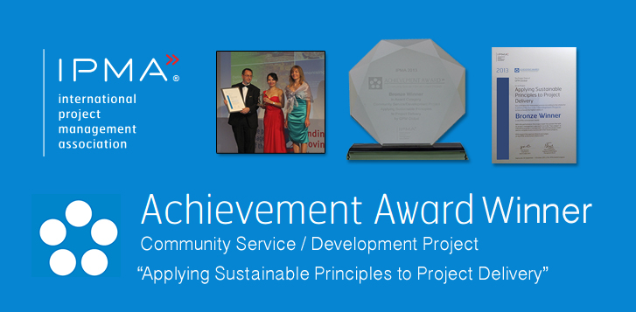
Industry Recognition
PRiSM is our structured project methodology that incorporates
ISO standards for:
Quality
Energy Management
Environmental Management
Corporate Social Responsibility
Project Management
The United Nations Global Compact Ten Principles for Sustainability
GRI G4 Framework
IPMA ICB Competence Baseline
Notes:
GPM earned an achievement award from the International Project Management Association for the development of PRiSM.

Slide 18

Award Yourself and/or a Colleague!
Project of the Year
  Gold and Silver
Sustainability Award
Fundamentals Award
The GPM® Fundamentals Award is bestowed upon the person who submits the most thorough EnVex in a PRiSM Practitioner course in a given year.
EnVexes are in-course-virtual-projects that are taken from real life case studies. These exercises challenge course participants to apply what they learn in the course to achieve project objectives while realizing benefits from a social, environmental, and economic standpoint.

Slide 19



Sustainability Drivers
Release 6

Slide 20
Sustainability Drivers
Module 2 | Module Covers | Learning outcomes
Sustainability Drivers | Sustainability Challenges The UN Global Compact 2030 Sustainable Development Goals UN PRME Initiative The Global Reporting Initiative Climate Change The Post 2015 Business Engagement Architecture | Understand current challenges with sustainability from a business perspective, the driving force for business to engage in sustainability and the organizations driving the way forward.
Version
6.0

Slide 21

A Growing Problem
According to Global Footprint Network’s calculations, our (global) demand for renewable ecological resources and the services they provide is now equivalent to that of more than 1.6 Earths.
The data shows us on track to require the resources of two planets well before mid-century.
(We don’t have 1.6 Planets)
http://www.footprintnetwork.org/en/index.php/GFN/page/earth_overshoot_day/
Notes:
We just covered a lot. Time for a quick break.

Slide 22

The earth system context
The Earth System provides the basis for all human societies and their economic activities. People need clean air to breathe, safe water to drink, healthy food to eat, energy to produce and transport goods, and natural resources that provide the raw materials for all these services
The 7 billion humans alive today are collectively exploiting the Earth’s resources at accelerating rates and intensities that surpass the capacity of its systems to absorb wastes and neutralize the adverse effects on
the environment.
http://www.unep.org/geo/
Notes:
GEO-5 is designed to be the most comprehensive, impartial and in-depth assessment of its kind. It reflects the collective body of recent scientific knowledge, drawing on the work of leading experts, partner institutions and the vast body of research undertaken within and beyond the United Nations system.
The launch of GEO-5 coincides with the final stages of preparation for the UN Conference on Sustainable Development (Rio+20), taking place two decades after the Rio Earth Summit that set the agenda for contemporary thinking about sustainable development. The report underlines the reasons why world leaders need to show decisive leadership in Rio and beyond. It highlights the state, trends and trajectories of the planet and its people, and showcases more than 100 initiatives, projects and policies from across the globe that are pioneering positive environmental change. (BAN Ki-moon, may 2012)
There is an urgent need to address the underlying drivers of the human pressures on the Earth System. At the same time, it is necessary to adopt approaches that can deal better with the complexities and inherent uncertainties of the Earth System. This must include three elements: basic research to understand interactions and feedbacks; sustained long-term monitoring and observation to underpin basic research; and regular evaluation of progress to allow the adjustment of responses when observations indicate that this is necessary.

Slide 23

The Accenture – UNGC 2013 Report
Survey result of 1,000 global CEOs, from 27 industries across 103 countries
93%
62%
of CEOs regard Sustainability as the new key for business success
of CEOs believe they can not quantify the value or their sustainability intiatives
SRC: http://www.accenture.com/SiteCollectionDocuments/PDF/Accenture-UN-Global-Compact-Acn-CEO-Study-Sustainability-2013.PDF
Notes:
Which is is great news as the world seems to be poised to support such an architecture as the majority of CEOs from around the world view sustainability as the key to business. Tge unfortunate truth is that these same CEOs can’t quantify the value of what they are doing to address it. What happens to projects that have no value to the organization?

Slide 24
What Happens?
50%
According to Executive Director Geog Kell, 50% of organizations that pledge to the the UN Global Compact are de-listed due to the fact that they are unable to fulfill their committment

Slide 25
Is this a problem?
97%
New report finds only 129 of 4,069 largest companies listed on the world’s stock exchanges are disclosing the most basic sustainability information
Src: http://www.theguardian.com/sustainable-business/2014/oct/13/97-companies-fail-to-provide-data-key-sustainability-indicators-stocck-exchange-report

Slide 26
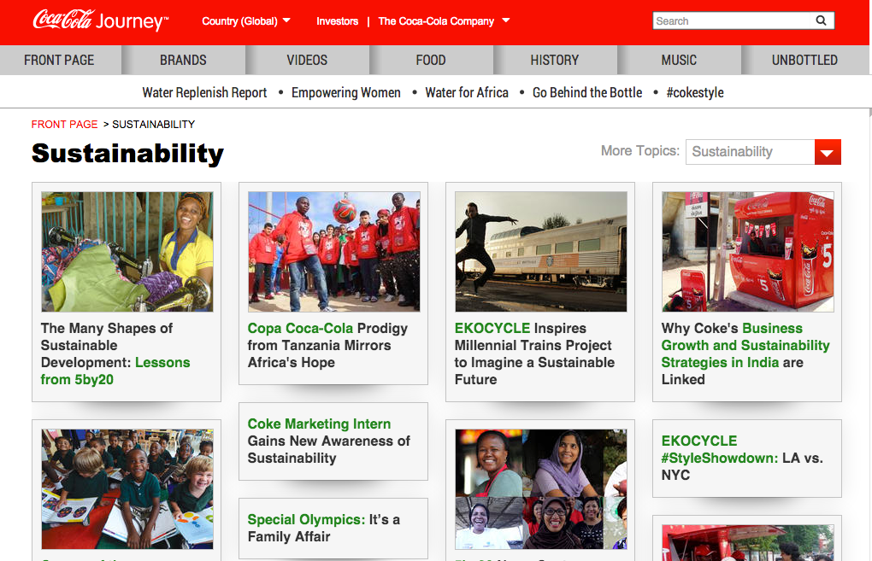


Example
Notes:
This is a snapshot coca cola’s sustainability website Each one of these efforts are outlined in a nice thick report of how responsible coca cola is and how much they care about sustainability. What is not shown is that coke spent One million seven hundred and fifty thousand USD to oppose labeling of food products that are made from GMO. Maybe they could focus on the sustainability of what they produce?

Slide 27
Organizations Driving Sustainability
Hundreds of NGO’s, Non-Profits and advocates promote sustainability
Internationally (and practically) the standards drivers are largely focused on
  ISO
  United Nations
    UN Global Compact
    UN PRME
  Global Reporting Initiative

Slide 28

The United Nations Global Compact
The Ten Principles
The UN Global Compact's ten principles in the areas of human rights, labour, the environment and anti-corruption enjoy universal consensus and are derived from:
The Universal Declaration of Human Rights
The International Labour Organization's Declaration on Fundamental Principles and Rights at Work
The Rio Declaration on Environment and Development
The United Nations Convention Against Corruption

Slide 29

The Ten Principles
Human Rights
Businesses should support and respect the protection of internationally proclaimed human rights; and
make sure that they are not complicit in human rights abuses.
Labor
3. Businesses should uphold the freedom of association and
the effective recognition of the right to collective bargaining;
4. the elimination of all forms of forced and compulsory labor;
5. the effective abolition of child labor; and
6. the elimination of discrimination in respect of employment and occupation.

Slide 30

The Ten Principles
Environment
7. Businesses should support a precautionary approach to environmental challenges;
8. undertake initiatives to promote greater environmental
responsibility; and
9. encourage the development and diffusion of environmentally friendly technologies.
Anti-Corruption
10. Businesses should work against corruption in all its forms, including extortion and bribery.

Slide 31

Principle 1 | Purpose: We will develop the capabilities of students to be future generators of sustainable value for business and society at large and to work for an inclusive and sustainable global economy.
Principle 2 | Values: We will incorporate into our academic activities and curricula the values of global social responsibility as portrayed in international initiatives such as the United Nations Global Compact.
Principle 3 | Method: We will create educational frameworks, materials, processes and environments that enable effective learning experiences for responsible leadership.
Principle 4 | Research: We will engage in conceptual and empirical research that advances our understanding about the role, dynamics, and impact of corporations in the creation of sustainable social, environmental and economic value.
Principle 5 | Partnership: We will interact with managers of business corporations to extend our knowledge of their challenges in meeting social and environmental responsibilities and to explore jointly effective approaches to meeting these challenges.
Principle 6 | Dialogue: We will facilitate and support dialog and debate among educators, students, business, government, consumers, media, civil society organisations and other interested groups and stakeholders on critical issues related to global social responsibility and sustainability.
Notes:
Launched at the 2007 UN Global Compact Leaders Summit in Geneva, the Principles for Responsible Management Education (PRME) initiative is the first organised relationship between the United Nations and business schools, with The mission of PRME is to inspire and champion responsible management education, research and thought leadership globally.
There are (only) 13 PRME supporting organizations. GPM Global represents the project management world.

Slide 32

The Sustainable Development Goals
“Business is a vital partner in achieving the Sustainable Development Goals. Companies can contribute through their core activities, and we ask companies everywhere to assess their impact, set ambitious goals and communicate transparently about the results.”
- Ban Ki-moon, United Nations Secretary-General
Notes:
IN 2000, 189 COUNTRIES OF THE WORLD CAME TOGETHER TO FACE THE FUTURE. And what they saw was daunting. Famines. Drought. Wars. Plagues. Poverty.
The perennial problems of the world. Not just in some faraway place, but in their own cities and towns and villages. They knew things didn’t have to be this way. They knew we had enough food to feed the world, but that it wasn’t getting shared. They knew there were medicines for HIV and other diseases, but that they cost a lot. They knew that earthquakes and floods were inevitable, but that the high death tolls were not. They also knew that billions of people worldwide shared their hope for a better future.
Leaders from these countries created a plan called the Millennium Development Goals (MDGs). This set of 8 goals imagined a future just 15 years off that would be rid of poverty and hunger. It was an ambitious plan.
The United Nations Development Programme (UNDP) has been one of the leading organizations working to achieve the MDGs. Present in more than
170 countries and territories, we funded projects that helped fulfil the Goals. We championed the Goals so that people everywhere would know how to do their part. And we acted as “scorekeeper,” helping countries track their progress. And the progress in those 15 years has been tremendous. Hunger has been cut in half. Extreme poverty is down nearly by half. More kids are going to school and fewer are dying.
Now these countries want to build on the many successes of the past 15 years, and go further. The new set of goals, the Sustainable Development Goals (SDGs), aims to end poverty and hunger by 2030. World leaders, recognizing the connection between people and planet, have set goals for the land, the oceans and the waterways

Slide 33
Responsibilities for Business
Understand the SDGs
  Understand and implement the business case
Define Priorities
  Map the value chain to identify impact areas
  Select indicators and collect data
  Define Priorities
Setting Goals
  Define Scope of goals and select Key Performance Indicators (KPIs)
  Define baseline and select goal type
  Set level of ambition
  Announce commitment
Integration
  Anchor goals with the business
  Embed sustainability across all functions
  Engage in partnerships
Reporting and communicating
  Stakeholder Reporting
  UNGC Reporting
  GRI Reporting
Src. SDG Compass

Slide 34

Understanding the business case for sustainability in project management.
Identify future business opportunities
Innovative technologies to increase efficiency
Reduce waste and emissions through sustainable project management practices
Enhancing the value of
corporate sustainability
Younger generations value responsible and inclusive business practices, and sustainability performance is emerging as an important factor in the ‘war for talent’.
Around the world, consumers are increasingly basing their purchasing decisions on their perception of a company’s sustainability
performance, and the SDGs may further
strengthen this trend.
Strengthening stakeholder relations and
keeping pace with policy developments
Improve trust among stakeholders;
Strengthen their license to operate;
Reduce legal, reputational and other
business risks;
Build resilience to costs or requirements imposed by future legislation.
Notes:
As a first step, it’s important to familiarize yourself with the SDGs and understand the opportunities and responsibilities they represent to the business. According to the UN Guiding Principles, it should always be a priority for a company to address all adverse human rights impacts associated with its operations and value chain. Where companies need to prioritize the order in which they address these issues, the UN Guiding Principles make clear that they should do so based first and foremost on the severity of the potential adverse impacts – in other words, how grave these impacts would be, how widespread, and how hard to remedy. Priority should be given to adverse human rights impacts or risk, regardless of the potential cost or benefit to the business.
Nevertheless, there is increasing evidence that risks to human rights frequently converge with risks to business and that this convergence is particularly strong where the most severe human rights impacts are concerned.

Slide 35





Define Priorities: Map the Value Chain
Increasing Positive Impact
Raw materials
Suppliers
Inbound Logistics
Company Operations
Distribution
Product Use
Product End of Life
Minimizing Negative Impact
Notes:
To benefit from the opportunities and challenges presented by the SDGs, defining where your business priorities are will help you to focus efforts. The extent to which an organization's initiatives contribute to each SDG, and the risks and opportunities they individually represent, will ultimately define how successful they will be as more an more, investors are looking at how organization’s put stock in How they do what they do…
NOTE: Not all 17 SDGs will be equally
relevant for your business. The extent to which your company can contribute to each, and the risks and opportunities they individually represent, will depend on many factors.
6. Company identifies as a priority to reduce its negative impact on SDG 6 in its supply chain by working with suppliers to reduce its water consumption in water stressed regions
8. Company identifies as a priority to increase its positive impact on SDG 8 in its operations by providing a living wage to all employees at all sites globally.
11. Company identifies as a priority to decrease its negative impact on SDG 11 in its inbound and outbound logistics by improving road safety for its drivers.
12. Company identifies as a priority to reduce its negative impact on SDG 12 at its products end of life by improving the reusability and recyclability of its products.
13. Company identifies as a priority to increase its positive impact on SDG 13 for use of its products by developing and delivering products that allow customers to reduce their energy use and related GHG emissions.
Later in the course, we will cover P5 which can be used to tie priorities to project activities.

Slide 36
Select Indicators and collect data
Example: A Project to develop water purification tablets has the potential to reduce incidence of water-borne diseases
Inputs
What Resources will be used that could affect an SDG?
Activities
What project activities
will be undertaken?
Outputs
What is created?
Outcomes
Impacts
What does the change initiative do?
What are the changes that occur as a result?
Example
Example
Example
Example
Example
R&D, manufacturing,
marketing spend
($ spent).
Water purification
tablet sales (qualitative description
of marketing and distribution efforts).
Tablets sold (# sold and demographic information regarding consumers
buying the tablets).
Purified water
consumed (% of total water
consumed).
Reduced incidence
of water-borne diseases (% reduction
Vs.pre-sales).
Notes:
Mapping high impact areas will help your company understand where to concentrate its efforts. For each of the areas of potential high impact, identify one or more indicators that most adequately express the relationship between your company’s activities and their impact on sustainable development, so that performance can be tracked over time.
An example will help demonstrate how a Logic
model works. A company that is investing in
the development of water purification tablets has
the potential to reduce incidence of water-borne
diseases, which contributes to SDG Goal 3

Slide 37
Define Priorities
Consider the magnitude, severity, and likelihood of current and potential negative impacts the the project and ourtcome “asset” will have. The importance of such impacts to key stakeholders and the opportunity to strengthen competitiveness through sustainable practices.
Assess the opportunity for your projects to gain advantage from its current or potential positive impacts across the SDGs. (This may include opportunities to innovate, develop new products and solutions or target new market segments.)
Notes:
The company should now have an understanding of its current and potential, negative and positive impacts on sustainable development. The next action is to define your priorities across the SDGs. The two suggestions listed on this page can assist.
Additional considerations include the likelihood that new regulation, standardization, market shortages (of materials or labor), supply chain disruptions, stakeholder pressure or changing market dynamics over time may translate these negative impacts into costs or risks for the company.

Slide 38
Minding the Gap
The Outside In Approach
The Inside Out Approach
By looking at what is needed externally from a global perspective and setting goals accordingly, projects can bridge the gap between current performance (Business as Usual) and Increased performance (Supporting SDGs)
Today’s internally focused approach to goal setting is not enough to address global needs.
SDGs
SDGs
Combined Impact of Project
Objectives
(Most Companies)
GAP
Global Societal Needs
(Where Companies should be)
SDGs
SDGs
Notes:
So… What we need to do is to get organizations to use projects as a mechanism to drive sustainable development (and do so sustainably). In this picture (in red), it shows how most companies look at sustainability as external to how they approach goals and objectives.
Project objectives should be based on business goals that are set based on external societal or global need, based on science and external data, AND benchmarked against the needs of society and how the business can address them.

Slide 39
Understand and share the commitment internally
1. Understanding a company’s goals can be an effective communication tool because they express in simple and practical terms the company’s aspirations on sustainable development.
2. Doing so may inspire and engage the project team and stakeholder. It provides a good basis for constructive dialogue with external stakeholders.

Slide 40
Integrating the SDGS
Corporate Management Strategy 2016
KPI: Contribute to SDG 12
Phasing out harmful* Chemicals in products by 2020
Ensuring that all harmful chemicals are identified and phased out where possible, and alternatives identified by year ending 2016
Project Governance
Actions
Operations Management
Phase in governance for projects and programs in 2016 to ensure that when harmful chemicals are required, alternative materials are sourced.
Identify and phase out where possible all harmful chemicals in purchased products and components by year ending 2016.
Actions
Actions
Project Level Action
Op. Mgmt. Action
Identify alternative materials for all identified harmful chemicals in products and components under responsibility by year 2016
Ensure all supply
accounts comply with
purchasing policy on
harmful chemicals by
year ending 2016.
* Harmful chemicals as identified with input from internal and external experts, which go beyond those that are prohibited by law
Notes:
As an outcome of goal setting, you will have identified specific KPIs and set goals for each of your company’s strategic priorities. Integrating sustainability into the core business and embedding targets\ across functions is fundamental towards addressing these goals.
Although dedicated sustainability teams and professionals can play an important role in achieving the company’s sustainability goals, the support and ownership of corporate functions such as R&D, Project Management, Business Development, Supply Management, Operations and Human Resources are the key to embedding sustainability in business strategy, culture and operations, and products.

Slide 41


Reporting
The GRI is a pioneering nonprofit propose a framework for sustainability reporting.
Companies use this report to inform its shareholders and consumers through their performance of economic, social and environmental
Learn more at www.globalreporting.org
GPM Global
Notes:
Global Reporting Initiative (GRI) is an organization whose purpose is to promote the development of sustainability reporting in all types of organizations. GRI produces a comprehensive framework for the preparation of Sustainability Reports, which are widely used worldwide. The Framework, including the Guide for the preparation of reports, sets out the principles and indicators that organizations can use to measure and disclose their economic, environmental and social. GRI is committed to continuously improving and increasing the use of these Guidelines, which are available to the public for free. ? GRI is a nonprofit organization with multiple stakeholders. It was founded by CERES and the United Nations Program for Environment (UNEP) in 1997 in the United States. In 2002, GRI moved its offices to Amsterdam, where he is currently its Secretariat. GRI has regional offices ("Focal Points") in Australia, Brazil, China, India and the United States, and also has a network of more than 30,000 people worldwide

Slide 42
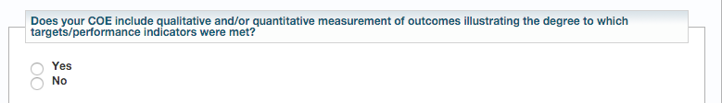
UN Global Compact Reporting
The UN Global Compact Reporting process requires communication on engagements or COEs
Project outcome reports are material to the reporting process and should be provided to whomever submits on behalf of the organization.
Src. The UN Global Compact Submission Dashboard

Slide 43

About GRI Reporting
video

Slide 44

Global Reporting Intiative’s Categories and Aspects
Economic
    Economic Performance
    Market Presence
    Direct Economic impact
Environment
  Materials, energy, water
  biodiversity
  Emissions, waste, transport
  Products and services
  Integral sustainability
Social
    Labor practices and decent work
    Society
    Human Rights
    Product liability
    Ethics
Notes:
Sustainability reporting’ is a broad term considered synonymous with others used to describe reporting on economic, environmental, and social impacts (e.g., triple bottom line, corporate responsibility reporting, etc.). A sustainability report should provide a balanced and reasonable representation of the sustainability performance
Reports can be used for the following purposes, among others:
• Benchmarking and assessing sustainability performance with respect to laws, norms, codes,
performance standards, and voluntary initiatives;
• Demonstrating how the organization influences and is influenced by expectations about sustainable development; and
• Comparing performance within an organization and between different organizations over time. – including both positive and negative contributions.

Slide 45
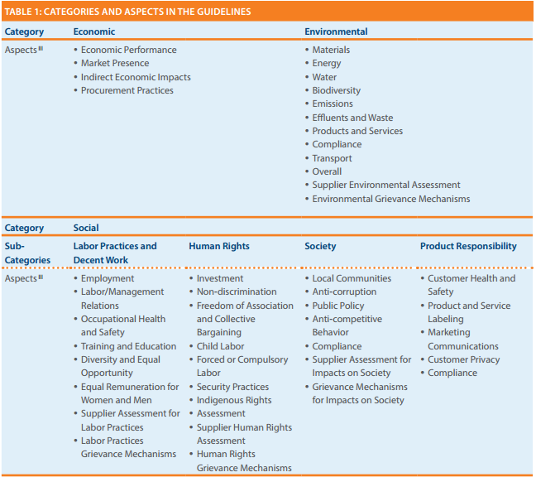
Going Deeper into the G4 GRI
Product Responsability!!
(A little weak)
Notes:
The table in figure is from the 2013 G4 release for GRI reporting.
GRI G4 states “Sustainability reporting is fundamental to an organization’s integrated thinking and reporting process in providing input into the organization’s identification of its material issues, its strategic objectives, and the assessment of its ability to achieve those objectives and create value over time”.
The reporting indicators are primarily structured in pairs, with a Core Indicator seeking disclosure on the processes in place to address the aspect, and an additional Indicator to report on degree of compliance.
The final category “Product Responsibility” includes Customer Health and Safety, Product Labeling, Marketing Communications, Customer Privacy, and Compliance. A more complete approach to sustainability reporting would take into account lifespan and servicing as well as the efficiency and maturity of the product’s design and build process.

Slide 46
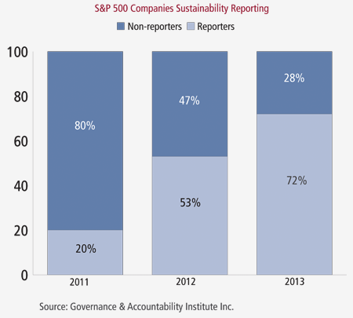
Fortune 500 Companies now Publishing
Sustainability/Responsibility Reports
“We are seeing clear indications over the past three years that senior corporate management understands the importance of adopting and implementing strategies that reflect the rising interest of investors and stakeholders in corporate sustainability,”
- Louis Coppola, executive vice president of G&A Institute.
72%
53%
20%
http://www.complianceweek.com/blogs/the-filing-cabinet/sustainability-reporting-on-the-rise
Notes:
It is no surprise to to see the trend shown here. If the number of CEOs that value sustainability as the way forward is on the rise and therefore reporting is also on the rise it is sure to create positive impacts. The problem is that focused attention in largely in part on supply chains.

Slide 47

The Cobb Salad Report
“These are all worthwhile topics however they are operationally focused and the emphasis needs to focus on what the organization produces from a product and service perspective.”
Timothy Hui. Head of Focal Point GRI for China
Health and Safety
Philanthropy
Carbon Emission Goals
Notes:
This rings loud and clear as when organizations report on sustainability, they look like chopped salads. Timothy Hui, Head of Focal Point GRI for China stated that the volume of reporting is increasing which is positive, however so is the volume of information in each report. Information is submitted on topics such as employee health and safety programs to carbon emission reduction goals to philanthropy initiatives (T. Hui, Presentation, May 27th, 2014). These are all worthwhile topics however they are operationally focused and the emphasis needs to focus on what the organization produces from a product and service perspective.
As of June 25th, 2014, 6,321 organizations having submitted over 15,234 reports to the Global Reporting Initiative alone.

Slide 48
Responsibilities for Business
Understand the SDGs
  Understand and implement the business case
Define Priorities
  Map the value chain to identify impact areas
  Select indicators and collect data
  Define Priorities
Setting Goals
  Define Scope of goals and select Key Performance Indicators (KPIs)
  Define baseline and select goal type
  Set level of ambition
  Announce commitment
Integration
  Anchor goals with the business
  Embed sustainability across all functions
  Engage in partnerships
Reporting and communicating
  Stakeholder Reporting
  UNGC Reporting
  GRI Reporting
Src. SDG Compass

Slide 49
Understanding the business case for sustainability in project management.
Identify future business opportunities
Innovative technologies to increase efficiency
Reduce waste and emissions through sustainable project management practices
Enhancing the value of
corporate sustainability
Younger generations value responsible and inclusive business practices, and sustainability performance is emerging as an important factor in the ‘war for talent’.
Around the world, consumers are increasingly basing their purchasing decisions on their perception of a company’s sustainability
performance, and the SDGs may further
strengthen this trend.
Strengthening stakeholder relations and
keeping pace with policy developments
Improve trust among stakeholders;
Strengthen their license to operate;
Reduce legal, reputational and other
business risks;
Build resilience to costs or requirements imposed by future legislation.
Notes:
As a first step, it’s important to familiarize yourself with the SDGs and understand the opportunities and responsibilities they represent to the business. According to the UN Guiding Principles, it should always be a priority for a company to address all adverse human rights impacts associated with its operations and value chain. Where companies need to prioritize the order in which they address these issues, the UN Guiding Principles make clear that they should do so based first and foremost on the severity of the potential adverse impacts – in other words, how grave these impacts would be, how widespread, and how hard to remedy. Priority should be given to adverse human rights impacts or risk, regardless of the potential cost or benefit to the business.
Nevertheless, there is increasing evidence that risks to human rights frequently converge with risks to business and that this convergence is particularly strong where the most severe human rights impacts are concerned.

Slide 50
Define Priorities: Map the Value Chain
Increasing Positive Impact
Raw materials
Suppliers
Inbound Logistics
Company Operations
Distribution
Product Use
Product End of Life
Minimizing Negative Impact
Notes:
To benefit from the opportunities and challenges presented by the SDGs, defining where your business priorities are will help you to focus efforts. The extent to which an organization's initiatives contribute to each SDG, and the risks and opportunities they individually represent, will ultimately define how successful they will be as more an more, investors are looking at how organization’s put stock in How they do what they do…
NOTE: Not all 17 SDGs will be equally
relevant for your business. The extent to which your company can contribute to each, and the risks and opportunities they individually represent, will depend on many factors.
6. Company identifies as a priority to reduce its negative impact on SDG 6 in its supply chain by working with suppliers to reduce its water consumption in water stressed regions
8. Company identifies as a priority to increase its positive impact on SDG 8 in its operations by providing a living wage to all employees at all sites globally.
11. Company identifies as a priority to decrease its negative impact on SDG 11 in its inbound and outbound logistics by improving road safety for its drivers.
12. Company identifies as a priority to reduce its negative impact on SDG 12 at its products end of life by improving the reusability and recyclability of its products.
13. Company identifies as a priority to increase its positive impact on SDG 13 for use of its products by developing and delivering products that allow customers to reduce their energy use and related GHG emissions.
Later in the course, we will cover P5 which can be used to tie priorities to project activities.

Slide 51
Select Indicators and collect data
Example: A Project to develop water purification tablets has the potential to reduce incidence of water-borne diseases
Inputs
What Resources will be used that could affect an SDG?
Activities
What project activities
will be undertaken?
Outputs
What is created?
Outcomes
Impacts
What does the change initiative do?
What are the changes that occur as a result?
Example
Example
Example
Example
Example
R&D, manufacturing,
marketing spend
($ spent).
Water purification
tablet sales (qualitative description
of marketing and distribution efforts).
Tablets sold (# sold and demographic information regarding consumers
buying the tablets).
Purified water
consumed (% of total water
consumed).
Reduced incidence
of water-borne diseases (% reduction
Vs.pre-sales).
Notes:
Mapping high impact areas will help your company understand where to concentrate its efforts. For each of the areas of potential high impact, identify one or more indicators that most adequately express the relationship between your company’s activities and their impact on sustainable development, so that performance can be tracked over time.
An example will help demonstrate how a Logic
model works. A company that is investing in
the development of water purification tablets has
the potential to reduce incidence of water-borne
diseases, which contributes to SDG Goal 3

Slide 52
Define Priorities
Consider the magnitude, severity, and likelihood of current and potential negative impacts the the project and ourtcome “asset” will have. The importance of such impacts to key stakeholders and the opportunity to strengthen competitiveness through sustainable practices.
Assess the opportunity for your projects to gain advantage from its current or potential positive impacts across the SDGs. (This may include opportunities to innovate, develop new products and solutions or target new market segments.)
Notes:
The company should now have an understanding of its current and potential, negative and positive impacts on sustainable development. The next action is to define your priorities across the SDGs. The two suggestions listed on this page can assist.
Additional considerations include the likelihood that new regulation, standardization, market shortages (of materials or labor), supply chain disruptions, stakeholder pressure or changing market dynamics over time may translate these negative impacts into costs or risks for the company.

Slide 53
Minding the Gap
The Outside In Approach
The Inside Out Approach
By looking at what is needed externally from a global perspective and setting goals accordingly, projects can bridge the gap between current performance (Business as Usual) and Increased performance (Supporting SDGs)
Today’s internally focused approach to goal setting is not enough to address global needs.
SDGs
SDGs
Combined Impact of Project
Objectives
(Most Companies)
GAP
Global Societal Needs
(Where Companies should be)
SDGs
SDGs
Notes:
So… What we need to do is to get organizations to use projects as a mechanism to drive sustainable development (and do so sustainably). In this picture (in red), it shows how most companies look at sustainability as external to how they approach goals and objectives.
Project objectives should be based on business goals that are set based on external societal or global need, based on science and external data, AND benchmarked against the needs of society and how the business can address them.

Slide 54
Understand and share the commitment internally
1. Understanding a company’s goals can be an effective communication tool because they express in simple and practical terms the company’s aspirations on sustainable development.
2. Doing so may inspire and engage the project team and stakeholder. It provides a good basis for constructive dialogue with external stakeholders.

Slide 55
Integrating the SDGS
Corporate Management Strategy 2016
KPI: Contribute to SDG 12
Phasing out harmful* Chemicals in products by 2020
Ensuring that all harmful chemicals are identified and phased out where possible, and alternatives identified by year ending 2016
Project Governance
Actions
Operations Management
Phase in governance for projects and programs in 2016 to ensure that when harmful chemicals are required, alternative materials are sourced.
Identify and phase out where possible all harmful chemicals in purchased products and components by year ending 2016.
Actions
Actions
Project Level Action
Op. Mgmt. Action
Identify alternative materials for all identified harmful chemicals in products and components under responsibility by year 2016
Ensure all supply
accounts comply with
purchasing policy on
harmful chemicals by
year ending 2016.
* Harmful chemicals as identified with input from internal and external experts, which go beyond those that are prohibited by law
Notes:
As an outcome of goal setting, you will have identified specific KPIs and set goals for each of your company’s strategic priorities. Integrating sustainability into the core business and embedding targets\ across functions is fundamental towards addressing these goals.
Although dedicated sustainability teams and professionals can play an important role in achieving the company’s sustainability goals, the support and ownership of corporate functions such as R&D, Project Management, Business Development, Supply Management, Operations and Human Resources are the key to embedding sustainability in business strategy, culture and operations, and products.

Slide 56
Reporting
The GRI is a pioneering nonprofit propose a framework for sustainability reporting.
Companies use this report to inform its shareholders and consumers through their performance of economic, social and environmental
Learn more at www.globalreporting.org
GPM Global
Notes:
Global Reporting Initiative (GRI) is an organization whose purpose is to promote the development of sustainability reporting in all types of organizations. GRI produces a comprehensive framework for the preparation of Sustainability Reports, which are widely used worldwide. The Framework, including the Guide for the preparation of reports, sets out the principles and indicators that organizations can use to measure and disclose their economic, environmental and social. GRI is committed to continuously improving and increasing the use of these Guidelines, which are available to the public for free. ? GRI is a nonprofit organization with multiple stakeholders. It was founded by CERES and the United Nations Program for Environment (UNEP) in 1997 in the United States. In 2002, GRI moved its offices to Amsterdam, where he is currently its Secretariat. GRI has regional offices ("Focal Points") in Australia, Brazil, China, India and the United States, and also has a network of more than 30,000 people worldwide

Slide 57
UN Global Compact Reporting
The UN Global Compact Reporting process requires communication on engagements or COEs
Project outcome reports are material to the reporting process and should be provided to whomever submits on behalf of the organization.
Src. The UN Global Compact Submission Dashboard

Slide 58
About GRI Reporting
video

Slide 59
Global Reporting Intiative’s Categories and Aspects
Economic
    Economic Performance
    Market Presence
    Direct Economic impact
Environment
  Materials, energy, water
  biodiversity
  Emissions, waste, transport
  Products and services
  Integral sustainability
Social
    Labor practices and decent work
    Society
    Human Rights
    Product liability
    Ethics
Notes:
Sustainability reporting’ is a broad term considered synonymous with others used to describe reporting on economic, environmental, and social impacts (e.g., triple bottom line, corporate responsibility reporting, etc.). A sustainability report should provide a balanced and reasonable representation of the sustainability performance
Reports can be used for the following purposes, among others:
• Benchmarking and assessing sustainability performance with respect to laws, norms, codes,
performance standards, and voluntary initiatives;
• Demonstrating how the organization influences and is influenced by expectations about sustainable development; and
• Comparing performance within an organization and between different organizations over time. – including both positive and negative contributions.

Slide 60
Going Deeper into the G4 GRI
Product Responsability!!
(A little weak)
Notes:
The table in figure is from the 2013 G4 release for GRI reporting.
GRI G4 states “Sustainability reporting is fundamental to an organization’s integrated thinking and reporting process in providing input into the organization’s identification of its material issues, its strategic objectives, and the assessment of its ability to achieve those objectives and create value over time”.
The reporting indicators are primarily structured in pairs, with a Core Indicator seeking disclosure on the processes in place to address the aspect, and an additional Indicator to report on degree of compliance.
The final category “Product Responsibility” includes Customer Health and Safety, Product Labeling, Marketing Communications, Customer Privacy, and Compliance. A more complete approach to sustainability reporting would take into account lifespan and servicing as well as the efficiency and maturity of the product’s design and build process.

Slide 61
Fortune 500 Companies now Publishing
Sustainability/Responsibility Reports
“We are seeing clear indications over the past three years that senior corporate management understands the importance of adopting and implementing strategies that reflect the rising interest of investors and stakeholders in corporate sustainability,”
- Louis Coppola, executive vice president of G&A Institute.
72%
53%
20%
http://www.complianceweek.com/blogs/the-filing-cabinet/sustainability-reporting-on-the-rise
Notes:
It is no surprise to to see the trend shown here. If the number of CEOs that value sustainability as the way forward is on the rise and therefore reporting is also on the rise it is sure to create positive impacts. The problem is that focused attention in largely in part on supply chains.

Slide 62
The Cobb Salad Report
“These are all worthwhile topics however they are operationally focused and the emphasis needs to focus on what the organization produces from a product and service perspective.”
Timothy Hui. Head of Focal Point GRI for China
Health and Safety
Philanthropy
Carbon Emission Goals
Notes:
This rings loud and clear as when organizations report on sustainability, they look like chopped salads. Timothy Hui, Head of Focal Point GRI for China stated that the volume of reporting is increasing which is positive, however so is the volume of information in each report. Information is submitted on topics such as employee health and safety programs to carbon emission reduction goals to philanthropy initiatives (T. Hui, Presentation, May 27th, 2014). These are all worthwhile topics however they are operationally focused and the emphasis needs to focus on what the organization produces from a product and service perspective.
As of June 25th, 2014, 6,321 organizations having submitted over 15,234 reports to the Global Reporting Initiative alone.

Slide 63

Example LEDtek
Principle | Commitment | Project | Considerations
9. and encourage the development and diffusion of environmentally friendly technologies. | Our organization has committed to reducing dependency on fossil fuels | Design and installation of cost effective aerial security lighting for Mbabane Shanty Towns | The balancing of these imperatives highlighted the overall integrated linkage between social, environmental. Alternative lighting sources were trailed by were not able to meet the criteria of lighting levels delivered on the ground. LEDtek attention to managing the aspects of the design phase, with particular emphasis on the incorporation of sustainability methodologies as per PRiSM, combined to produce the effective outcome of the project, meeting all the criteria.
Notes:
Projects are material to non-financial reporting. Aligning the project to the organization’s commitment in correlation with the ten principles provides a greater and more complete picture of “what” the company does which is what the true spirit of reporting.

Slide 64
GPM’s Non Financial Report (UNGC)
Principle | Committment | Systems and Principles | Services
Human Rights
1. Businesses should support and respect the protection of internationally proclaimed human rights; 2. and make sure that they are not complicit in human rights abuses. | GPM Global, our partners and suppliers recognize that human rights are an integral part of corporate citizenship. We respect, support and advocate the Universal Declaration of Human Rights and the Guiding Principles on Business and Human Rights: Implementing the United Nations' Protect, Respect and Remedy Framework’. GPM Global has a Human Rights Statement, in line with international best practice. | GPM Global Human Rights Statement GPM Global Core Principles GPM Global Supplier and Partner Code of Conduct The GPM Global P5 Standard for Sustainability in Project Management The GPM Reference Guide to Sustainability in Project Management | Portfolio, Program, & Project Management Sustainability and Materiality Assessments (PSM3) Projects integrating Sustainable Methods (PRiSM) Project Methodology PRiSM Training
Labor Standards
3. Businesses should uphold the freedom of association and the effective recognition of the right to collective bargaining; 4. the elimination of all forms of forced and compulsory labor; 5. the effective abolition of child labor; | GPM Global, our partners and suppliers do not use forced, compulsory or child labor. GPM Global, our partners and suppliers support freedom of association and recognize the right to collective bargaining. | GPM Global Human Rights Statement GPM Global Core Principles The GPM Global P5 Standard for Sustainability in Project Management The GPM Reference Guide to Sustainability in Project Management | Portfolio, Program, & Project Management Sustainability and Materiality Assessments (PSM3) Projects integrating Sustainable Methods (PRiSM) Project Methodology PRiSM Training
https://www.unglobalcompact.org/participation/report/cop/create-and-submit/detail/202031
Notes:
Materiality should tie to what the business does and include governance policies that are available for public viewing. Find our full report on the UN Global Compact Website under “GPM Global” and COE

Slide 65
Corporations get it (sort of).
The UN Global Compact comprises of 8,000 companies +4,000 non-businesses
  All must communicate on progress of HOW they put the ten principles into practice.
  (almost) none of them see the materiality of projects to their strategy.
  50% are delisted for not reporting.
The Global Reporting Initiative
  2015 saw a 28% increase in reports compared to 2014 with a total of 19,192 as of July
Notes:
What is encouraging is that the number of organizations who put stock in sustainability is increasing. This will require all aspects of business to evolve. I point out that 50% are delisted for not reporting on progress which is alarming.
As I mentioned earlier, we are a social enterprise so reporting is required and we just published our report two days ago.

Slide 66

Climate Change
video

Slide 67
Climate Change
From 1880 to 2012, average global temperature increased by 0.85°C. To put this into perspective, for each 1 degree of temperature increase, grain yields decline by about 5 per cent. Maize, wheat and other major crops have experienced significant yield reductions at the global level of 40 megatons per year between 1981 and 2002 due to a warmer climate.
Oceans have warmed, the amounts of snow and ice have diminished and sea level has risen. From 1901 to 2010, the global average sea level rose by 19 cm as oceans expanded due to warming and ice melted. The Arctic’s sea ice extent has shrunk in every successive decade since 1979, with 1.07 million km² of ice loss every decade
Given current concentrations and on-going emissions of greenhouse gases, it is likely that by the end of this century, the increase in global temperature will exceed 1.5°C compared to 1850 to 1900 for all but one scenario. The world’s oceans will warm and ice melt will continue. Average sea level rise is predicted as 24 – 30cm by 2065 and 40-63cm by 2100. Most aspects of climate change will persist for many centuries even if emissions are stopped
Global emissions of carbon dioxide (CO2) have increased by almost 50 per cent since 1990
Emissions grew more quickly between 2000 and 2010 than in each of the three previous decades
It is still possible, using a wide array of technological measures and changes in behavior, to limit the increase in global mean temperature to two degrees Celsius above pre-industrial levels
Major institutional and technological change will give a better than even chance that global warming will not exceed this threshold
Notes:
Every country in the world is seeing the drastic effects of climate change, some more than others. On average, the annual losses just from earthquakes, tsunamis, tropical cyclones and flooding count in the hundreds of billions of dollars. We can reduce the loss of life and property by helping more vulnerable regions—such as land-locked countries and island states—become more resilient. The impact of global warming is getting worse. We’re seeing more storms, more droughts and more extremes than ever before. It is still possible, with political will and technological measures, to limit the increase in global mean temperature to two degrees Celsius above pre-industrial levels—and thus avoid the worst effects of climate change. The Sustainable Development Goals lay out a way for countries to work together to meet this urgent challenge.

Slide 68
Executives on Climate Change
Just as we drive product innovations, we also further develop our own production processes. Since 1990, we have reduced the greenhouse gas
intensity of our production by 74%.
In order to continue on this path, we just set ourselves the new corporate target to implement energy efficiency management systems at all our production sites by 2020.
However, we have to realize that the technological improvement of existing processes has physical limits. That is why we are also looking for disruptive innovations for our production processes.
Kurt Bock CEO, BASF

Slide 69
Executives On Climate Change
80%
77%
74%
Climate change will create opportunities for growth and innovation for my company in the next 3 - 5 years
My company is already seeing rewards from our investments in low-carbon solutions
Action on climate change is an urgent priority for my business
Data based on survey of 75 CEOs of Caring for Climate participant companies; data represents proportion of respondents selecting “agree” and “strongly agree”.
Notes:
Amid the commitment of CEOs to tackling the global climate challenge is a clear message to governments and policymakers. With one-third reporting that current policy and regulation is hindering their company from investing in low-carbon solutions, fully 87% of CEOs believe that the long-term agreement made in Paris is critical in unlocking private sector investment in addressing the climate challenge.

Slide 70
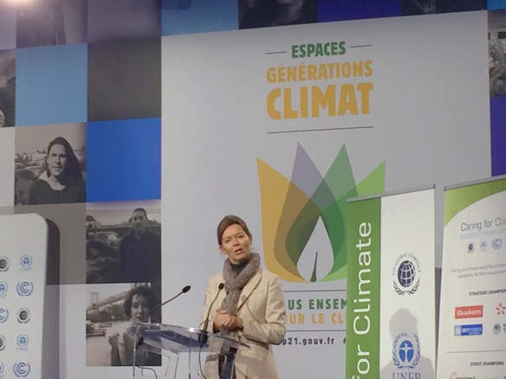

Paris Agreement
Strengthen resilience and adaptive capacity to climate-related hazards and natural disasters in all countries
Integrate climate change measures into national policies, strategies and planning
Improve education, awareness-raising and human and institutional capacity on climate change mitigation, adaptation, impact reduction and early warning
Implement the commitment undertaken by developed-country parties to the United Nations Framework Convention on Climate Change to a goal of mobilizing jointly $100 billion annually by 2020 from all sources to address the needs of developing countries in the context of meaningful mitigation actions and transparency on implementation and fully operationalize the Green Climate Fund through its capitalization as soon as possible
Promote mechanisms for raising capacity for effective climate change-related planning and management in least developed countries and small island developing States, including focusing on women, youth and local and marginalized communities
Lise Kingo, UN Global Compact Executive Director Speaking at COP21

Slide 71
Status Update from Paris
Setting emissions reduction targets is now common practice for business:
80% of the world’s 500 LARGEST COMPANIES reported targets to CDP in 2014.
However, most of them are not sufficient to meet the threat posed by climate change and keep warming below 2°C.
Notes:
The science tells us that we must cut global greenhouse gas emissions by up to 70% by 2050 to limit global warming to 2°C and avert catastrophic and irreversible climate change.
This will require global transformational change. Never before have there been methodologies to support companies to keep their emissions aligned with planetary boundaries.
Using science-based targets is an ambitious approach and leading companies have now started to take an “outside-in” approach to goal setting.

Slide 72
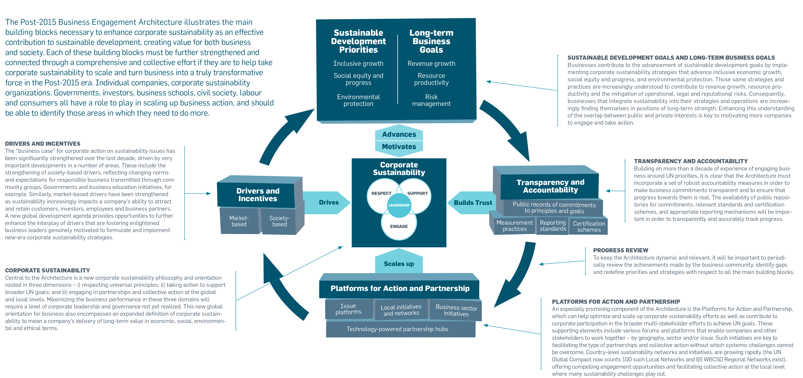
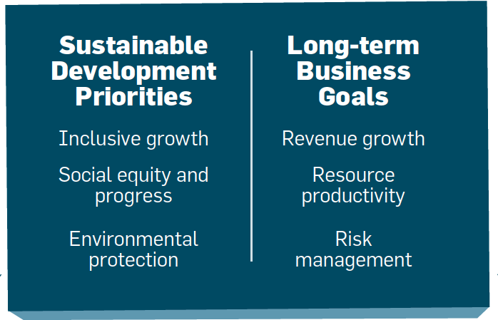

POST-2015 BUSINESS ENGAGEMENT ARCHITECTURE
Notes:
Facilitator – This slide is important but only from a high level. Highlight the fact that each building block is supposed to support forward progress towards business inclusion.
This model is a good from a high level, but what is missing are specific actionable items. GPM’s approach meets all of the requirements for this framework, including certification schemes under Transparency and Accountability. In this course, participants will learn how to naturally (holistically) put it into practice.

Slide 73

Essentially
• Leverage channels to communicate corporate sustainability performance to investors and, where relevant, adopt a responsible investment policy for corporate pension funds;
• Undertake sustainability due-diligence and set clear expectations before signing partnership contracts in order to encourage partners throughout the value chain to uphold minimum standards and advance sustainable practices;
• Intensify engagement in issue platforms and sector initiatives in order to scale-up and advance business engagement on sustainability issues and, as relevant, help overcome systemic challenges;
• Engage in local networks and initiatives, actively sharing best practice and learnings with local business community and providing operational support and resources, as appropriate;
• Engage in partnerships with other businesses and stakeholders that can have transformative impacts – moving beyond an ad-hoc project focus.
-RUN YOUR BUSINESS
-DO NO HARM
-MAKE THE WORLD A BETTER PLACE

Slide 74
Where do we fit in?
“
I guarantee that within four years, the marketplace will have changed from within because sustainability and its reality is becoming a transformative force.
...finally, asset managers are waking up to the basic reality that sustainability pays off.
Long term financial success can only be assured if companies also good on governance, on social behavior, and environmental stewardship.
Failure on any of these three pillars will make it impossible for companies to sustain success over time or to become successful.
Georg Kell,
Former UN Global Compact Executive Director
June 25th 2015
Notes:
We deliver the assets… If asset owners are waking up, we will have to drive.

Slide 75
We must move beyond this.
TIME
QUALITY
COST
SCOPE

Slide 76
To this.
SOCIAL
RISK
VALUE
TIME
PERFORMANCE
&
QUALITY
ECONOMIC
ENVIRONMENTAL
COST
SCOPE
BENEFITS
PROCESS & PRODUCTS

Slide 77
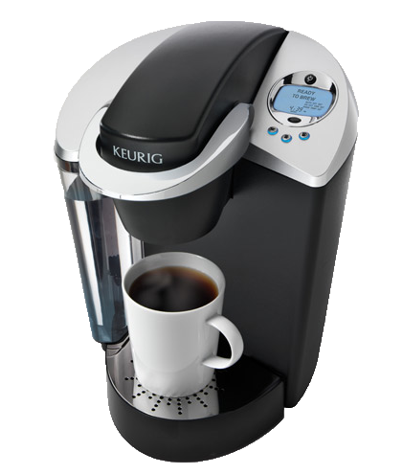

Success and Failures
In 2013, Green Mountain produced 8.3 billion K-Cups, enough to wrap around the equator 10.5 times.
Only five percent of its current cups are made out of recyclable plastic. (Don‘t buy any more K-cups until 2020)
Success or Failure?

Slide 78



Success and Failures
Nespresso Capsules are Aluminum
In many countries Nestle has setup pod
recycling centres to collect them so they can create new pods.
Success or Failure?

Slide 79
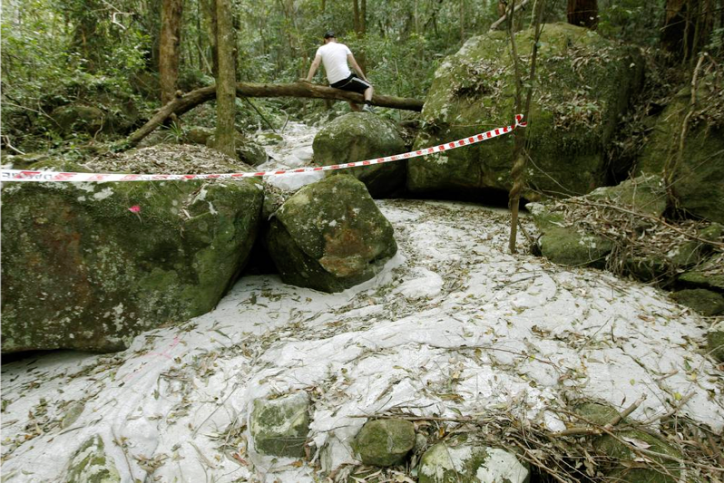

Success and Failures
Success or Failure?
Sugarloaf Colorado, USA
Workers Grouted the Coal Mine to fix cracks as a project to not impact the nature preserve that was adjacent to the mine.
Natural waterways absorbed the grout and created a concrete river in a nature reserve.
A massive fracture running up the hillside. Photo: Darren Pateman
Notes:
A large section of Sugarloaf State Conservation Area in the lower Hunter has been destroyed by massive subsidence from Glencore's West Wallsend Colliery.
A Fairfax Media investigation has uncovered cliff faces crumbled or collapsed, a waterway destroyed, large cracks opened in the earth and a huge collapse of a hillside.
Damage was tracked over more than two kilometres within the ecologically sensitive conservation area adjacent to the mine's Longwall 41.
In one area a cliff face fall of more than 20 metres was discovered.
Damage was cause by unplanned subsidence from longwall mining by West Wallsend Colliery that is mining beneath 23 per cent of the conservation area.
Fairfax Media can also reveal that in June this year a waterway was accidentally grouted by workers carrying out remediation works in the reserve.
Grouting in one of the cracks. Photo: Darren Pateman
A spokesman for the Office of Environment and Heritage confirmed grouting material, used to fill mine subsidence cracks and holes, leaked into a ''drainage line'' and the colliery had been ordered to ''clean up the site''.
Read more: http://www.smh.com.au/nsw/mine-subsidence-devastates-sugarloaf-conservation-area-20130828-2spuc.html#ixzz3D7KkWUy2

Slide 80
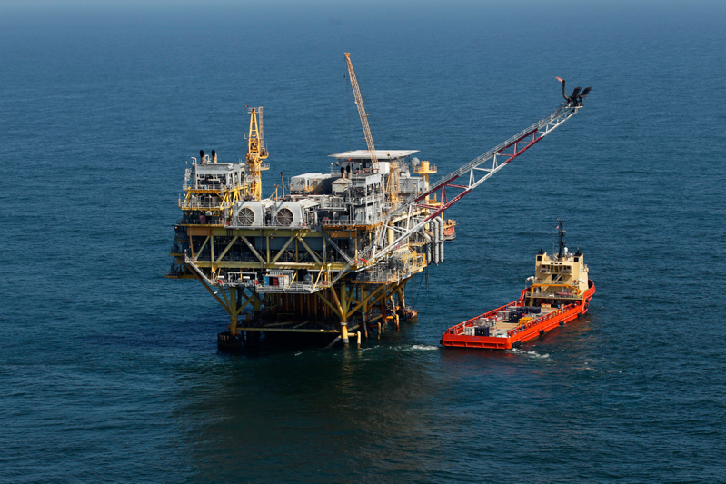

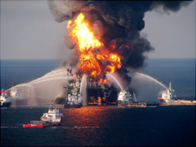
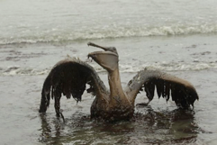
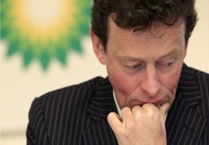
Success and Failures
Success or Failure?
Deep Water Horizon, USA
an ultra-deepwater, dynamically positioned, semi-submersible offshore oil drilling rig - Gulf of Mexico
Deep Water Horizon, USA
$20,000,000,000 USD in Fines
Or
734,60,000,000 AED

Slide 81
What are we up against?
Understanding the language
Topic legitimacy “is it our problem”
Prevailing mindsets and attitudes.
Eliminating the Silo mentality
Practical Tools
Organizational Capacity for Change
Aligning the challenges to Strategic Business goals

Slide 82
We have covered
Sustainability Challenges
UN Global Compact
Sustainable Development Goals
Global Reporting Initiative
PRME
Post-2015 Business Engagement Architecture

Slide 83
Systems Thinking
Release 6

Slide 84
Systems Thinking
Module 3 | Module Covers | Learning outcomes
Systems Thinking | What is Systems Thinking ISO standards and how to use them. ISO 14000 Series on Environmental Management ISO 26000 Corporate Social Responsibility ISO 14000 Series on Environmental Management ISO 9000 Quality Management ISO 50001 Energy Management ISO 55000 Asset Management | This module covers a critical aspect of sustainable change delivery by explaining a thinking versus the traditional “input/output” approach
Version
6.0

Slide 85
The GPM Sustainability Services Focus
Organizations are locked on process and output…
GPM encourages focus on the overall corporate system and benefits / strategic objectives… delivering real value for the business and customers!

Slide 86

What is a System?
A system is a set of parts that interact and affect each other, thereby creating a larger whole of complex thing.
Notes:
Let's start with a simple example from nature: the Earth. Our planet is a very complex system consisting of atmosphere, water, mountains, plains, jungles, plants, insects, animals, humans and our technological wonders, just to name a few. A scientist may look at many interactions of these parts in researching climate change. General patterns may be found in these interactions that may help explain the system and find solutions to the problems by changing the patterns of interaction between the parts.
Now, let's apply the idea of a system to business. We'll start small and work our way up. A business is a system consisting of many parts: employees, management, capital, equipment, and products, among others. Your business and your competitors comprise a system, which we may call an industry. Different industries, along with consumers, governments, and non-governmental organizations make up our economic system.
http://education-portal.com/academy/lesson/systems-thinking-in-management-definition-theory-model.html

Slide 87
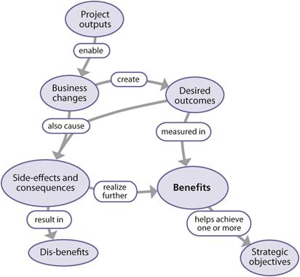
Output vs. Benefit
Output
  The deliverable, or output developed by a project from a planned activity.
Capability
  The completed set of project outputs required to deliver an outcome; exists prior to transition.
Outcome
  A new operational state achieved after transition of the capability into live operations.
Benefit
  The measurable improvement resulting from an outcome perceived as an advantage by one or more stakeholders, which contributes towards one or more organizational objectives.
Relationship between outputs, outcomes and benefits, The Office of Government Commerce (2009-07-15). Managing Successful Projects with PRINCE2™ 2009 Edition, Kindle Edition.

Slide 88


Why we encourage this?
Many Project Managers focus on project inputs and outputs rather than value and benefit to the overall system. This is the same as focusing on a single drop of water. If we pollute it, no big deal. It is only one drop…
That’s a lot of water… Over 20,000,000
Project Managers globally
Notes:
We just covered a lot. Time for a quick break.

Slide 89

Getting to Know ISO Standards

Slide 90

ISO standards
Guidelines and Standards
Guidelines
ISO 26000 - CSR
ISO 21500 – Project Management
Normative Standards
ISO 9000 – Quality Management
ISO 14000 - Environmental
ISO 50001- Energy Management
ISO 55000 – Asset Management
Notes:
What are the benefits of ISO International Standards?
We cover ISO Standards that pertain to sustainability as they are important in understanding the principles and approach that project managers should take to ensure quality, benefits and value.
ISO International Standards ensure that products and services are safe, reliable and of good quality. For business, they are strategic tools that reduce costs by minimizing waste and errors and increasing productivity. They help companies to access new markets, level the playing field for developing countries and facilitate free and fair global trade. (ISO.org)
There are two kinds. Guidelines and normatives….

Slide 91

What ISO 26000 is NOT…
A management system standard.
Intended or appropriate for certification purposes or regulatory or contractual use.
Intended to provide a basis for legal actions, complaints, defenses or other claims in any international, domestic or other proceeding.
Intended to be cited as evidence of the evolution of customary international law.
Intended to prevent the development of national standards that are more specific, more demanding, or of a different type.

Slide 92
What ISO 26000 is…
Intended to assist organizations in contributing to Sustainable Development.
Intended to promote common understanding in the field of Social Responsibility.
Intended to complement other instruments & initiatives for Social Responsibility and not to replace them.
Intended to provide organizations with guidance concerning Social Responsibility and can be used as part of public policy activities.
Notes:
ISO 26000 contains no requirements and therefore the word “shall”, which indicates a requirement in ISO language, is not used
But does contain 386 “should”s

Slide 93
ISO 26000
Principles of Social Responsibility
Accountability
  Businesses are expected to be accountable for its impacts on society & the environment
Transparency
  Businesses are expected to be transparent in its decisions & activities that impact on society & the environment.
Ethical Behavior
  Businesses are expected to behave ethically at all times.
Stakeholder Interests
  Businesses are expected respect, consider & respond to the interests of its stakeholders.
Rule of Law
  Businesses are expected to abide by the rule of law for that region and or country.
International Norms of Behavior
  Businesses are expected to respect international norms of behavior, while adhering to the principle of respect for the rule of law.

Slide 94
ISO 26000
Principles of Social Responsibility
Respect for Human Rights
  An organization should: respect and, where possible, promote the rights set out in the International Bill of Human Rights;
  respect the universality of these rights, that is, that they are indivisibly applicable in all countries, cultures and situations;
  in situations where human rights are not protected, take steps to respect human rights and avoid taking advantage of these situations; and
  in situations where the law or its implementation does not provide for adequate protection of human rights, adhere to the principle of respect for international norms of behavior.

Slide 95
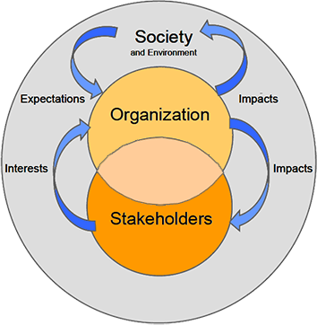
ISO 26000
Principles of Social Responsibility
Recognizing Social Responsibility - Impacts, Interests, and Expectations In addressing its social responsibility an organization should understand three relationships
Between the organization and society - An organization should understand and recognize how its decisions and activities impact on society and the environment. An organization should also understand society's expectations of responsible behavior concerning these impacts. This should be done by considering the core subjects and issues of social responsibility
Between the organization and its stakeholders - An organization should be aware of its various stakeholders. These are the individuals or groups whose interests could be affected by the decisions and activities of the organization
Between the stakeholders and society An organization should understand the relationship between the stakeholders' interests that are affected by the organization, on the one hand, and the expectations of society on the other.
Figure - Relationship between an organization, its stakeholders and society
Notes:
The recognition of social responsibility involves identifying the issues raised by the impacts of an
organization's decisions and activities, as well as the way these issues should be addressed so as to
contribute to sustainable development.
The recognition of social responsibility also involves the recognition of an organization's stakeholders. As
described in earlier is a basic principle of social responsibility is that an organization should respect and consider
the interests of its stakeholders that will be affected by its decisions and activities.

Slide 96

ISO 14000 Family
A series of guidance documents and standards to help organizations address environmental issues.
These ISO’s below deal with Environmental Management Systems (EMS)
  14001: Environmental Management Systems
  14004: EMS general guidelines
  14010: Guidelines for Environmental Auditing
  14011: Guidelines for Auditing of an EMS
  14012: Auditing - Qualification criteria
  14064: Greenhouse gases
Notes:
ISO 14004 is guidance on how to implement ISO 14001
10, 11, and 12 relate to auditing of the 14001 standard. I would note here that a new joint auditing standard is currently being developed that will eventually replace 14010, 14011, and 14012. This new standard ISO 19011 is an auditing standard that may be used for both ISO 9000 and ISO 14001.
ISO 14064-1:2006
Greenhouse gases -- Part 1: Specification with guidance at the organization level for quantification and reporting of greenhouse gas emissions and removals

Slide 97
What is the Environment?
Environment: Surroundings in which an organization operates, including air, water, soil, natural resources, flora, fauna, humans and their interrelation. (ISO 14001:2015)

Slide 98
ISO 14001:2015 Key Elements
  Context of the Organization
    Understanding the organization and its context
    Understanding the needs and expectation of interested parties
    Understanding the scope of the environmental management system
    Environmental management system
  Leadership
    Leadership and commitment
    Environmental policy
    Organizational roles, responsibilities and authorities
  Planning
    Actions to address risks and opportunities
    Environmental objectives and planning to achieve them
  Support
    Resources
    Competence
    Awareness
    Communication
    Documented information
  Operation
    Operational planning and control
    Emergency preparedness and response
  Performing Evaluation
    Monitoring, measurement, analysis and evaluation
    Internal Audit
    Management review
  Improvement
    General
    Nonconformity and corrective action
    Continual Improvement
Notes:
According to ISO 14001:2015
Introduction
Achieving a balance between the environment, society and the economy is considered essential to meet the needs of the present without compromising the ability of future generations to meet their needs. Sustainable development as a goal is achieved by balancing the three pillars of sustainability.
Societal expectations for sustainable development, transparency and accountability have evolved with increasingly stringent legislation, growing pressures on the environment from pollution, inefficient use of resources, improper waste management, climate change, degradation of ecosystems and loss of biodiversity.
This has led organizations to adopt a systematic approach to environmental management by implementing environmental management systems with the aim of contributing to the environmental pillar of sustainability.
Aim of an environmental management system
The purpose of this International Standard is to provide organizations with a framework to protect the environment and respond to changing environmental conditions in balance with socio-economic needs. It specifies requirements that enable an organization to achieve the intended outcomes it sets for its environmental management system.
A systematic approach to environmental management can provide top management with information to build success over the long term and create options for contributing to sustainable development by:
— protecting the environment by preventing or mitigating adverse environmental impacts;
— mitigating the potential adverse effect of environmental conditions on the organization;
— assisting the organization in the fulfilment of compliance obligations;
— enhancing environmental performance;
— controlling or influencing the way the organization's products and services are designed, manufactured, distributed, consumed and disposed by using a life cycle perspective that can prevent environmental impacts from being unintentionally shifted elsewhere within the life cycle;
— achieving financial and operational benefits that can result from implementing environmentally sound alternatives that strengthen the organization’s market position;
— communicating environmental information to relevant interested parties

Slide 99
What is an EMS?
Systematic way of managing an organization’s environmental affairs
Based on Plan-Do-Check-Act Model (PDCA)
Focused on Continual Improvement of system
Addresses immediate and long-term impact of an organization’s products, services and processes on the environment.
A tool to improve environmental performance
Notes:
I introduce the term “PDCA” here
I often use the term “activities, products, and services” here and reference the standard’s use of these terms

Slide 100
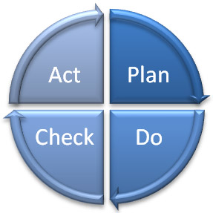
What is an EMS?
Deming Model - PDCA
Management
Review
Planning
Checking
Corrective Action
Implementation
Notes:
The steps in each successive PDCA cycle are:
PLAN Establish the objectives and processes necessary to deliver results in accordance with the expected output (the target or goals). By establishing output expectations, the completeness and accuracy of the specification is also a part of the targeted improvement. When possible start on a small scale to test possible effects.
DO Implement the plan, execute the process, make the product. Collect data for charting and analysis in the following "CHECK" and "ACT" steps.
CHECK Study the actual results (measured and collected in "DO" above) and compare against the expected results (targets or goals from the "PLAN") to ascertain any differences. Look for deviation in implementation from the plan and also look for the appropriateness and completeness of the plan to enable the execution, i.e., "Do". Charting data can make this much easier to see trends over several PDCA cycles and in order to convert the collected data into information. Information is what you need for the next step "ACT".
ACT Request corrective actions on significant differences between actual and planned results. Analyze the differences to determine their root causes. Determine where to apply changes that will include improvement of the process or product. When a pass through these four steps does not result in the need to improve, the scope to which PDCA is applied may be refined to plan and improve with more detail in the next iteration of the cycle, or attention needs to be placed in a different stage of the process.

Slide 101
Why Do Organizations Implement an EMS ?
Helps to identify the causes of environmental problems.
  better to make a product right the first time
  cheaper to prevent a spill or other accident
  cost effective to prevent pollution
Trade and competitive issues
  Inconsistency in environmental regulation and enforcement
Many individual parts may already be in place – just need to unify under the EMS umbrella!
??Why should a project manager be familiar with the EMS?

Slide 102

ISO 50001: 2011 Energy Management Systems
ISO 50001 gives organizations the requirements for energy management systems (EnMS)
Provides a framework for
  Industrial plants
  Commercial
  Institutional and governmental facilities
  Entire organizations to manage energy
Notes:
ISO 50001 establishes a framework for industrial plants ; commercial, institutional, and governmental facilities ; and entire organizations to manage energy.
Targeting broad applicability across national economic sectors, it is estimated that the standard could influence up to 60 % of the world’s energy use.*
* This estimate is based on information provided in the section, “ World Energy Demand and Economic Outlook ”, in the International Energy Outlook 2010, published by the US Energy Information Administration. This cites 2007 figures on global energy consumption by sector, including 7 % by the commercial sector (defined as businesses, institutions, and organizations that provide services), and 51 % by the industrial sector, (including manufacturing, agriculture, mining, and construction). As ISO 50001 is primarily targeted at the commercial and industrial sectors, adding the above figures provides an approximate total of 60 % of global energy demand on which the standard could have a positive impact.

Slide 103
ISO 50001: 2011 Energy Management Systems
ISO 50001 — Why is it important ?
1. Improved energy performance can provide rapid benefits for an organization by maximizing the use of its energy sources and energy-related assets, thus reducing both energy cost and consumption.
2. The organization will also make positive contributions toward reducing depletion of energy resources and mitigating worldwide effects of energy use, such as global warming.
Notes:
ISO 50001 — Why is it important?
Energy is critical to organizational operations and can be a major cost to organizations, whatever their activities. An idea can be gained by considering the use of energy through the supply chain of a business, from raw materials through to recycling.
In addition to the economic costs of energy to an organization, energy can impose environmental and societal costs by depleting resources and contributing to problems such as climate change.
The development and deployment of technologies for new energy sources and renewable sources can take time.
Individual organizations cannot control energy prices, government policies or the global economy, but they can improve the way they manage energy in the here and now. Improved energy performance can provide rapid benefits for an organization by maximizing the use of its energy sources and energy-related assets, thus reducing both energy cost and consumption. The organization will also make positive contributions toward reducing depletion of energy resources and mitigating worldwide effects of energy use, such as global warming.
ISO 50001 is based on the management system model that is already understood and implemented by organizations worldwide. It can make a positive difference
for organizations of all types in the very near future, while supporting longer term efforts for improved energy technologies.

Slide 104
ISO 50001: 2011 Energy Management Systems
Primary Energy Sources
  Renewable: Solar, Water, Wind, Biomass
  Non-Renewable: Oil, Gas, Carbon and Nuclear fusion
Secondary Energy
  Electric, mechanic, Thermic, Hot water, Compressed Air, Biodiesel and Fuel in general
Final Use
  Lighting, Refrigeration, Heating, Process, etc.

Slide 105

Principles of Quality Management (ISO 9001:2015)
These principles embodied in ISO 9001 have been developed with the intention that management can lead the organization towards improved performance.
Customer Focus
Leadership
Engagement of people
Process approach
Improvement
Evidence-based decision making
Relationship management
Look for this again during Project Quality Management!
Notes:
Source: http://www.iso.org/iso/iso_9001-2015_-_how_to_use_it.pdf

Slide 106
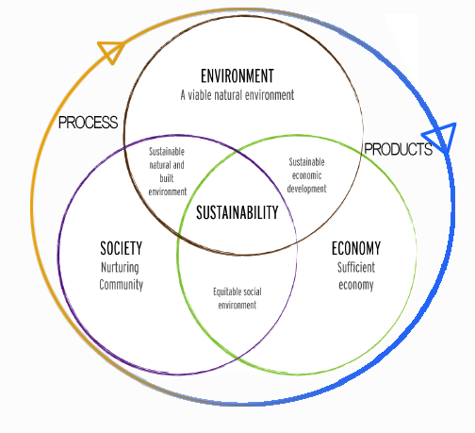
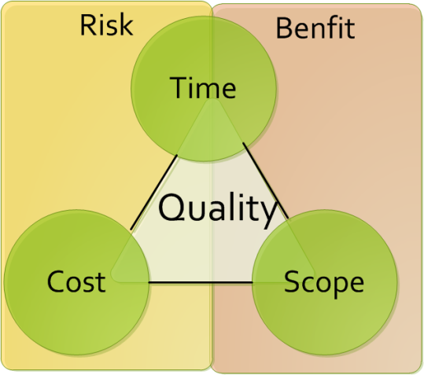
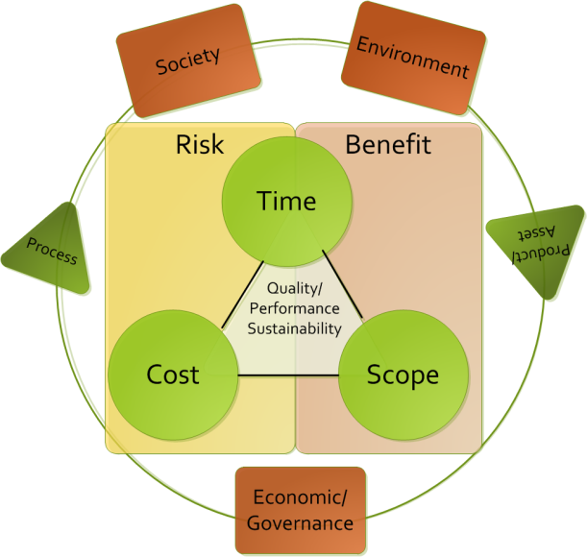
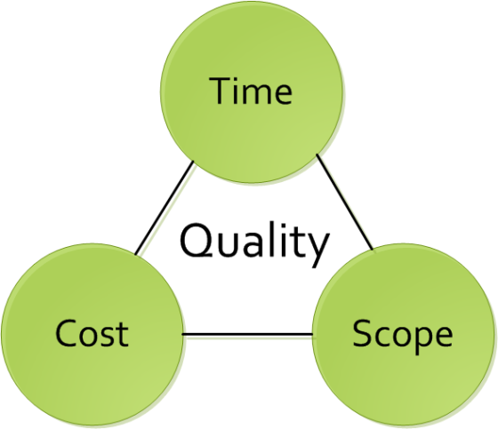
The Current PM Challenge
Many project managers are locked onto focusing on the traditional Time / Cost / Scope paradigm (if lucky they take into account quality)
Successful project managers focus on time, cost, quality, scope, benefits and risk
Exceptional project managers also take into account the other triple constraint… Though the key questions for organizations is how to facilitate this?

Slide 107

Internal Audits
Definitions (ISO 9000:2005)
"A systematic, independent and documented process for obtaining audit evidence of
Audit Evidence: Records, statements of fact or other information relevant to the audit criteria and verifiable
... And evaluating it objectively to determine the extent to which they meet the criteria for audit “
Audit Criteria: A set of policies, procedures or requirements.
(They are used as a benchmark against which we compare the evidence of the audit)

Slide 108
Internal Audits
Audit Principles
  Ethical conduct: trust, integrity, confidentiality, and discretion.
  Fair Presentation: report truthfully and accurately
  Professional Care: Application of the audit. Necessary competence.
  Independence: the basis for the impartiality and objectivity of the conclusions.
Notes:
What is the Purpose of an Audit?
What are the stages of an Audit?
- Preparation, Execution, and Monitoring Report

Slide 109
What is ISO 55000?
The International Standard that is used for managing physical assets in particular, but can also be applied to other asset types.
Project managers must be responsible for the entire asset lifecycle and therefor understand how the asset (product) will be managed after it leaves the project lifecycle
55000

Slide 110
What is Asset Management
The factors which influence the type of assets that an organization requires to achieve its objectives, and how the assets are managed, include the following:
  the nature and purpose of the organization;
  its operating context;
  its financial constraints and regulatory requirements;
  the needs and expectations of the organization and its stakeholders.
These influencing factors need to be considered when establishing, implementing, maintaining and continually improving asset management.

Slide 111
What are the benefits of asset management?
Improved financial performance: improving the return on investments and reducing costs can be achieved, while preserving asset value and without sacrificing the short or long-term realization of organizational objectives;
Informed asset investment decisions: enabling the organization to improve its decision making and effectively balance costs, risks, opportunities and performance;
Managed risk: reducing financial losses, improving health and safety, good will and reputation, minimizing environmental and social impact, can result in reduced liabilities such as insurance premiums, fines and penalties;
Improved organizational sustainability: effectively managing short and long-term effects, expenditures and performance, can improve the sustainability of operations and the organization;
Improved efficiency and effectiveness: reviewing and improving processes, procedures and asset performance can improve efficiency and effectiveness, and the achievement of organizational objectives.

Slide 112
What are the benefits of asset management?
improved services and outputs: assuring the performance of assets can lead to improved services or products that consistently meet or exceed the expectations of customers and stakeholders;
Demonstrated social responsibility: improving the organization’s ability to, for example, reduce emissions, conserve resources and adapt to climate change, enables it to demonstrate socially responsible and ethical business practices and stewardship;
Demonstrated compliance: transparently conforming with legal, statutory and regulatory requirements, as well as adhering to asset management standards, policies and processes, can enable demonstration of compliance;
Enhanced reputation: through improved customer satisfaction, stakeholder awareness and confidence;

Slide 113
Fundamentals : Value
Assets exist to provide value to the organization and its stakeholders.
Asset management does not focus on the asset itself, but on the value that the asset can provide to the organization. The value (which can be tangible or intangible, financial or non-financial) will be determined by the organization and its stakeholders, in accordance with the organizational objectives.
This includes:
a clear statement of how the asset management objectives align with the organizational objectives;
the use of a life cycle management approach to realize value from assets;
the establishment of decision-making processes that reflect stakeholder need and define value.

Slide 114
Fundamentals : Alignment
Asset management translates the organizational objectives into technical and financial decisions, plans and activities.
Asset management decisions (technical, financial and operational) collectively enable the achievement of the organizational objectives.
This includes:
the implementation of risk-based, information-driven, planning and decision-making processes and activities that transform organizational objectives into asset management plans
the integration of the asset management processes with the functional management processes of the organization, such as finance, human resources, information systems, logistics and operations;
the specification, design and implementation of a supporting asset management system.

Slide 115
Fundamentals : Leadership
Leadership and workplace culture are determinants of realization of value.
Leadership and commitment from all managerial levels is essential for successfully establishing, operating and improving asset management within the organization.
This includes:
clearly defined roles, responsibilities and authorities;
ensuring that employees are aware, competent, and empowered;
consultation with employees and stakeholders regarding asset management.

Slide 116
Fundamentals : Assurance
Asset management gives assurance that assets will fulfill their required purpose.
The need for assurance arises from the need to effectively govern an organization. Assurance applies to assets, asset management and the asset management system.
This includes:
developing and implementing processes that connect the required purposes and performance of the assets to the organizational objectives;
implementing processes for assurance of capability across all life cycle stages;
implementing processes for monitoring and continual improvement;
providing the necessary resources and competent personnel for demonstration of assurance, by undertaking asset management activities and operating the asset management system.

Slide 117
Correlation
According to ISO relevant asset management subject areas include:
data management;
condition monitoring;
risk management;
quality management;
environmental management;
systems and software engineering;
life cycle costing;
dependability (availability, reliability, maintainability, maintenance support);
configuration management;
tero-technology;
sustainable development;
inspection;
non-destructive testing;
pressure equipment;
financial management;
value management;
shock and vibration;
acoustics;
qualification and assessment of personnel;
project management;
property and property management;
facilities management;
equipment management;
commissioning process;
energy management.
Notes:
Ask the class which of these are not relevant to project management. The answer is none. They are all relevant. If a PM doesn’t understand asset management, they will not be successful.

Slide 118
Relationship to Projects
Stakeholders and organizational context
Portfolio, Program & Project Management
Organizational plans and objectives
Asset management policy
Strategic asset management plan (SAMP) Asset management objectives
Plans for developing asset management system & relevant support
Asset management plans
Implementation of asset management plans
Asset Management system + relevant support
Asset Portfolio
Performance evaluation and improvements
Based on ISO 55000, Relationship between key elements of an asset management system
Notes:
In blue, you will find the relationship between key elements of an asset management system. In green you will see the cross pollination to the project management realm.

Slide 119
We have covered
Systems Thinking
ISO 26000
ISO 14000 Series
ISO 9000
ISO 50001
ISO 55000

Slide 120
Ethics, Principles, and Values
Module 4 | Module Covers | Learning outcomes
Ethics, Principles and Values | Ethics Principles Values | Understand the Principles, Ethics and Values behind Sustainable Change Delivery. .
Version
6.0

Slide 121

Business Ethics
Business ethics are:
  Rules of conduct
  Patterns of behaviour in business
  ‘Doing the right thing’
Involves responsibility to:
  Suppliers
  Employees
  Wider community
  Even competitors…

Slide 122
Business Principles
Shared values horizontally and vertically
  Shape relationships with all stakeholders
  Affects dealings through supply chain
Key principles
  Respect for human rights
  Setting appropriate conditions of employment in suppliers’ factories

Slide 123

Costs of ethical behaviour
Increased costs due to
  Audits and training
  Remedial actions
  Employment of Ethical Trade teams
However….. These produce
  Improvements to a supplier mean standards improve
  Transparency in business gives all stakeholders, including customers, confidence in the brand

Slide 124
Corporate Social Responsibility
(Why Morally)
Corporations cause socio-environmental issues and should therefore play a role in solving them (E.g.: pollution)
As powerful players in society, they should use that power responsibly
Corporations rely on the contributions of shareholders, employees, suppliers, communities and consumers and have a duty to take into account their collective needs.

Slide 125
Corporate Social Responsibility
(Why Ethically)
Expectations by society go beyond meeting legal responsibilities
  For Example:
    Ensuring contractors and sub-contractors pay their employees
    Purchasing from suppliers that have good environmental practices
    Not working with organizations the violate human rights

Slide 126
The 9 components of Business Ethics Management
Business Ethics Management
Mission or Values Statement
Code of Ethics
Reporting/ Advice Channels
Risk Analysis and Management
Ethics Officers and Committees
Ethics Consultants
Ethics Education and Training
Stakeholder consultation dialogue and partnership programs
Auditing, Accounting and Reporting
Notes:
The direct attempt to formally manage ethical issues through specific policies practices and programs.

Slide 127
Enhanced Focus
Early in the course we covered the UN Global Compact Ten Principles and the PRME Six Principles.
GPM Has taken these principles as well as principles from the Earth Charter and developed Six Principles for Sustainable Change Delivery that should be employed on all Projects.

Slide 128
What are Principles and Values
Principles: Fundamental norms, rules, or values that represent what is desirable and positive for a person, group, organization, or community, and help it in determining the rightfulness or wrongfulness of its actions. Principles are more basic than policy and objectives, and are meant to govern both.
Values: Important and lasting beliefs or ideals shared by the members of a culture about what is good or bad and desirable or undesirable. Values have major influence on a person's behavior and attitude and serve as broad guidelines in all situations. Some common business values are fairness, innovation and community involvement.
Notes:
Source: http://www.businessdictionary.com/definition/principles.html
http://www.businessdictionary.com/definition/values.html

Slide 129

Communicating policies and values
According to Huguette Labelle - Chair, Transparency International Member, UN Global Compact Board
Reporting Guidance on the UNGC 10th Principle?
Through transparency, organizations can communicate to stakeholders and the public their values and polices and how they are being translated into action.
Transparency of commitment to values and openness about policies and processes will not only enhance a company’s reputation but act as a substantial deterrent to those wishing to act corruptly.
Transparency is a first line defence against corruption
Notes:
The Business Case for reporting on the 10th Principle:
There are three major benefits from reporting on anti-corruption. The first two categories apply to individual organizations (independent of their size), whereas the third category outlines benefits also for the overall community.
Increased internal integrity and transparency
Enhanced reputation
Common information basis
■■ sharing experience and procedures with other organizations;
■■ stimulating multi-stakeholder dialogues;
■■ increasing importance of disclosure on anti-corruption activities in overall sustainability agendas; and
■■ driving media coverage of good anti-corruption practices through provision of comparable progress reports.
Corruption is defined by Transparency International as “the abuse of entrusted power for private gain”. This convenient shorthand, encompassing myriad illegal and illicit acts, recognizes the breadth of the concept, but does not attempt to enumerate or precisely delimit. During the negotiations of the United Nations Convention against Corruption, UN Member States carefully considered the opportunity for the global anti-corruption treaty to provide a legal definition of corruption. Concluding that any attempt at a comprehensive definition inevitably would fail to address some relevant forms of corrupt behaviour, the international community reached global consensus on a large number of manifestations of corruption while leaving each State free to go beyond the minimum standards set forth in the Convention.
The Convention calls for ratifying States to outlaw, at a minimum, bribery of public officials; embezzlement, trading in influence, abuse of function, and illicit enrichment by public officials; and bribery and embezzlement in the private sector, as well as money laundering and obstruction of justice. These corrupt actions are spelled out under the chapter of the Convention devoted to criminalization
and law enforcement, denoting that corruption is a crime, which is a notion wider than bribery and extortion. In consonance with this approach, the 10th Principle of the United Nations Global Compact calls for companies to work against corruption in all its forms, including extortion and bribery.

Slide 130
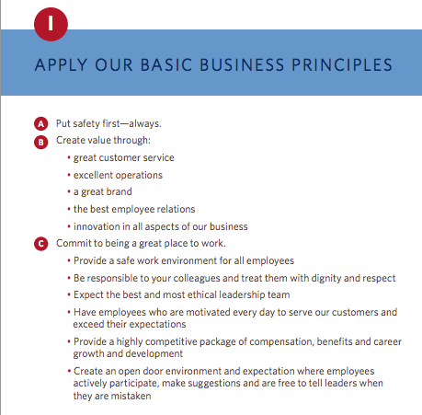
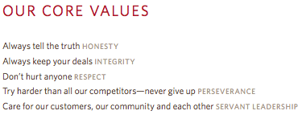
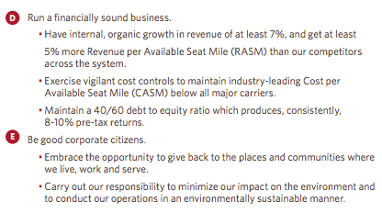
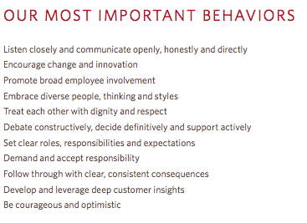

Example – Delta Airlines
http://www.delta.com/content/dam/delta-www/pdfs/policy/delta-rules-of-the-road.pdf

Slide 131
GPM® Sustainable Change Delivery Principles
Commitment & Accountability - Recognizing the essential rights of all to healthy, clean and safe environments, equal opportunity, fair remuneration, ethical procurement, and adherence to rule of law
Ethics & Decision Making - Supporting organizational ethics, decision making with respect for universal principles through identification, mitigation, and the prevention of adverse short and long-term impacts on society and the environment
Integrated & Transparent - Fostering the interdependence of economic development, social integrity, and environmental protection in all aspects of governance, practice and reporting
Principal & Values Based - Conserving and enhancing our natural resource base by improving the ways in which we develop and use technologies and resources
Social & Ecological Equity - Assessing human vulnerability in ecologically sensitive areas and centers of population through demographic dynamics
Economic Prosperity - Establishing fiscal strategies, objectives, and targets that balance the needs of stakeholders, including immediate needs and those of future generations

Slide 132
PSM3™ Levels for Sustainability
Level 5
PRINCIPLED
Has industry leading practices and procedures with continuous improvement, quantifiable value from sustainability initiatives
Level4
Essential
Organization demonstrates active interest, adopted policies and procedures for sustainability
Level 3
Foundational
Organization has formal policies, has identified formal processes and procedures

Slide 133
PSM3™ Levels for Sustainability
Level 2
Provisional
The organization is aware of some competency demonstrated in sustainable practice.
Level 1
Nonexistant
The organization is unaware of any focused attention to sustainability
Level 0
Uncertain
Organization does not know where it currently stands.

Slide 134
Conflict of Interest.
A situation that arises when a practitioner of project management is faced with making a decision or doing some act that will benefit the practitioner or another person or organization to which the practitioner owes a duty of loyalty and at the same time will harm another person or organization to which the practitioner owes a similar duty of loyalty.
The only way practitioners can resolve conflicting duties is to disclose the conflict to those affected and allow them to make the decision about how the practitioner should proceed.

Slide 135
VALUES, MORALS & ETHICS
Values are the fundamental beliefs that we hold. They are the principles that we hold regarding what is right, good, and just.
Morals are the values which are inherent in a system of beliefs – a higher authority such as a business society in which business values such as performance excellence, quality, safety, service, and accomplishing desired results are important.

Slide 136
Ethics in Project Management
Project team members are required to work in different environments that have unique cultural value systems, morals, and ethics.
It is expected that people in the project management field have both personal and professional ethics.

Slide 137
Eight ethical guidelines foundation for projects.
Recognize that managing ethics is a process. Ethics management is the process of reflection and dialog . that produces deliverables such as codes, policies and procedures.
The goal of an ethics management initiative is preferred behaviour in the project environment.
The best way to manage ethical dilemmas, like negative project risks, is to avoid their occurrence in the first place
Make ethics decisions in teams, and make decisions public, as appropriate
Integrate ethics management with other project practices. Define preferred ethical values directly in the project plan
Use cross-functional teams to develop your ethics management plan. Benefit from varied input
Value forgiveness Help project personnel recognize and address their mistakes and then support them to continue to try to operate ethically
Give yourself credit for trying Attempting to operate ethically and making a few mistakes is better than not trying at all. All projects are comprised of people and people are not perfect.
APMBoK V. 5

Slide 138
We have covered
Principles For Sustainable Change Delivery
Values
Ethics

Slide 139
Governance, Portfolio and Program Management
Release 6

Slide 140
Governance, Portfolio and Program Management
Module 5 | Module Covers | Learning outcomes
Governance, Portfolio and Program Management | What is Project Governance Principles of Project Governance Project Governance Areas P3O (Portfolio, Program, Project Offices) Portfolio Management Program Management Benefits of Project Offices Types of Project Offices Responsibilities of Project Offices | Gain an understanding of governance, portfolio and program management.
Version
6.0

Slide 141
Project Governance
Governance is the framework by which an organization is directed and controlled. Project governance includes, but is not limited to, those areas of organizational governance that are specifically related to project activities.
ISO 21500

Slide 142
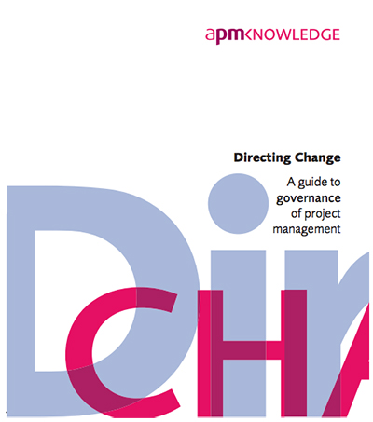
Four Key Principles of Governance
Portfolio Direction
Project Sponsorship
Project Management Capability
Disclosure and Reporting

Slide 143
Eight Key Principles of Project Governance
The (project) board has overall responsibility for the governance of project management.
The organization differentiates between projects and non project-based activities.
Roles and responsibilities for the governance of project management are defined clearly.
Disciplined governance arrangements, supported by appropriate methods, resources and controls are applied throughout the project life cycle. Every project has a sponsor.
There is a demonstrably coherent and supporting relationship between the overall business strategy and the project portfolio.
All projects have an approved plan containing authorization points at which the business case, inclusive of cost, benefits and risk is reviewed. Decisions made at authorization points are documented and communicated.

Slide 144
Eight Key Principles of Project Governance
Members of delegated authorization bodies have sufficient representation, competence, authority and resources to enable them to make appropriate decisions.
Project business cases are supported by relevant and realistic information that provides a reliable basis for making authorization decisions.

Slide 145
Project Governance
Project governance may include subjects such as the following:
  — defining the management structure;
  — the policies, processes and methodologies to be used;
  — limits of authority for decision-making;
  — stakeholder responsibilities and accountabilities;
  — interactions such as reporting and the escalation of issues or risks.
The responsibility for maintaining the appropriate governance of a project is usually assigned either to the project sponsor or to a project steering committee.
Src. ISO 21500 Pg.6
Notes:
We just covered a lot. Time for a quick break.

Slide 146
Where Project Governance Exists
Project Governance
Notes:
Here is a diagram, from ISO 21500, Guidance on Project Management page 3 that depicts the project organization. The boxes represent project management concepts and the arrows represent a logical flow by which the concepts are connected. The dotted lines are organizational boundaries.
The blue box listed as opportunities represents what becomes the project initiation phase and comes from organizational need, market demand and so forth. I will stress that factors outside the organizational boundary include regulatory, socio-economic, and ecological. If they are penetrating the organization then where would they most likely live within the project environment? Project Governance. Makes sense.

Slide 147
Project portfolios
a collection of projects or programs and other work that are grouped together to facilitate effective management of that work to meet strategic business needs’
(Project Management Institute, 2008)
the totality of an organisation’s investment in the changes [projects and programs] required to achieve its strategic objectives
(Office of Government Commerce, 2009)

Slide 148
Why portfolio management?
Portfolio management is needed when an organisation operates a number of projects and programs
The decision on which projects to undertake is usually made by senior managers
A central project office, or network of project offices, can assist by providing information and updates about projects and programs

Slide 149
Aims of Portfolio Management
Effective portfolio management is based on:
Sources: Kendall & Rollins, 2003; Cooper, Edgett, Klienschmidt, 2001
ALIGN | Aligning projects with strategy
SELECT | Selecting the right number of projects
BALANCE | Maintaining a balance of project types
VALUE | Maximising value to the organisation
RESOURCE | Ensuring that the project portfolio fits with resource capability so that the organization can sustain the maximum value from project investments
RISK | Reduce overall risk

Slide 150
Sustainable Portfolios
Collection of projects and programs that delivers value for the organisation and society
without creating undue impact on the organization and its workers, society or the
environment.
ALIGN | Aligning projects with strategy AND obligations to environment and society
SELECT | Incorporating sustainability principles into project selection criteria Using non-financial measures (eg SROI) to determine desirable projects
BALANCE | Balancing projects positive and negative impacts across environmental, social and economic dimensions Use integrated reporting on portfolio performance
VALUE | Embedding sustainability into capital investment appraisal and risk management Managing benefits delivery to maximize positive outcomes
RESOURCE | Determine the carrying capacity of the portfolio
RISK | Determine the organization's sustainability risk and opportunities (using PSM3) Undertaking an sustainability impact assessment for all projects in the portfolio

Slide 151
Portfolio management characteristics
Screening, analysis and financial appraisal of project and program characteristics (resources, schedules, cash flows, risks, benefits, etc.) in relation to overall business strategy.
Prioritization and/or selection of projects and programs within the portfolio, given the resources available, likely returns and risks.
Continued monitoring of the portfolio characteristics as projects and programs develop.
Adjustment of the portfolio with regard to the constraints, risks and anticipated returns in the light of developing circumstances.
Practically, this means…
APMBoK V. 5
Notes:
This means:
Don’t take on more projects/programs than you can cope with. If you want to start up a new program/project you may need to slow or stop one or more others to free up the resources (including financial resources).
Don’t take on too many projects/programs that are high risk at any one time – unless you want to end up like Lehmann Brothers.
Keep an eye on the mix to make sure it doesn’t get out of hand.
When commercial/economic/political circumstances change, you might need to change what’s in the portfolio. Some projects/programs may no longer be appropriate or affordable. If costs rise on a key project/program you may need to close/suspend others to be able to continue to pay for the overrun.

Slide 152
Project Portfolio Management
1
6
7
2
8
3
4
5
Notes:
A portfolio is a collection of projects, programs and other work. Think of it like a suitcase containing objects, or even a share portfolio that contains a range of different stocks.

Slide 153
Project Portfolio Management
Environment
Strategy
9
11
10
1
6
7
2
3
8
4
5
Notes:
A portfolio is a permanent structure in an organisation, unlike projects and programs which are temporary in nature. This means that over time, new projects are kicked off {blue bubbles} (and become part of the portfolio) and projects are completed {green bubbles} (and exit the portfolio). Some projects are also cancelled {red bubble}. New projects come from a variety of sources. Quite often the projects are established due to a range of ideas that emanate from within the organisation. This could be to make an improvement to a business process or practice, or to replace an old platform or system, for example. Projects may also be established as a result of key priorities in the organisations strategy or due to factors outside the organsation, such as new products being demanded by customers or in response to the actions of a competitor.

Slide 154
Project Portfolio Management
17
12
9
6
7
13
16
10
11
3
4
5
15
14
Notes:
One of the biggest issues in portfolio management is the organisations desire to deliver more projects than is possible, resulting in projects being under resourced or only partially funded. When new projects are identified, the prioritization and selection process must occur and both new and existing projects must be prioritised. This may result in some existing projects being put on hold or cancelled as they are no longer the highest priority (and other projects are now a higher priority).

Slide 155
Project Portfolio Management
9
6
7
10
11
3
4
5
Notes:
When projects are successfully completed they exit the portfolio. This allows for new projects to be identified and prioritized

Slide 156
The P3O
There is a growing argument against the creation of PMOs (Project Management Office) and instead the development of Organizational Project Management that supports the enterprise. We will refer to the function as P3O
P3Os can range from simple setups that offer support functions for the project manager to larger scale operations such as departments that are responsible for linking corporate strategy to project execution.

Slide 157
Program management characteristics
Initiate, accelerate, decelerate, redefine and terminate projects
Manage interdependencies between projects and between projects and business as usual
Manage resources and resource conflicts
Manage program level risks, issues and changes
Define and realize strategic benefits
Notes:
Initiate, accelerate, decelerate, redefine and terminate projects is about prioritising where to apply resources (including financial resources). Which project(s) need to be speeded up, which ones slowed down to free up resource, etc.

Slide 158
Project management vs. program management
Project
Defined start and end
Shorter timescale
May change
Delivers products
Benefits usually follow
Consists of activities
Manages resources
Program
Ends once goal achieved
Longer timescale
May evolve
Delivers strategic change
Benefits usually during
Consists of projects
Manages resource conflict

Slide 159
Program manager’s role
Partner the business
Identify and define projects within the program
Delegate to project managers
Monitor the projects in terms of time, cost, quality, risks and issues
Monitor interdependencies
Focus on strategic benefits
Intervene in projects when necessary
Manage resource conflicts

Slide 160
Benefits of program management
Closer alignment of projects with business strategy
Closer alignment with business priorities
Improved prioritization of projects within the program
Improved focus on benefits
Improved resource management
Consistent management reporting within the program
Program wide and cross-project view of risk
Consistent project management processes and standards within the program

Slide 161
Types of PMOs
Whether it a department or office inside a department, the P3O’s mandate will come from executive leadership.
Project Management Office (PMO)
Project support office (PSO)
Program and Project support office (PPSO)
Program management office (PgMO)
Enterprise project management office (EPMO)
Project Management Department (PMD)
Notes:
Add p30

Slide 162
Benefits of PMXs
Provides a centre of excellence
  Expertise and support in planning tools, risk software, etc
Provide economies of scale
  Supports multiple projects
Maintains corporate standards
  Ensures the consistent application of standards
  Supports effective governance
Acts as a single source of information
Supports quality assurance
Supports Continuous improvement

Slide 163
“Experts” advise…
Companies that implemented successful PMOs achieved:
  80% ROI
  20% reduction in project time
  30-35% successful project delivery
Companies without a PMO experience 74% project failure rate
Source: Forrester Research

Slide 164
Strategic Roles
These Ten Functions are key for an optimized P3O. Most start with a few and mature over time to take on more responsibility.
Build, manage and sustain the project methodology
Setting up and providing professional development for competence development that links to a competence framework
Ensuring that Resources are balanced appropriately among projects
Leading and Managing Project Governance
Offering support to project owner/project board
Overall administration in support of projects (tools, software, templates etc.)
Maintaining Project Documents and archives
Providing insight/consult to organizational leadership
Providing information to increase overall organizational knowledge and stewarding organizational capacity for change
Ensuring that projects align with current organizational strategy

Slide 165
The EPMO Enables The Adaptive Organization
By 2015, 60% of the Fortune 1000 will establish an EPMO to improve the value created by investments in projects and programs.
Supporting the Strategic Planning Assumption:
With continued pressure on financial accountability, organizations will require enterprise-level visibility of where their money is going
Continued problems with project coordination across silos will further fuel the need for enterprise visibility and coordination of programs and investments
Alternate position to the Strategic Planning Assumption:
Organizations have the structure that suits their real objectives. A strong PMO is often perceived as a threat to other senior managers.
Most PMOs are in IT — a weak PMO operating in a weak matrixed management environment allows the squeaky wheel to get greased.
Notes:
Strategic Planning Assumption: By 2015, 60% of the Fortune 1000 will establish an EPMO to improve the value created by investments in projects and programs.
Organizations are increasingly concerned with understanding the value that their investment in projects and programs is actually creating.
The strategy execution gap has gone from something pundits write about to something companies are actively beginning to close as quickly and effectively as possible.
The need to proactively rationalize cross-silo dependencies is driving a need to establish an organization at the enterprise level that is chartered with keeping everyone focused on building toward the same strategic outcome.
The economic environment in which organizations find themselves is driving their decision to adopt one of the four common styles of an enterprise PMO (EPMO).

Slide 166


Case study - Fifth Third bank
Super Regional Bank
Founded in 1862
Headquartered in Cincinnati, Ohio.
Fortune 500 - #326
Lines of Business
Commercial Banking
Branch Banking
Consumer Lending
Investment Advisors
49% interest in Fifth Third Processing Solutions/
Affiliate Model (15 Affiliates)
>1,300 full-service banking centers (>100 Bank Marts)
>2,450 ATMs
12 States: Ohio, Kentucky, Indiana, Michigan, Illinois, Florida, Tennessee, North Carolina, West Virginia, Pennsylvania, Missouri, and Georgia.
Fifth Third Bank
(NASDAQ – FITB)
Over $5 B in Revenue
Over $12.3 B Market Capitalization
Over $274 B in Assets under care
Notes:
Placeholder for text (substitute your own text; delete when not used)

Slide 167
Problem
“Silo-ed” Operational Model (by LOB/by Affiliate)
Project redundancies
PMO = IT Governance
Viewed strictly as an enforcement agency
Redundant/inefficient approval & prioritization of initiatives
Enterprise Risk’s NPI (New Product & Initiative)
= Business Case justification + Risk Identification Questionnaires
Finance’s AR (Appropriation Request)
= Business Case Justification + Capitalization Worksheets
IT Architecture’s ITAC Review
= Business Case Justification + Architecture Questionnaires
Adoption challenges

Slide 168
Results
Over 900 Active Projects
Health
On-time Delivery
Executive Dashboards
Over 900 Projects Proposals
IT Compliance self-regulation
5/3 emerged from TARP in Q1 2011
2011 Bloomberg’s World 7th Strongest Bank
Reviewed & prioritized by Tier 1 / Tier 2
Delegation of Toll Gate Audits except for the Top Level of Rigor
Paid U.S. Treasury back $ 3.4 B
Only 3 U.S. Banks made it in the Top 20

Slide 169
We have covered
What is Project Governance
Principles of Project Governance
Project Governance Areas
Portfolio Management
PMO (Project Offices)
Benefits of Project Offices
Types of Project Offices
Responsibilities of Project Offices

Slide 170
Organizational Capacity for Change
Module 6 | Module Covers | Learning outcomes
Organizational Capacity for Change | What is OCC Why Change initiatives fail The Eight Dimensions for OCC Six Points for Innovative Cultures ADKAR Model | Understand what Organizational Capacity for Change is, why it is necessary and what the critical components for change culture are.
Version
6.0

Slide 171
Organizational Capacity for Change Defined
Organizational capacity for change (OCC) can be conceptualized as the overall capability of an organization to either effectively prepare for or respond to an increasingly unpredictable and volatile environmental context. This overall capability is multidimensional, and it comprises three ingredients:
  (a) human skill sets and resources
  (b) formal systems and procedures, and
  (c) organizational culture, values, and norms.

Slide 172
On Change
“It is not the strongest of the species that will survive, nor the most intelligent, but the one most responsive to change.”
—Charles Darwin
“The only person who likes change is a wet baby.”
—Price Pritchett

Slide 173
The New Mandate for Change Leadership
Executive leaders must react quickly to current problems and opportunities, they must also look to and prepare for the future.
Organizations must become more agile, flexible, and nimble.
The new leadership mandate for the 21st century is delivering results in the short term while building change capacity for the long term.

Slide 174
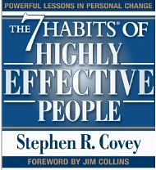
Capacity Opportunity
All individuals must invest time and energy in balancing “production” with “production capacity.”
Covey states that “every production problem is a production capacity opportunity.”
While this insight was directed to individuals and personal effectiveness, it also applies to strategic leaders and collective effectiveness.
Covey, S. (1989). The seven habits of highly effective people. New York, NY: Free Press.

Slide 175
Primary Reasons for Failure to Bring About Change
Organizational members operating in “departmental silos” that focus on local optimization at the expense of the entire system.
Organizational Change takes time, a precious commodity.
The traditional view of organizations is that they are hierarchies with power concentrated at the top with rational and logical employees operating throughout this hierarchy. (While it is true that all organizations are hierarchical in some form and that organizational members are rational at times, this viewpoint is limited and not terribly realistic.)

Slide 176

Leading with both hands
“Strategic leaders today need to be ambidextrous in their approach to leadership. This balancing act is much more challenging than pushing hard for short-term results or nurturing the organization so that new ideas and capabilities emerge in the long term.”
Notes:
Because current pressures usually shove long-term objectives to the side, leaders are proving to be much more practiced in reacting to putting out brush fires in today’s organizations than in preparing the organization to be more change capable. Nonetheless, leaders must learn to fly the plane while rewiring it in flight—this is the mandate of the 21st century.
Change-capable organizations optimize on both of these seemingly contradictory cultural virtues. Hence, the organization needs to become ambidextrous culturally, using the right-handed accountability norms in balance with the left-handed innovation norms.

Slide 177
The Eight Dimensions of organizational capacity for change
Corporate Social Infrastructure
Critical Human Capital
Accountable Cultures
Trustworthy Leadership
Systems
Thinking
Organizational
Capacity for
Change (OCC)
Involved
Mid-management
Innovative
Culture
Capable
Champions
Communication
Systems
Trustworthy
Followers
Adapted from Building Organizational Capacity for Change, Business Expert Press 2011, Pg. 8

Slide 178
Breaking them down
1. Trustworthy Leadership - authority is not enough to make an organization change capable; the strategic leaders must be perceived to be competent and looking out for the well-being of the rest of the employees in the organization.
2. Trusting Followers - within the organization must be favorably disposed to trusting their organization to be change capable.
Notes:
Trustworthy leaders. No lasting, productive change within an organization ever happens without a modicum of trust between its members. As a consequence, the first essential dimension for OCC is the extent to which an organization is perceived to be led by trustworthy leaders. A trustworthy leader is someone who is not only perceived to be competent in leading the organization but also perceived as someone who has the best interests of the organization as their priority. They are only half of the equation when it comes to organizational change; the other half is the followers.
Psychologists tell us that all individuals have a “disposition to trust” others. This disposition is influenced by such things as a person’s genetic background, family norms, and work-related experiences. When an organization
is filled with a critical mass of individuals who are hopeful, optimistic, and trusting, it will be well positioned to experiment with new ways of operating. When an organization is dominated with a critical mass of individuals who are cynical, pessimistic, and not trusting, it will not be well positioned to engage with organizational change initiatives. In sum, a second key dimension of organizational capacity for change is the overall level of trust held by the employees of the organization.

Slide 179
Breaking them down
3. Capable Champions - those individuals within the senior executive group, the middle management ranks, or both who drive the change initiatives within an organization. These individuals are often mavericks and they don’t normally fit in well in bureaucratic structures.
4. Involved Middle Managers- The middle management group that is often uninvolved with the strategy formation design initiatives. This is a mistake. Middle managers have a unique and important role to play in enhancing the change capability of the organization.
Notes:
Individuals, and hence organizations, tend to be inertial. In other words, change takes extra energy and it is much easier to keep doing things the way in which we are accustomed to. Consequently, organizations must identify, develop, and retain a cadre of capable change champions in order to lead the change initiative(s). Within small organizations, these champions are often the same as the head of the organization. Within medium and larger organizations, these champions are often drawn from the ranks of middle management.
Middle managers are those who link top executives to frontline workers. Department heads are classic examples of middle managers, but there are many other types of linkages. While it is undeniable that today’s organizations are flatter hierarchies with fewer middle managers than in the past, their role in helping to bring about change is still important. While change champions often come from the middle management ranks, middle managers can passively or actively block change initiatives due to their unique position within an organization.

Slide 180
Breaking them down
5. Systems Thinking-System thinking is a major departure from the old way of business decision-making in which you would break the system into parts and analyze the parts separately.
6. Effective Communication Systems- When an organization combines systems thinking with high-functioning communication systems, systemic knowledge is created and dispersed throughout the organization.
Notes:
Organizational change capacity involves more than just the “getting the right people on the bus and the wrong people off the bus,” however. It also depends on a proper organization infrastructure.
One of the key infrastructure issues that influence or retard an organizational change initiative is what is called “systems thinking.” These are the rules, structural arrangements, and budgetary procedures that facilitate or hinder an organization-wid —as opposed to a “segmentalist”—approach to organizational change. While segmentalism works quite well for routine procedures, it is anathema to the study of nonroutine events such as strategic decision making, organizational change, or both

Slide 181
Breaking them down
7 and 8 Accountable Cultures – where there are consequences for employees that fail or succeed. Must be counterbalanced with an Innovative Culture. Together, these two dimensions of organizational change capacity—accountability and innovativeness—help to ensure that the organization efficiently marshals scarce resources while creatively looking to the future.
Notes:
the degree to which an organization holds its members accountable for results.

Slide 182
Six points to establish Innovative Culture
Make Innovation Everyone’s Responsibility
Hire and Retain Creative Employees
Put as Many Promising Ideas to the Test as Possible
Use Your Human Resources System to Create Psychological Safety
Emphasize Interdisciplinary Teams Throughout the Entire Organization
Change Cultural Artifacts, Assumptions and Values to Signal Importance of Innovation
Notes:
Notes:
Easily Explained
Easily Explained
Easily Explained
Some mistakes are more lethal than others, so mistakes that do not jeopardize the survival of the organization need to be accepted, even welcomed by leaders. Relatedly, it is more important to focus on the ideas rather than the individuals behind the ideas so that failure is not personalized. And “failure-tolerant leaders emphasize that a good idea is a good idea, no matter where it comes from.
In the 1970s and 1980s, many organizations tried to create specialized subunits where their mandate was to make the organization more innovative. This structural approach to innovation largely failed, either immediately or in the long term. For example, General Motors created the Saturn division as a built-from-scratch innovative new way to produce and sell cars. At first, Saturn had spectacular success. However, the lessons learned from Saturn never translated to the rest of the organization and recently the Saturn division was eliminated. Similarly, too many large organizations try to rely solely on their research and development units for innovation, which greatly constrains the idea production and development process.
Hanna, D. (2010, March 8). How GM destroyed its Saturn success. Forbes, 28.

Slide 183
The Prosci® ADKAR® Model
Briefly describe the change that is being implemented at your workplace and summarize the key elements of. the change
Awareness - Describe your awareness of the need to change. What are the business, customer or competitor issues that have created a need to change?
Desire - List the motivating factors or consequences (good and bad) related to this change that impact your desire to change, including compelling reasons to support the change and specific objections to the change.
Knowledge - List the skills and knowledge you need to support this change, both during and after the transition.
Ability- Considering the skills and knowledge from above, assess your overall ability to implement this change. What challenges do you foresee?
Reinforcement - List the reinforcements in your organization that will help you sustain the change. What incentives are in place to make the change stick? What incentives do not support the change?
ADKAR® is a registered trademark of PROSCI Inc.
Notes:
Using the Prosci ADKAR® Model to analyze a change at your workplace will give you insight as to where you are in the change process and what steps you can take to survive change and advance professionally in a changing business environment. Complete the worksheet to the best of your ability, rating each element on a scale of one (e.g. no awareness) to five (e.g. complete awareness).

Slide 184
Conclusions
“Since organizations are so central to our lives and since they are so important to the fate of humanity, it is imperative that they function well. However, the organizations of the 21st century are not agile enough to deal with the unpredictable and increasingly volatile nature of the environments that they occupy. We need organizations that are more capable of change.” - William Q. Judge, Jr

Slide 185
We have covered
What is OCC
Why Change initiatives fail
The Eight Dimensions for OCC
Six Points for Innovative Cultures
ADKAR Model

Slide 186
The Business Case, Benefits and Value Management
Release 6

Slide 187
The Business Case, Benefits and Value Management
Module 7 | Module Covers | Learning outcomes
The Business Case, Benefits and Value Management | What is the purpose of the business case. Contents of the business case Practical use of the business case Investment Appraisal techniques Calculating Valuation Understanding Benefits | This module covers the business case, how it relates to the project, how to evaluate value and manage benefits
Version
6.0

Slide 188
What is a business case?
The business case provides justification for undertaking a project, in terms of evaluating the benefit, cost and risk of alternative options and rationale for the preferred solution
Its purpose is to obtain management commitment and approval for investment in the project
The business case is owned by the sponsor
APM BoK, 5th edition

Slide 189
Why do we need a business case?
Every project should in some way contribute to the business strategy of the organisation and deliver benefits to the organisation or its customers
In most organisations there are usually several initiatives competing for limited funds.
The purpose of the Business Case is to demonstrate why a particular project should be favoured over others.
It should contain enough relevant information to enable a reasoned decision to be made

Slide 190

Purpose of Business Case
Justification of the project
To obtain authorization for the project and its funding
Used to give direction to a project team
Baseline document for phase and stage reviews
Used in evaluation of change requests
Baseline document for benefits reviews
Used by organization to facilitate lessons learned

Slide 191

Contents of Business Case
Purpose
Project Summary
Business Objectives
Project Objectives
Benefits
Deliverables
Performance Indicators
Risks and Opportunities
Market and Competition Conditions
Organizational Constraints
Project Sponsor
Product Owner
Project Control
Resources
Other Constraints
Business Case
Business Case
(Not the one we are referring to.)
Notes:
The typical contents of a Business Case are shown on the slide above. (Couldn’t help the bad humor… in the picture.)
The first element to the document should be the reason or justification for the project.
A statement of Success and Acceptance Criteria should be shown within the Business Case to allow the Project Manager to identify from these the Quality Standards that he/she will be expected to achieve in their project goals.
The Project Sponsor should also identify what benefits the organization should be looking to gain by having this project go ahead so that anyone reading the document can see the reason and result of the project within one area.
The Project Manager will also need to know what they are being asked to produce as an end product. This product needs to be clear and precise so that the Project Manager can develop a prescriptive scope of work to match the deliverables.
A further area of the Business Case will be the Investment Appraisal which will give financial support to the project giving the true value of a project to the organization.
It is important within a Business Case to list the options or approaches available or being considered and this must also include the option of not doing the project and its relevant impact.
The Business Case as stated early is the driving force behind each project and so at every review it must be present for consideration as to whether or not the project should proceed or be halted as the justification or benefit can not now be realised. This is most commonly known as the Go/No go decision point.

Slide 192

Sustainability in the Business Case
Should include references to:
  Corporate Sustainability Governance
  Regulatory Compliance
  Goals and Objectives
  Principles and Values
  Performance Indicators Using P5 (We will get to that)
Project Managers should always review the Business Case or Charter from a CSR Perspective by leveling the deliverables against the EMS or with the CSR Officer.

Slide 193
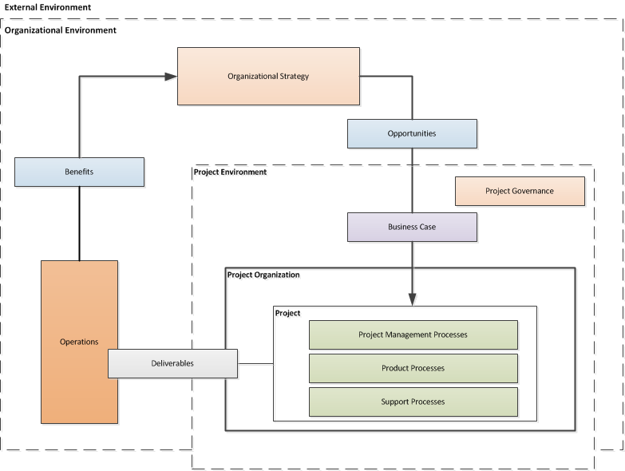
Business case in terms of concept to relationships
Business Case
Notes:
Overview of project management concepts and their relationships

Slide 194
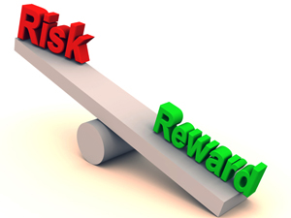
Investment appraisal
The investment appraisal enables the financial viability of projects to be measured both on a standalone basis and in comparison with other projects competing for funds
The process should confirm why the forecast cost and time will be worth the investment and justify the project based upon the estimated costs and the value of projected benefits.

Slide 195
Investment analysis techniques
Payback Period
  The time taken to pay back the project investment.
Return on Investment (RoI)
  The percentage ratio of average yearly profit over the productive life of the project, divided by the original investment.
Social Return on Investment (S-RoI)
  A method for measuring extra-financial value (i.e., environmental and social value not currently reflected in conventional financial accounts) relative to resources invested.
Discounted Cash Flow (DCF)
  DCF uses compound interest calculation to reflect the cost of money by “discounting” future cash flows to an equivalent “present value”
Net Present Value (NPV)
  The aggregate of future net cash flows discounted back to a common base date, usually the present.
Internal Rate of Return (IRR)
  The discount rate at which the Net Present Value of future cash flows is zero.

Slide 196
Payback period
If a project costs $1,000,000 and yields benefits as follows:
  Year 1 $200,000
  Year 2 $300,000
  Year 3 $500,000
  Year 4 $400,000
  Year 5 $400,000
The Payback Period is three years
$1M
Year 3
$500k
Year 2
$300k
Year 1
$200k

Slide 197
Return on investment (ROI)
ROI = (Average Annual Profit/Original Investment) x 100%
where Average Annual Profit = Total Profit/Years
Year | Investment | Benefits
0 | $1,000,000 | $0
1 |  | $200,000
2 |  | $300,000
3 |  | $500,000
4 |  | $400,000
5 |  | $400,000
 |  | $1,800,000
Average Annual Profit = ($1,800,000-$1,000,000)/5 = $160,000
ROI = ($160,000/$1,000,000) * 100% = 16%

Slide 198
Discounted cash flow
Leaving money invested in a deposit account at 10% interest would see growth based on compound interest:
Year 0 | $1.00
Year 1 | $1.10
Year 2 | $1.21
Year 3 | $1.33
If we kept the money instead of investing it, its comparative value would fall:
Year 0 | $1.00
Year 1 | $1.00/$1.10 = $0.91
Year 2 | $1.00/$1.21 = $0.83
Year 3 | $1.00/$1.33 = $0.75
Discounting is the opposite of compound interest. It recognises that the $1.33 in three years time is worth the same as $1.00 now.

Slide 199
Discounted cash flow example
Year | Investment | Benefits | DCF
0 | $1,000,000 | $0 | $0
1 |  | $200,000 x 0.91 | $182,000
2 |  | $300,000 x 0.83 | $249,000
3 |  | $500,000 x 0.75 | $375,000
4 |  | $400,000 x 0.68 | $272,000
5 |  | $400,000 x 0.62 | $248,000
 |  | $1,800,000 | $1,326,000

Slide 200
Net present value
The net present value (NPV) is the sum of all the discounted cash flows (both investments and benefits). It is the value of the project expressed in current monetary value.
Year | Investment | Benefits | Net cash flow | Discount factor (10%) | DCF
0 | $1,000,000 | $0 | -$1,000,000 | 1.00 | -$1,000,000
1 |  | $200,000 | $200,000 | 0.91 | $182,000
2 |  | $300,000 | $300,000 | 0.83 | $249,000
3 |  | $500,000 | $500,000 | 0.75 | $375,000
4 |  | $400,000 | $400,000 | 0.68 | $272,000
5 |  | $400,000 | $400,000 | 0.62 | $248,000
Total | $1,000,000 | $1,800,000 | $800,000 |  | NPV $326,000

Slide 201
Social Return on Investment
Establishing scope and identifying key stakeholders. Clear boundaries about what the SROI will cover, and who the will be involved are determined in this first step.
Mapping outcomes. Through engaging with stakeholders, an impact map, or theory of change, which shows the relationship between inputs, outputs and outcomes is developed.
Evidencing outcomes and giving them a value. This step first involves finding data to show whether outcomes have happened. Then outcomes are monetized – this means putting a financial value on the outcomes, including those that don’t have a price attached to them.
Establishing impact. Having collected evidence on outcomes and monetized them, those aspects of change that would not have happened anyway (deadweight) or are not as a result of other factors (attribution) are isolated.
Calculating the SROI. This step involves adding up all the benefits, subtracting any negatives and comparing them to the investment.
Reporting, using and embedding. Easily forgotten, this vital last step involves sharing findings and recommendations with stakeholders, and embedding good outcomes processes within your organization.
Notes:
It can help organizations understand what social value an activity creates in a robust and rigorous way and so manage its activities and relationships to maximize that value.
The process opens up a dialogue with stakeholders, helping to assess the degree to which activities are meeting their needs and expectations.
SROI puts social impact into the language of 'return on investment’, which is widely understood by investors, commissioners and lenders. There is increasing interest in SROI as a way to demonstrate or measure the social value of investment, beyond the standard financial measurement.
Where it is not being used already, SROI may be helpful in showing potential customers (for example, public bodies or other large purchasers) that they can develop new ways to define what they want out of contracts, by taking account of social and environmental impacts.
SROI can also be used in strategic management. The monetized indicators can help management analyze what might happen if they change their strategy, as well as allow them to evaluate the suitability of that strategy to generating social returns, or whether there may be better means of using their resources.

Slide 202
What is project success and benefits management?
Project success is the satisfaction of stakeholder needs and is measured by the success criteria as identified and agreed at the start of the project.
Benefits management is the identification of the benefits at an organisational level and the monitoring and realisation of those benefits.
APM BoK, 5th edition
This text has been reproduced from APM BoK with prior permission from the Association for Project Management

Slide 203
What is success?
The definition of success will vary from project to project.
  The 2016 Olympics must open on time.
  A new medicine must be safe.
Each stakeholder will define success differently.
  The bride’s father wants the wedding to come in on budget.
  The bride’s mother wants every relative to be invited.

Slide 204
When to define success
Success should be defined and documented up front in the Concept phase of the project.
Success should be defined as a set of success criteria.
Once agreed and approved the success criteria should only be changed through formal change control.
Success is measured at the end.
Notes:
Ask the delegates what happens if success criteria aren't agreed up front.

Slide 205
Focusing on Benefits
Business Case
Project Outputs
Enable
Desired
Outcomes
Business
Changes
Create
Measured in
Also Cause
Benefits
Side-effects and consequences
Further Realize
Helps Achieve one or more
Result in
Strategic Initiatives
Dis-benefits
Notes:
Senior managers tend to focus on output delivery, which has no quantifiable value or benefit until successfully accepted, adopted and integrated into the organization as business as usual.
The real focus should be on demonstrable value and benefits aligned to strategic objectives, which also aligns with sustainability principals.

Slide 206
Key Principles / KPIs
Follow Best Practices while developing using Common Sense and Principles:
  Aligned to Strategy, Principles, Priorities and Expectations
  Conduct a Health Check
  Establish Governance
  Define the Vision
  Establish a Transformational approach
  Identify your Numbers
  Establish a Support Structure
  Don’t ignore Social and Environmental impacts

Slide 207
Benefits Realization
Measures of success
Common project management practice dictates that
benefits are based on business specific economic returns.
Concept
Definition
Implementation
Handover and Closeout
Operations
Benefits Realisation

Slide 208
Benefits Realization with Sustainability
GPM’s benefits extend beyond economic returns
P5 Sustainability Framework
Concept
Definition
Implementation
Handover and Closeout
Operations
Benefits Realisation
Benefits are based on:
Business Specific Economic Returns
Alignment with Organizational and Government Sustainability Initiatives/Goals
Risk Responsiveness and Aversion
Global Reporting Initiative Reporting Standards & UN Post 2015 Engagement Architecture Reporting Capabilities
Alignment with ISO 14001 Environmental Management
Alignment with ISO 50001 Energy Management
Alignment with ISO 26000 Corporate Social Responsibility
Increased efficiency of process and increased organizational maturity in projects

Slide 209
Benefits Realization Plan
Description of the benefit
What strategic objective does it support?
Against values will the benefits be assessed and recorded?( for example: money, number of visitors, number of jobs, CO2 reduction etc.)
What is the current value of the benefit and what future value is anticipated?
Outputs required for the benefit to be realized
Dependency to other benefits
Benefit owner (see Benefit responsibilities section)
Which stakeholders this benefit will effect
How the benefit will be measured
Notes:
One of the causes for ineffective benefits management in practice is the lack of clear responsibilities in this respect. Assigning benefits management responsibilities can be challenging because this activity continues after the project.

Slide 210

The Benefit Owner
Benefit owner
The benefit owner is an individual who is responsible for ensuring it is realized.
The benefit owner is assigned during project initiation. Benefit owners do not have to be part of the project team but do play a role which is increasingly important towards the end of the project.
Typical responsibilities of the benefit owner will be:
Own the benefit profile
Provide input for the benefits realization plan
Manage benefits measurements
Organize benefit reviews
Report on progress of benefits realization

Slide 211
We have covered
What is the purpose of the business case.
Contents of the business case
Practical use of the business case
Investment Appraisal techniques
Calculating Valuation
Understanding Benefits

Slide 212
Requirements Management
Release 6

Slide 213
Requirements Management
Module 8 | Module Covers | Learning outcomes
Requirements Management | The importance of requirements management Requirements and Definition | Understand requirements management, and preferred practices.
Version
6.0

Slide 214
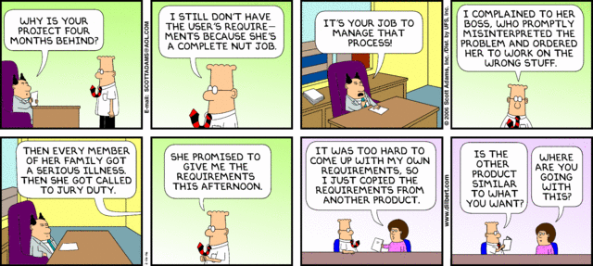
Poor Requirements = Poor Performance
Dilbert.com
Notes:
A simple opening on requirements.

Slide 215
What is Requirements Management?
Requirements management is the process of capturing, analysing and testing the documented statement of stakeholder and user wants and needs.
Requirements are a statement of the need that a project has to satisfy, and should be comprehensive, clear, well structured, traceable and testable.
47%
of unsuccessful projects
fail to meet goals due to poor requirements management
APM BoK 5th Edition
http://www.pmi.org/~/media/PDF/Knowledge%20Center/PMI-Pulse-Requirements-Management-In-Depth-Report.ashx
Notes:
We just covered a lot. Time for a quick break.

Slide 216
What Are Requirements?
The stakeholders’ and users’ wants and needs
They state ‘What’ is required NOT ‘How’ it is to be achieved
They contain acceptance criteria
They provide a measure against which project success can be judged
High-level requirements are documented during the Concept phase of the life cycle
They are further developed and agreed during the Definition phase

Slide 217
Requirements Life Cycle
Design Freeze
Baseline
Quick
Look
Detailed
Look
Finish
off
Benefits
Realization
Idea
Do It
Requirements Capture and Testing
Configuration Management & Change Control
Requirements Reviews
Notes:
The existence of a product specification is essential at the commencement of the implementation stage. This may initially only define requirements such as physical features, performance aspects and key acceptance criteria. To ensure the development of the design will achieve the objectives and benefits a series of reviews are conducted. This enables the design to be compared to the requirements in order to identify and address any deviations or shortcomings. A requirements review may be conducted during design to check that designers understand and can achieve the stated requirements.
As the product design develops, further reviews are carried out to check that the design will meet the product requirements. At the end of development the design is reviewed prior to build. As the design develops further, acceptance criteria, plans and methods are fully defined. These, the designs and production readiness are typically reviewed prior to the release of the design to production. This will check that the test methods are appropriate and will ensure that the product is adequately tested in line with the requirements.
Tests and inspections are typically carried out during the acceptance stage to verify that the deliverable products meet the requirements. If satisfactory, the product is formally accepted and signed off.
Throughout the development, the requirements, product specification and associated documentation is controlled using a formal change control and configuration management process.
The requirements management process facilitates the opportunity to provide confidence to the Project Team and the Stakeholders during the life cycle that the product is more likely to achieve the project objectives and its proposed benefits.

Slide 218
Requirements Structuring
Factors used to structure the construct of the requirements:
Value
  The size of the benefit from each requirement
Priority
  Stakeholders agree the priority order
Time
  Deadlines for each requirement
Process
  The way the solution is to be built, by which sub-contractors
Impact
  The P5* impact that the requirement has
*Sustainability Impact - People, Planet, Profit, Project Process and Resulting Product

Slide 219
Elements of a Requirements Management Plan
Introduction
  Purpose of The Requirements Management Plan
Requirements Management Overview
  Organization, Responsibilities, and Interfaces
  Tools, Environment, and Infrastructure
Requirements Management
  Assumptions/Constraints (Sustainability Impacts)
  Requirements Definition
  Requirements Traceability
  Workflows and Activities
Change Management
Key Terms
Requirements Management Plan Approval Page

Slide 220
Important Skills For Requirements Management
Active Listening and Communication Skills
Interpreting and articulating requirements, their alignment to organizational strategic goals and principles
Navigating ambiguity
Active Engagement of Stakeholders
Understanding the Need “You gave me what I asked for but not what I needed.”
Clearly defined and functioning change control
Ability to articulate the business value of the requirement

Slide 221
The study of why things go wrong
If you don’t know what you want,
or what you want keeps changing;
or you can’t commit the required money to the project;
or you don’t have anyone in charge of the project,
or you keep changing the person in charge,
or the person who
is supposed to be in charge doesn’t really call the shots;
or the person at the top of the business doesn’t care about the project;
and you don’t focus on what the actual benefit to the business is;
and you don’t regularly talk to the people who will have to use the system;
and you don’t constantly check progress;
or you have an unrealistic timetable and try to run before you can walk;
or you fail to test the system properly before you launch it;
or if you don’t provide enough training;
or you don’t have a Plan B in case things go wrong;
or you try to bite off more than you can chew in one go;
or if you don’t realise that the bigger project the greater the chance of its being overtaken by events or new technology or new legislation;
or you don’t realise that you may not have the skills you need to manage the project;
or you don’t realise that some suppliers are quite capable of telling you they can deliver when they can’t;

Slide 222
The frequent result
Don’t be surprised if you end up with:
a mess that is way behind schedule,
damages your organization,
traumatises your staff,
costs much more than it is supposed to,
(and doesn’t work.)”

Slide 223
We have covered
Requirements Management
Requirements Lifecycle
Requirements Structuring
Requirements Management Plan
Important Skills For Requirements Management

Slide 224
Project Management
Release 6

Slide 225
Project Management
Module 9 | Module Covers | Learning outcomes
Project Management | What is a Project What is Project Management What are Process Groups and how What are Subject Groups What is the Project Environment | Understand what project management is, the ins and outs, and the project environment
Version
6.0

Slide 226

What is a Project?
A project consists of a unique set of processes consisting of coordinated and controlled activities with start and end dates, performed to achieve project objectives.
Achievement of the project objectives requires the provision of deliverables conforming to specific requirements. A project may be subject to multiple constraints.
Although many projects may be similar, each project is unique. Project differences may occur in the following:
  deliverables provided;
  stakeholders influencing;
  resources used;
  constraints;
  the way processes are tailored to provide the deliverables.
Every project has a definite start and end, and is usually divided into phases.
Both the Burj Khalifa and a wedding are examples of projects.
Notes:
Projects are a way to deliver value to an organization. Although there may be other ways to deliver this value, projects often have certain advantages that make them apt for the specific task. These advantages include focus, control and specialization.
Focus, as projects are a temporary organization established for just one set of objectives: to deliver this value; control, as projects are subject to predefined constraints, including deadlines, budgets, quality standards, and specialization, as project management has become a profession, including best practices, tools, methods and certification schemes.
A project is defined as a unique, temporary, multi-disciplinary and organized endeavor to realize agreed deliverables within predefined requirements and constraints. Achievement of the project objective requires these deliverables to conform to specific requirements, including multiple constraints such as time, cost, resources and quality standards or requirements.
Project management is concerned with the application of methods, tools, techniques and competences to a project to achieve goals. It is performed through processes and includes the integration of the various phases of the project life cycle.
Effective project management has a number of benefits for the organization and stakeholders. It provides a greater likelihood of achieving the goals and ensures efficient
http://en.wikipedia.org/wiki/File:Burj_Khalifa.jpg

Slide 227
Project Management
Constraints
time, cost, quality, technical, other performance parameters, legal, environmental, social
Input
Project Management
Output
business need
problem
opportunity
project deliverables:
Products
Services
change
Mechanisms
people, tools, techniques, equipment, organization
Notes:
Projects
A project consists of a unique set of processes consisting of coordinated and controlled activities with start and end dates, performed to achieve project objectives. Achievement of the project objectives requires the provision of deliverables conforming to specific requirements. A project may
be subject to multiple constraints.
Although many projects may be similar, each project is unique. Project differences may occur in: deliverables provided; stakeholders influencing; resources used; constraints; and the way processes are tailored to provide the deliverables.
Every project has a definite start and end, and is usually divided into phases
Project Management
Project management is the application of methods, tools, techniques and competencies to a project.
Project management includes the integration of the various phases of the project life cycle
Project management is performed through processes. The processes selected for performing a
project should be aligned in a systemic view. Each phase of the project life cycle should have
specific deliverables. These deliverables should be regularly reviewed during the project to meet
the requirements of the sponsor, customers and other stakeholders
ISO 21500 Section 3.2 and 3.3

Slide 228
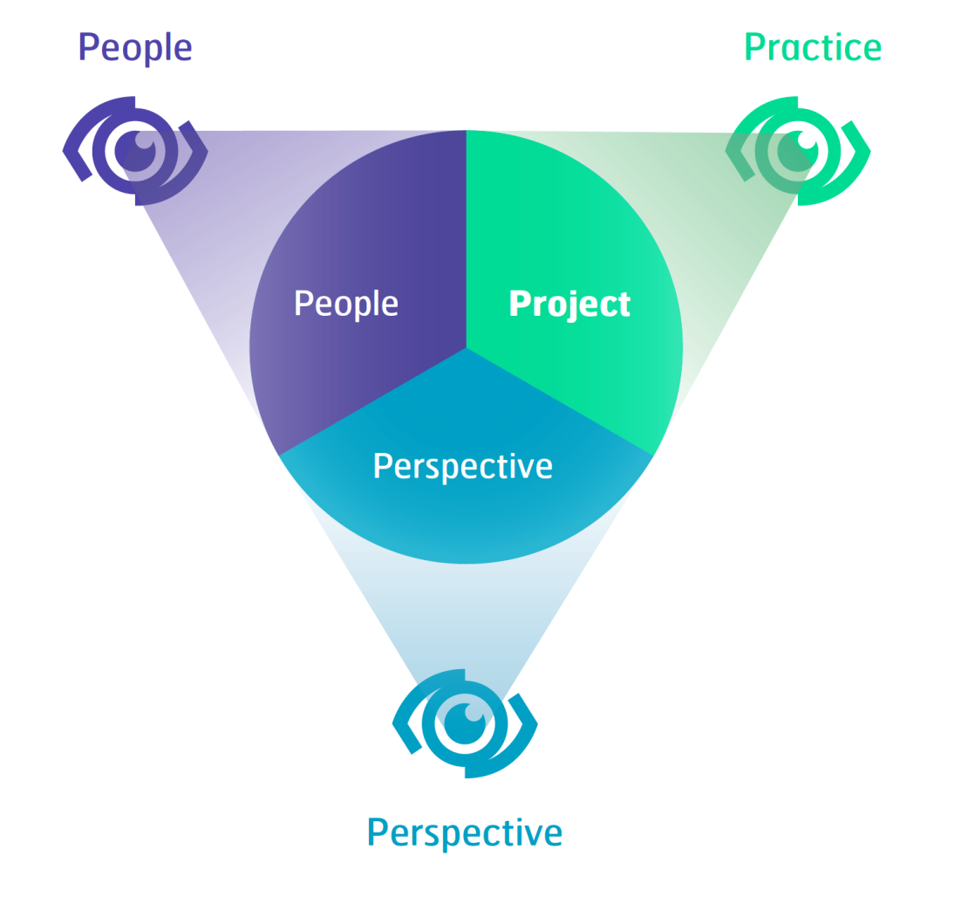
Competences
The individual has to have perspective competences that address the contexts of projects, people competences that address personal and social topics and project competences that address the specific practice competences for managing projects.
SRC. IPMA ICB PG. 21
Notes:
The IPMA Eye of Competence is applicable for the three management domains project management, program management and portfolio management.
Based on the generic model every individual has to have a specific set of competences to manage projects successfully.

Slide 229
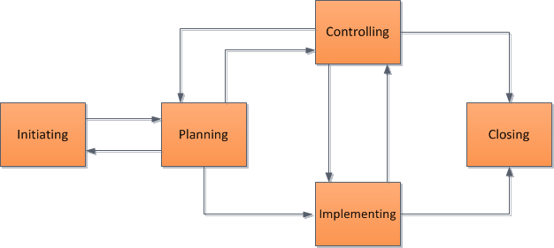
Project Management Process Groups
Notes:
The management of a project starts with the initiating process group and finishes with the closing process group. The interdependency between process groups requires the controlling process group to interact with every other process group as shown in Figure 5. Process groups are seldom discrete or one-time in their application. The process groups are normally repeated within each project phase to drive the project to completion. All or some of the processes within the process groups may be required for a project phase.

Slide 230
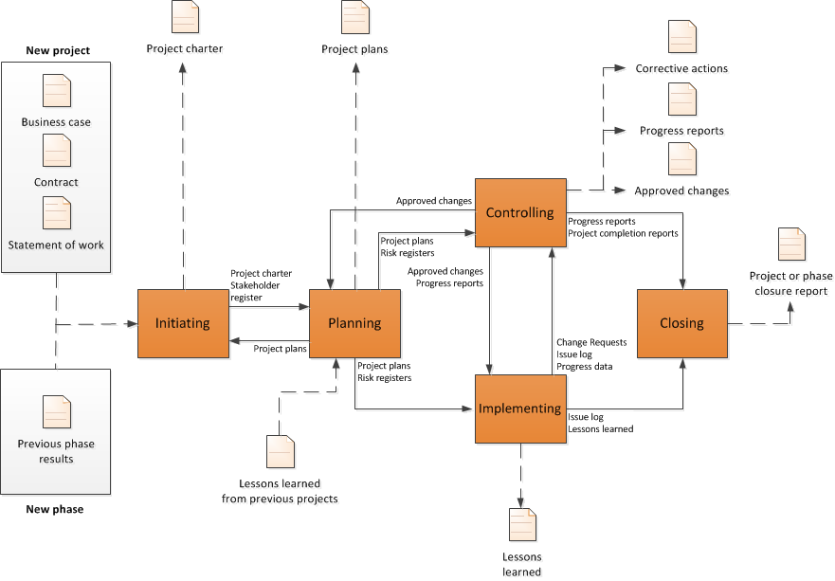
Interaction Among Process Groups
Source ISO 21500 Pg.12
Notes:
This page shows the interactions among the process groups inside the boundaries of the project, including the representative inputs and outputs of processes within the process groups. With the exception of the controlling process group, linkages between the various process groups are through individual processes within each process group. While linkage is shown in the diagram between the controlling process group and other process groups, the controlling process group may be considered self-standing because its processes are used to control not only the overall project, but also the individual process groups.

Slide 231
Projects and the business
All projects need to be aligned with the values of the organization and have to follow the formal cultural rules and demands of related functional departments or support units, and the culture of superordinate projects and strategic decision making bodies.
Notes:
Sometimes the espoused values are written down in one or more documents (for instance mission statement, quality policy, or corporate values). The individual should be able to discern the relevant implications of these cultural aspects for the project and take these into account in the approach. Moreover, the individual needs to be sure that the project supports the sustainable development of the organisation, which also includes corporate social responsibility (CSR).

Slide 232
Subject Groups
Each subject group consists of processes applicable to any project phase or project. These processes are defined in terms of purpose, description and primary inputs and outputs in and are interdependent. Subject groups are independent of application area or industry focus.
Integration – Processes to identify, define, combine, unify, coordinate, control and close activities.
Stakeholder - the processes required to identify and engage the project sponsor, customers and other stakeholders
Scope – the processes required to identify and define the work and deliverables required
Resource – the processes required to identify and acquire adequate project resources
Time – the processes required to schedule the project activities and to monitor progress to control the schedule
Cost – the processes required to develop the budget and to monitor progress to control costs
Risk - the processes required to identify and manage threats and opportunities
Quality - the processes required to plan and establish quality assurance and control
Procurement - the processes required to plan and acquire products, services or results, and to manage supplier relationships
Communication - includes the processes required to plan, manage and distribute information relevant to the project
Derived from ISO 21500
Notes:
Some Organizations call these “knowledge areas”. This is incorrect. It is not enough to be knowledgeable. You must be proficient.
Each subject group consists of processes applicable to any project phase or project. These processes are defined in terms of purpose, description and primary inputs and outputs in and are interdependent. Subject
groups are independent of application area or industry focus.
ISO 21500 Definitions
Integration - The integration subject group includes the processes required to identify, define, combine, unify, coordinate, control and close the various activities and processes related to the project.
Stakeholder - The stakeholder subject group includes the processes required to identify and engage the project sponsor, customers and other stakeholders.
Scope - The scope subject group includes the processes required to identify and define the work and deliverables, and only the work and deliverables required.
Resource - The resource subject group includes the processes required to identify and acquire adequate project resources such as people, facilities, equipment, materials, infrastructure and tools.
Time - The time subject group includes the processes required to schedule the project activities and to monitor progress to control the schedule.
Cost -The cost subject group includes the processes required to develop the budget and to monitor progress to control costs.
Risk - The risk subject group includes the processes required to identify and manage threats and opportunities.
Quality - The quality subject group includes the processes required to plan and establish quality assurance and control.
Procurement - The procurement subject group includes the processes required to plan and acquire products, services or results, and to manage supplier relationships.
Communication - The communication subject group includes the processes required to plan, manage and distribute information relevant to the project.

Slide 233
Relationship between project management concepts and processes
Project management is accomplished through processes utilizing the concepts [knowledge] and application [competencies.]
A process is a set of interrelated activities. Processes used in projects are generally categorized into three major types.
  project management processes -- specific to project management and determine how the activities selected for the project are managed
  delivery processes -- not unique to project management, result in the specification and
  provision of a particular product, service, or result and vary depending on the particular project
Deliverable support processes -- not unique to project management, provide relevant and valuable support to product and project management processes in such disciplines as logistics, finance, accounting and safety
Notes:
This standard addresses only project management processes. However, it should be noted that product, support and project management processes might overlap and interact throughout a project.

Slide 234
True or False?
1. A project starts when the performing organization completes the processes required to mandate a new project.
FALSE
TRUE
2. A project ends when the project deliverables have been accepted or the project has been prematurely terminated, and when all project documentation is delivered and all closure activities have been completed.
TRUE
3. A project manager’s responsibility for a project ends when all closure activities have been completed.
Notes:
Understanding the management of the outcome after handover is important.

Slide 235
The Project Environment
ISO 21500
Notes:
This slide shows the project environment. Organizational Strategy creates opportunities that become business cases. The business case is carried out via projects that hand deliverables over to the operations side of the organization. Benefits are then derived and realized by the strategic level.
The Project Manager is responsible for benefit realization.

Slide 236

Project Complexity
GAPPS has developed an approach to categorizing projects based on their management complexity. The GAPPS framework uses a tool called the Crawford-Ishikura Factor Table for Evaluating Roles, or CIFTER. The tool, named after two major contributors to GAPPS, is used to differentiate project manager roles based on the complexity of the projects managed.
1. Stability of the overall project context
2. Number of distinct disciplines, methods, or approaches involved in performing the project
3. Magnitude of legal, social, or environmental implications from performing the project
4. Overall expected financial impact (positive or negative) on the project’s stakeholders
5. Strategic importance of the project to the organization or organizations involved
6. Stakeholder cohesion regarding the characteristics of the product of the project
7. Stakeholder cohesion regarding the characteristics of the product of the project
Notes:
Project Managers are expected to produce essentially the same results – outputs and outcomes that are acceptable to relevant stakeholders. However, the context in which these results are produced may differ: some projects are inherently harder to manage than others. A project manager who is competent to manage an easier, less complex project may not be competent to manage a harder, more complex project.

Slide 237
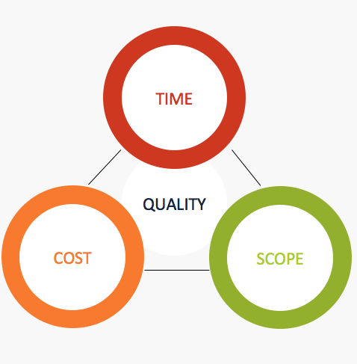
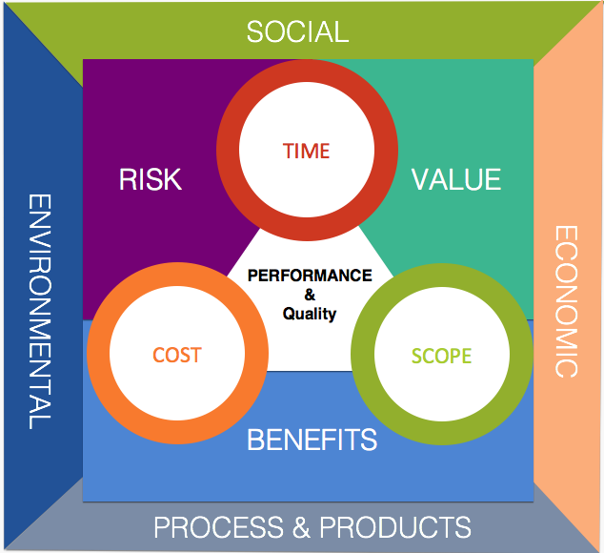
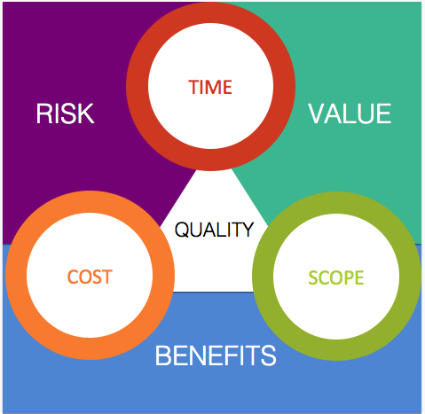
The Current PM Challenge
Many project managers are locked onto focusing on the traditional Time / Cost / Scope paradigm (if lucky they take into account quality)
Successful project managers focus on time, cost, quality, scope, benefits and risk
Exceptional project managers also take into account the other triple constraint… Though the key questions for organizations is how to facilitate this?

Slide 238
Great Project Managers
Focus on Customer Needs
Challenge “TTWWHADI” –Anyone know what this is?
Meet Face to Face (video conference also counts ;)
Understand the requirements and how they relate to organizational principles and benefit
Collaborate with the project team
Delegate Effectively
Are comfortable in the “C” Suite
Are proactive
Can lead under pressure
Notes:
TTWWHADI “That’s the way we have always done it.

Slide 239
We have covered
What is a Project
What is Project Management
What are Process Groups and how What are Subject Groups
What is the project Environment

Slide 240
Project Lifecycles and PRiSM
Release 6

Slide 241
Project Lifecycles and PRiSM
Module 10 | Module Covers | Learning outcomes
Project Lifecycles And PRiSM | Project and Product life cycles. Product Lifespans Cradle to Cradle and Cradle to Grave Project phases such as Initiate, Plan Implement and Close. The relationship between phases and stages. The PRiSM Flow The Product Life Cycle | Describe a project life cycle. Describe a product life cycle Understand The PRiSM Lifecycle Understand the Product Lifecycle
Version
6.0

Slide 242
Requirements Life Cycle
Design Freeze
Baseline
Quick
Look
Detailed
Look
Do It
Finish
off
Get the
benefits
Idea
Requirements Capture and Testing
Configuration Management & Change Control
Requirements Reviews
Notes:
The existence of a product specification is essential at the commencement of the implementation stage. This may initially only define requirements such as physical features, performance aspects and key acceptance criteria. To ensure the development of the design will achieve the objectives and benefits a series of reviews are conducted. This enables the design to be compared to the requirements in order to identify and address any deviations or shortcomings. A requirements review may be conducted during design to check that designers understand and can achieve the stated requirements.
As the product design develops, further reviews are carried out to check that the design will meet the product requirements. At the end of development the design is reviewed prior to build. As the design develops further, acceptance criteria, plans and methods are fully defined. These, the designs and production readiness are typically reviewed prior to the release of the design to production. This will check that the test methods are appropriate and will ensure that the product is adequately tested in line with the requirements.
Tests and inspections are typically carried out during the acceptance stage to verify that the deliverable products meet the requirements. If satisfactory, the product is formally accepted and signed off.
Throughout the development, the requirements, product specification and associated documentation is controlled using a formal change control and configuration management process.
The requirements management process facilitates the opportunity to provide confidence to the Project Team and the Stakeholders during the life cycle that the product is more likely to achieve the project objectives and its proposed benefits.

Slide 243
Project Lifecycle – High Level
A project lifecycle typically consists of of four phases:
Initiate
Plan
Implement
Handover & Closeout
Initiate – identify options and consider viability
Plan – produce plans
Implement – implement the plans
Handover and Closeout – handover the outputs
Notes:
GPM divides projects into phases and follow the ISO 21500 guideline.
Projects are usually organized into phases that are determined by governance and control needs. These phases should follow a logical sequence, with a start and an end, and should use resources to provide deliverables. In order to manage the project efficiently during the entire project life cycle, a set of activities should be performed in each phase. Project phases are collectively known as the project life cycle.
The project life cycle spans the period from the start of the project to its end. The phases are divided by decision points, which can vary depending on the organizational environment. The decision points facilitate project governance. By the end of the last phase, the project should have provided all deliverables. To manage a project throughout its life cycle, project management processes should be used for the project as a whole or for individual phases for each team or sub project.

Slide 244
Initiation phase
Initiate
Plan
Handover & Closeout
Implement
The sponsor is selected
The Need/Problem/Opportunity is established
Feasibility is investigated
Fit with strategy is checked
High level risks are identified and assessed
Levelling against Management Systems are completed
P5 Impact analysis is completed and SMP is initiated
Initial stakeholders are identified and analysed
High level requirements are identified
Business options (inc Do Nothing) are identified, evaluated and documented in the Business Case
Plans for next phase (Definition) are produced.

Slide 245
Planning phase
Initiate
Plan
Handover & Closeout
Implement
Project Manager is appointed (if not already in place)
The preferred solution is checked against high level requirements
Alternative designs are considered
The approach is agreed with the Sponsor
Detailed requirements are gathered and refined
The Project Management Plan (PMP) is prepared
Estimates of time, resources and costs are produced
The Business Case is updated to reflect plans and estimates
Detailed plans for next phase (Implementation) are prepared

Slide 246
Implementation phase
Initiate
Plan
Handover & Closeout
Implement
Implementation phase may be divided into Stages:
  Design
    Design optimised and completed
    Design documentation produced
    Design approved
  Build
    Actual products are now produced
    Components tested against acceptance criteria
Project Manager:
  Controls and monitors the delivery
  Manages risks, issues and changes
  Communicates progress with stakeholders

Slide 247
Handover & closeout phase
Initiate
Plan
Handover & Closeout
Implement
Test the completed set of deliverables in operational mode
Sponsor and users accept products
Transfer ownership
Complete all project documentation
Review project performance (Post Project Review)
Capture and disseminate lessons (Lessons Learned)
Close the project

Slide 248
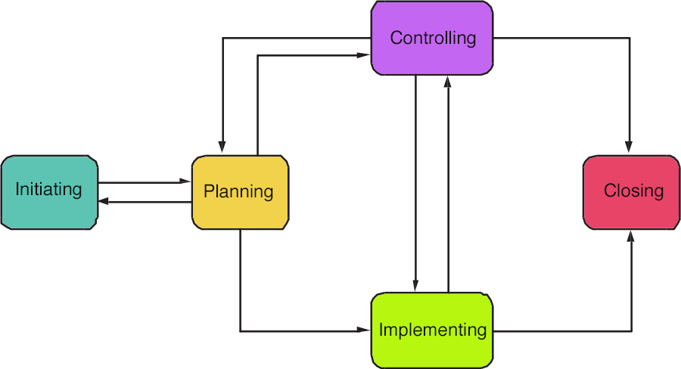
Process Groups (Review)
IMPORTANT! Process Groups are not to be confused with phases of a Life-Cycle!
The management of a project starts with the initiating process group and finishes with the closing process group. The interdependency between process groups requires the controlling process group to interact with every other process group.
Notes:
Initiating process group
The initiating processes are used to start a project phase or project, to define the project phase or project objectives and to authorize the project manager to proceed with the project work.
Planning process group
The planning processes are used to develop planning detail. This detail should be sufficient to establish baselines against which project implementation can be managed and project performance can be measured and controlled.
Implementing process group
The implementing processes are used to perform the project management activities and to support the provision of the project’s deliverables in accordance with the project plans.
Controlling process group
The controlling processes are used to monitor, measure and control project performance against the project plan. Consequently, preventive and corrective actions may be taken and change requests made, when necessary, in order to achieve project objectives.
Closing process group
The closing processes are used to formally establish that the project phase or project is finished, and to provide lessons learned to be considered and implemented as necessary.
Project management process group interrelationships and interactions

Slide 249

The Strength of PRiSM
The project methodology/approach that was designed to align with ISO 26000, 21500, 14001, 9000, 50001 the UNGC Ten Principles, and The GRI G4 Framework for Sustainability Reporting.
Notes:
We are now going to do a walkthrough of the PRiSM Methodology from a Workflow Perspective before diving in a little deeper.
PRiSM Short for (Projects integrating Sustainable Methods)
PRiSM™ (Projects integrating Sustainable Methods) is the sustainability based project delivery method which incorporates tangible tools and methods to manage the balance between finite resources, social responsibility, and delivering “green” project outcomes. It was developed for organizations to integrate project processes with sustainability initiatives to achieve business objectives while decreasing negative environmental impact.
PRiSM is a structured project management methodology that highlights areas of sustainability and integrates them into the traditional core project phases which, when understood and effectively addressed, can reduce negative environmental impacts in all types of projects while maximizing opportunities to manage sustainability and finite resources. PRiSM is cut from the same cloth as the globally accepted standards for professional project management. These standards are the “books of knowledge” as they are known to project managers. PRiSM incorporates a framework of activities derived from ISO 21500, 14001, 26000, 50001 and 9001, focuses on specific areas and incorporates best practices to practically answer the question: "How do I apply sustainability in to my projects?”

Slide 250

PRiSM Flow
Workflow
Step/Process
Phase Connector
Document
Begin / End
Decision
Sub Process

Slide 251

The PRiSM Pre-Project Phase
Projects arise from an idea or a need. This may result from new business objectives, responding to competitive pressures, changes in legislation, or a recommendation in a report or an audit.
The project mandate is provided by the commissioning organization (corporate or program management) and can vary in form from a verbal instruction to a well-defined and justified project definition.
Notes:
The initiation phase is one where the ideas are formulated and the business reviews whether this is a feasible project or element of a project to be included within the portfolio of projects that it is currently running. What you see here is an example of steps-to-take in an initiation phase for sustainability integration. I will go over them in detail.
The key deliverable within this phase is the Project Charter. the value of the sustainability elements are housed here. We are going to mainly focus on this phase today but will touch on all four.

Slide 252
The PRiSM Pre-Project Phase
Nothing should be done until foundational information needed to make decisions about the commissioning of the project is defined.
The Project Sponsor and Project Manager is selected/appointed
The project PLANNING team is selected
Notes:
The initiation phase is one where the ideas are formulated and the business reviews whether this is a feasible project or element of a project to be included within the portfolio of projects that it is currently running. What you see here is an example of steps-to-take in an initiation phase for sustainability integration. I will go over them in detail.
The key deliverable within this phase is the Project Charter. the value of the sustainability elements are housed here. We are going to mainly focus on this phase today but will touch on all four.

Slide 253
The PRiSM Pre-Project Phase
During the Pre-Project Phase, if the Business Case for the project should be in (at least) draft form.
Business Case
Provides justification for undertaking a project or program. It evaluates the benefit, cost and risk of alternative options and provides a rationale for the preferred solution.
Notes:
The initiation phase is one where the ideas are formulated and the business reviews whether this is a feasible project or element of a project to be included within the portfolio of projects that it is currently running. What you see here is an example of steps-to-take in an initiation phase for sustainability integration. I will go over them in detail.

Slide 254

The PRiSM Pre-Project Phase
Determination to proceed with or abandon a plan or project. In quality control, 'go' denotes that a product conforms to the specifications; when it does not, it is 'no go.’
Notes:
The initiation phase is one where the ideas are formulated and the business reviews whether this is a feasible project or element of a project to be included within the portfolio of projects that it is currently running. What you see here is an example of steps-to-take in an initiation phase for sustainability integration. I will go over them in detail.
The key deliverable within this phase is the Project Charter. the value of the sustainability elements are housed here. We are going to mainly focus on this phase today but will touch on all four.

Slide 255

PRiSM Project Initiation
Notes:
Once there is a decision to go ahead with the project, it needs to be planned in detail. Funding needs to be obtained and controls should be defined to ensure that the project proceeds in accordance with the wishes of those people paying for the project and those who will make use of what the project delivers. The detailed planning, establishment of the project management strategies and controls, development of a robust Business Case, and a means of reviewing benefits are covered by the Initiating a Project process.
The initiation stage culminates in the production of a finalized business case, which is reviewed by the Project Board to decide whether to authorize the project. As the contents of the project plan are likely to change throughout the project (under change control), the business case is preserved as input for later performance reviews.

Slide 256

PRiSM Project Initiation
Always Review Lessons Learned!

Slide 257
PRiSM Project Initiation
Reconcile with Organizational Management Systems
The organization should update the business case to reflect findings.
Notes:
With an understanding of the interaction with, dependency on, and impact to organizational management systems, of the organization, the project manager must review the project’s objectives and reconcile with existing management systems. The internal and external forces that impinge on the organization of the project must be reconciled to mutual benefit. The project manager must be cognizent existing management systems or have resources on the project planning team that can provide a statement of reconciliation to outline potential risks.
It is tat this point the organization can update the business case.

Slide 258

PRiSM Project Initiation
Perform P5 Impact Analysis
Based on the Analysis, score the project (at this point) define risks.
Draft the SMP including the P5 Score, and the recommendations for risk mitigation and opportunities for increased benefit.

Slide 259

Tools to Integrate Sustainability and Project Management
The Sustainability Management Plan (SMP) Ties corporate CSR goals and objectives to the project plan and identifies project impacts from an Environmental, Social, and Economic standpoint.
Notes:
Sustainability in Project Management in short addresses the impact of a project on the environment. There have been several theories identified over the past several years but none that can be adopted as repeatable processes that provide governance and deliver consistent results.
The SMP uses a change management process to map sustainability objectives derived from the P5 impact analysis into a column table that outlines the P5 category (People, Planet, or Profit,) sub category, and element as well as the reason for the inclusion, the initial score, any legal or regulatory conflicts and a proposed action.

Slide 260

What is included in an SMP
Table of Contents
Document Control
  Version History and recipients list
Purpose
  A brief on what the document is
Executive Summary or Brief
  An outline of the sustainability factors in the project
List Project Sustainability Objectives
  Derived from the P5 Impact Analysis
Outline Key Measures and Performance Indicators (Qualitative and Quantitative)
The P5 Impact Assessment Score (and updates)
Scope Exclusions
Sustainability Reviews and Reporting
Checklist

Slide 261
Version Control and Distribution

Slide 262

Project Sustainability Objectives
Sustainability objectives are taken from the P5 analysis. Anything that needs to be improved upon is included.

Slide 263
Key Performance Measures
(Qualitative and Quantitative)
Example:
Key Performance Indicators Environmental
Energy: Number of green Buildings in the city
Waste: Amount of dangerous waste treated
Transport: Number of electric public transport
Water Usage: Amount of building with water recycled system
Materials and Resources: amount of promotional benefits to acquire local materials and their impacts in the local industries. ie. Construction
Key Performance Indicators Financial
Return on Investment: ROI
Business Agility: number of days to resolve upcoming squatting, weeds, pests, unsafe buildings, graffiti
Key Performance Indicators Products
Servicing of Product: Satisfaction Survey Results (surveys carried out be independent agency)
Lifespan of Product: The Enforcement Agency should have 60% Community Satisfaction
Key Performance Indicators Processes
Maturity of process: Maturity of the EMS: Plan-Do-check-Act
Maturity Efficiency and fairness of process: number of corrective actions and its financial impact
Key Performance Indicators Personal
Labour Practices and Decent Work: Number of labor accidents and amount of money incurred
Society and Customers: Number of children received training course regarding Sustainability.
Ethical Behaviour: implement “Sustainability Awards” at school, restaurants, event organizer, etc.

Slide 264

P5 Impact Assessment
A summary of the planned environmental impact and steps that will be taken to decrease the effects or increase the opportunities identified

Slide 265
The final pieces
Scope Exclusions
None.
Sustainability Risk Management
For the Sustainability Risk Management the agency will apply the PMBOK® Guide. The Sustainability Risk Plan should include the above environmental aspects and impacts and the response for each of one.
Reviews and Reporting
The Enforcement Agency members monthly will review and make a Sustainability Report that will be published at website of Enforcement Agency; and maintain periodically meeting with representatives of local community groups, and State and local officials.
Current Sustainability (P5) Score
+2.03
Checklist
The Following Assessments are considered in this Sustainability Management Plan:
Financial Assessment
Process Assessment
Product Assessment
Environmental Assessment
Social and Corporate Assessment

Slide 266
Where does the SMP Impact the project?
Source ISO 21500 Pg.12
Notes:
Once an SMP is used in a project, it will impact future business cases, contracts, SOWs, charters (if you use them), etc. Essentially, Sustainability will become business as usual…

Slide 267

PRiSM Project Initiation
The estimation of costs, the setting of an agreed budget, and management of actual and forecast costs against that budget.
The organization can now complete the business
Case.

Slide 268

PRiSM Project Initiation
This review focuses on the business justification of the project prior to the key decision to approve project initiation and authorizes the project to proceed to planning.
If it is determined that the project will not proceed or will be put on hold, document lessons learned and close the project.
If the determination is made to continue, gain sign off and proceed to the planning phase.
Notes:
Once there is a decision to go ahead with the project, it needs to be planned in detail. Funding needs to be obtained and controls should be defined to ensure that the project proceeds in accordance with the wishes of those people paying for the project and those who will make use of what the project delivers. The detailed planning, establishment of the project management strategies and controls, development of a robust Business Case, and a means of reviewing benefits are covered by the Initiating a Project process.
The initiation stage culminates in the production of a finalized business case, which is reviewed by the Project Board to decide whether to authorize the project. As the contents of the project plan are likely to change throughout the project (under change control), the business case is preserved as input for later performance reviews.
This review focuses on the business justification of the project prior to the key decision to approve project initiation. It aligns with the Directing a Project activity of authorizing initiation

Slide 269

PRiSM Project Planning
Notes:
The planning processes are used to develop planning detail. This detail should be sufficient to establish baselines against which project implementation can be managed and project performance can be measured and controlled.

Slide 270

PRiSM Project Planning
The project needs the right people in place, with the authority, responsibility and competence to make decisions.
The project management team needs to reflect the interests of all the stakeholders who will be involved.
Notes:
The planning processes are used to develop planning detail. This detail should be sufficient to establish baselines against which project implementation can be managed and project performance can be measured and controlled.

Slide 271

PRiSM Project Planning
Together with the project team, review the business case and define the scope of work.
The scope of the project outlines the objectives set forth in the business case and the goals that need to be met to achieve the intended result and benefits.
Notes:
The planning processes are used to develop planning detail. This detail should be sufficient to establish baselines against which project implementation can be managed and project performance can be measured and controlled.

Slide 272
PRiSM Project Planning
Draft a Benefits Management Plan.
Managing Benefits can be broken down into the following:
Identifying & Structuring Benefits
Planning Benefits Realisation
Realising & Tracking Benefits
Evaluation
Notes:
The planning processes are used to develop planning detail. This detail should be sufficient to establish baselines against which project implementation can be managed and project performance can be measured and controlled.

Slide 273

PRiSM Project Planning
Perform Stakeholder Analysis
Who are the project stakeholders?
Who must you keep satisfied?
Who must be engaged closely/carefully?
Who must be kept highly informed?
Who needs a basic status appraisal?
Notes:
The planning processes are used to develop planning detail. This detail should be sufficient to establish baselines against which project implementation can be managed and project performance can be measured and controlled.

Slide 274

PRiSM Project Planning
Develop an Organizational Breakdown Structure
Owner
Head Chef
Manager
Sous Chef
Assistant Manager
Beverage Manager
Line Cooks
Wait Staff
Bar Staff
Notes:
The planning processes are used to develop planning detail. This detail should be sufficient to establish baselines against which project implementation can be managed and project performance can be measured and controlled.

Slide 275


PRiSM Project Planning
Define sustainability quality component
aspects of the project.
Establishes thresholds for sustainability impacts relevant to the project to for both project deliverables and project processes against P5.
An Example could be: If procuring resources, the P5 score must not exceed +1

Slide 276
PRiSM Project Planning
Project controls can include:
The frequency and format of communication between the project manager and stakeholders
Mechanisms to capture and analyze issues and changes
Mechanisms to escalate exceptions
Etc.
Notes:
Covered in Project Controls

Slide 277

PRiSM Project Planning

Slide 278
PRiSM Project Planning
Chocolate Chip Cookie
Chocolate Chips
Dough
Eggs
Flour
Sugar
Butter

Slide 279
PRiSM Project Planning
1.0
Level One
1.1
1.2
1.3
Level Two
1.3.1
1.3.2
Level Three
1.3.1.1
1.3.1.2
Level Four
Notes:
Covered in Project Controls

Slide 280
PRiSM Project Planning
2 Wks.
4 Wks.
2 Wks.
A
C
D
Start
Finish
B
E
F
3 Wks.
1 Wk.
3 Wks.
Notes:
Covered in Project Controls

Slide 281
PRiSM Project Planning
Establish Responsibility Assignment Matrix (RAM)
Project Manager
Team Manager
Team Manager
1
Jane
Sam
Joe
Mary
Dave
Contractor
1.1
1.1.1
R
A
C
I
1.1.2
R
A
C
I
1.1.3
I
R
C
A
Products or Work Packages
R – Responsible A -Accountable
C - Consult I - Inform
281
Notes:
Covered in Project Controls

Slide 282

PRiSM Project Planning
Once you have your RAM
In place, calibrate your estimators and the duration of activities.
Techniques:
Expert Judgment
Analogous Estimate (based on similar activity)
Parametric Estimate (based on relationship)
Notes:
Essentially, a parametric estimate is determined by identifying the unit cost or duration and the number of units required for the project or activity.
Analogous estimating uses a similar past project to estimate the duration or cost of your current project, thus the root of the word: analogy.

Slide 283
PRiSM Project Planning
The Refinement of the SMP should include:
  Scope Changes
  Sustainability Quality Components
  Changes to the P5 Score +/-
  Sustainability Risks Identified
Notes:
Essentially, a parametric estimate is determined by identifying the unit cost or duration and the number of units required for the project or activity.
Analogous estimating uses a similar past project to estimate the duration or cost of your current project, thus the root of the word: analogy.

Slide 284


PRiSM Project Planning
Once your SMP is refined,
compile your management
Plans, hold a review and establish
a go forward strategy.
If the project will continue, proceed to
Implementation. If not, document
Lessons learned and close the project.

Slide 285

PRiSM Project Implementing
Notes:
The implementation phase is where all the work that went into planning is put into action. The purpose of project implementation is to produce the deliverables with a benefits focus.
During implementation the project team utilizes all the schedules ,controls and measures that were prepared during the planning phase.

Slide 286

PRiSM Project Closure
Notes:
Walk them through the steps.
The final phase of the project is the closure phase. The project manager has many activities to deliver in this phase and must ensure that they have planned the closure in a structured and organized manner to make sure that everything is truly accounted for within the project.
Carrying out a review of the project once it has been delivered is essential for learning for future development. The green matters of the project should be included as part of the project review, however early maturity or highly mature organizations may choose to hold the sustainability element of the review separately from the remainder of the post project review. This is a personal choice, however the most important thing is that a review is carried out, the lessons are captured and that the organization then use these lessons to develop in the future.
Ensuring that the product or service is used in a sustainable manner throughout its full life allows the continuance of sustainability into operations and then through to its demise and disposal in a sustainable way.

Slide 287



PRiSM Project Closure
ISO 21500
Notes:
Emphasize that by using the sustainability management plan you can contribute to your organization’s GRI Report which key stakeholders are using to make business decisions.

Slide 288

Post Project Phase
IMPORTANT!!!!!!!
Work with the organization to ensure that the end resulting product/asset/change is able to be adopted, integrated and produce benefits.

Slide 289

Handover
Product Delivery (Deliverables)
Acceptance Criteria
Punch List
Transfer of Ownership
Handover and Acceptance Process
Key Stakeholders present
Start Up requirements and knowledge transfer
Review of risks and issues to be transferred into operations phase with deliverable
Notes:
The Handover milestone is a significant point in the project life cycle since it allows the project to enter into an operational environment. At this point the ownership of all project deliverables is transferred from the project manager to the sponsor and user.
The decision will depend on the product achieving the acceptance criteria.
A snagging list is generated during handover to list any minor shortcomings identified during acceptance. Typically rectification actions will be agreed between the sponsor, project manager and operators as appropriate.
It defines handover objectives, identifies the stakeholders involved, and explains how acceptance and handover will be achieved for each deliverable.
Key stakeholders likely to be involved include:
project manager – achievement of acceptance and delivering products
project sponsor – formal acceptance of product and handover to operators/users
project team – conducting acceptance testing and handover activities
quality assurance – monitoring and auditing acceptance and certifying results
users – (including those people involved in the business as usual activities) witness acceptance testing, taking delivery and starting up product operation
The handover plan will include tasks to be undertaken by the project implementation team to complete acceptance and delivery of the products, and tasks that need to be carried out by the sponsor and stakeholders (most likely operators and users), to receive, start up and operate the deliverables safely in their final operation mode. Handover may be an instantaneous, gradual or phased process.
The handover stage also includes the transfer of any live risks, actions or issues associated with the product. This allows the customer or the Project Sponsor to have a defined and precise view of potential problems that may exist with the product throughout its whole life cycle.

Slide 290
Closure
Closure Report
  Compared to Success Criteria and reviewed against each milestone
  Transfer/close outstanding Risks and Issues
Carry out audits, close documentation
Contract review and closure
Asset lifecycle review and team redeployment
Carry out Post Project Review
Project Sponsor Formal Sign Off
Notes:
Project closeout will normally occur when all of the products have been delivered and the implementation stage is complete. In certain circumstances such as changes in viability or requirements, projects may be closed before planned completion.
Project closeout involves completion of all product and project handover activities in a controlled manner. Product handover activities are included in the previous discussion covering product handover.
A closure report is produced by the project manager to record the final outcome of the project against the Success Criteria, any issues outstanding and actions arising from closure.
Actions specific to project closure include:
identification and disposal of non deliverable materials and documents. For example, product design data may need to be archived to enable retrieval at a later date.
demobilisation, including arrangements for disbanding the project team and supporting infrastructure; conducting performance appraisals; completion of technical and quality audits.
contract and purchase order closure and arrangements for any continuing contractual obligations such as technical support during operation.
all project accounts are finalised
Before project closure, the project manager should conduct the Post-Project Review, record lessons and recommend improvements.
Finally, when all closure tasks have been completed, the sponsor will formally sign off the project to release the project manager.

Slide 291

Flexible Framework
PRiSM is:
A structured approach if used “as is”.
PRiSM be modified to support/augment an organization’s existing approach
PRiSM be integrated with other approaches such as PRINCE2 or Agile
Project Brief
Example: The GPM Sustainable
PRINCE2 Approach
Directing
a Project
Project Initiating Documentation
Organizational CSR Policy
Prepare the Risk Management Strategy
Prepare the Quality Management Strategy
Prepare the Configuration Management Strategy
Prepare the Sustainability Management Plan
Prepare the Communication Management Strategy
Set up the
project controls
Create the
Project Plan
IP – Initiating
a Project
Refine the
Business Case
Assemble the
Project Initiation Documentation

Slide 292
Product Life Cycle
TIME
Product
Extension
Sales
Introduction
Growth
Maturity
Decline
Notes:
The Product Life Cycle (PLC) is based upon the biological life cycle. For example, a seed is planted (introduction); it begins to sprout (growth); it shoots out leaves and puts down roots as it becomes an adult (maturity); after a long period as an adult the plant begins to shrink and die out (decline).
In theory it’s the same for a product. After a period of development it is introduced or launched into the market; it gains more and more customers as it grows; eventually the market stabilizes and the product becomes mature; then after a period of time the product is overtaken by development (extensions/new releases/models) and the introduction of superior competitors, it goes into decline and is eventually withdrawn.

Slide 293
Sustainable Concepts
Cradle to Cradle
Mining of resources
Production
Use
Simple Cradle
to Cradle Diagram
Recycle
Cradle to Grave
Mining of resources
Production
Use
Simple Cradle
to Grave Diagram
Dispose
Notes:
Cradle to cradle production all material inputs and outputs are seen either as technical or biological nutrients. Technical nutrients can be recycled or reused with no loss of quality and biological nutrients composted or consumed. By contrast cradle to grave refers to a company taking responsibility for the disposal of goods it has produced, but not necessarily putting products’ constiuent components back into service.

Slide 294
Deliverables from a concept to relationships perspective
Deliverables
Notes:
This graphic is from ISO 21500 Guidance on Project Management, Page 3. and shows how project management concepts relate to each other. The organizational strategy identifies opportunities. The opportunities are evaluated and should be documented. Selected opportunities are further developed in a business case or other similar document, and can result in one or more projects that provide deliverables. Those deliverables can be used to realize benefits. The benefits can be an input to realizing and further developing the organizational strategy.

Slide 295
We have covered
Project and Product life cycles.
Product Lifespans Cradle to Cradle and Cradle to Grave
Project phases such as Initiate, Plan Implement and Close.
The relationship between phases and stages.
The PRiSM Flow
The Product Life Cycle

Slide 296
The GPM P5 Standard for Sustainability in Project Management.
Release 6

Slide 297
The P5 Standard
Module 11 | Module Covers | Learning outcomes
The P5 Standard | The GPM P5 Standard for Sustainability in Project Management | Be able to use the P5 standard for project selection, risk management, and sustainability governance.
Version
6.0

Slide 298








The P5™ Standard for Sustainability in Project Management
Notes:
P5, which is free and being redeveloped in 2016 but in it’s present form maps to the SDGs and has had over 20,000 downloads.

Slide 299

P5 Overview
Five measureable elements to sustainability
Each measured individually and through Mutual Possession
  Planet (Environmental aspect)
  People (Social aspect)
  Profit (Financial aspect)
  Process (Governance aspect)
  Product (Technical aspect)
Notes:
(Cue and read from slide… DETAILS to follow in upcoming slides)

Slide 300

P5 Matrix
Project
Product Impacts
Objectives & Efforts
Lifespan & Servicing
Process Impacts
Maturity and Efficiency
Society
(People)
Environmental
(Planet)
Economic
(Profit)
Labor Practices & Decent Work
Society and Customers
Human Rights
Ethical Behavior
Transport
Energy
Water
Waste
Return on Investment
Business Agility
Economic Stimulation
Employment
Labor/
Management
Relations
Health and Safety
Training and
Education
Organizational
Learning
Diversity and
Equal Opportunity
Trained
Professional
Emigration
Community
Support
Job/
Unemployment
Public Policy/
Compliance
Customer Health
and Safety
Market
Communications
and Advertising
Customer Privacy
Cultural Impact
Non-
Discrimination
Freedom of
Association
Child Labor
Forced or
Compulsory
Labor
Investment and
Procurement
Practices
Bribery and
Corruption
Anti-Competitive
Behavior
Local
Procurement
Digital
Communication
Traveling
Transport
Materials
Energy Used
Emission / Co2
from Energy
Used
Clean Energy
Return
Water Quality
Water
Consumption
Water
Displacement
Recycling
Disposal
Reusability
Incorporated
Energy
Waste
Benefit Cost
Ratio
Direct Financial
Benefits
External Rate of
Return
Internal Rate of
Return
Net Present
Value
Flexibility/
Optionality
in the
project
Increased
Business
Flexibility
Local Economic Impact
Indirect Benefits
The GPM® P5™ Standard
For Sustainable Project Management

Slide 301

What is a product?
A "product" defined to be any tangible or intangible service, good(s), change, resource, business result or outcome undertaken by an organization using the project management processes as the method to create, update, expand, maintain and eventually dispose of the products, with the objective to use the "product" to provide future benefit to the organization. "
Products commonly follow four stages
Introduction – A product is introduced to the market
Growth – the product starts to grow in the market
Maturity – the product is established, sales increase and eventually stabilize
Decline – the stage where the product begins to decline and either the market for the product is no longer there.
Notes:
P5 looks at the product life cycle from a different perspective. The product’s impact from a social, environmental, and economic perspective during each of these phases should be accounted for in the product’s project from the time that the idea for the product is conceived until it is handed off in its final form.

Slide 302

What is a Project Process?
According to ISO 21500, A process is a set of interrelated activities. Processes used in projects are generally categorized into three major types:
Project management processes, which are specific to project management and determine how the activities selected for the project are managed;
Delivery processes, which are not unique to project management, which result in the specification and provision of a particular product, service or result, and which vary depending on the particular project deliverable;
Support processes, which are not unique to project management and which provide relevant and valuable support to product and project management processes in such disciplines as logistics, finance, accounting and safety.

Slide 303

P5 and the Social Bottom Line
Labor Practices and Decent Work
Employment
Labor Management Relations
Health and Safety
Training and Education
Organizational Learning
Diversity and Equal Opportunity
Trained Professional Emigration
Notes:
This sub-category covers project governance policies as they pertain to labor practices, the relationship to policy set forth in organizational strategy, and operations, its hiring and staffing policies and procedures, treatment of employees, and their well-being.

Slide 304
P5 and the Social Bottom Line
Society and Customers
Community Support
Public Policy/ Compliance
Customer Health and Safety
Products Labeling and Services Labeling
Market Communications and Advertising
Customer Privacy
Notes:
This sub-category covers the impacts of a portfolio, program, or project on the society in which the project’s product will impact the end users or customers that will make use of it.

Slide 305
P5 and the Social Bottom Line
Human Rights
Non Discrimination
Freedom of Association
Child Labor
Forced or Compulsory Behavior
Notes:
This sub-category covers project process and product impacts as they pertain to human rights.
Among the human rights issues included are non-discrimination, gender equality, freedom of association, collective bargaining, child labor, forced or compulsory labor.
The international legal framework for human rights is comprised of a body of law made up of treaties, conventions, declarations and other instruments. The corner stone of human rights is the United Nations (UN) International Bill of Rights, which is formed by three instruments:
• United Nations (UN) Declaration, ‘Universal Declaration of Human Rights’, 1948
• United Nations (UN) Convention, ‘International Covenant on Civil and Political Rights’, 1966
• United Nations (UN) Convention, ‘International Covenant on Economic, Social, and Cultural Rights’, 1966
These are the first reference points for any organization reporting on human rights.

Slide 306
P5 and the Social Bottom Line
Ethical Behavior
Investment and Procurement Practices
Bribery and Corruption
Anti-Competitive Behavior
Notes:
This sub-category covers project process and product impacts as they pertain to ethical behavior and focuses on three areas: Investment and Procurement, Bribery and Corruption, and Anti-Competition.
Each element in this sub-category extends beyond a behavioral competence to organizational culture in how conscious leadership and higher purpose are cornerstones to successful projects and ultimately stronger business.

Slide 307

P5 and the Environmental Bottom Line
Transport
Local Procurement
Digital Communication
Traveling
Notes:
The environmental aspect of sustainability concerns portfolio, program, or project’s impact on living and non-living natural systems, including land, air, water and ecosystems.

Slide 308
P5 and the Environmental Bottom Line
Energy
Energy Used (Consumed)
Emission / Co2
Clean Energy Return
Notes:
This sub-category covers project process and product impacts as they pertain to energy resources and focuses on three primary areas: Energy used, Emissions/Co2, and Clean Energy Return.

Slide 309
P5 and the Environmental Bottom Line
Water
Water Quality
Water Quantity
Water Consumption
Water Displacement
Notes:
This sub-category covers project process and product impacts as they pertain to water resources and focuses on three primary areas: Water Quality, Water Consumption, and Water Displacement.

Slide 310
P5 and the Environmental Bottom Line
Waste
Recycling
Disposal
Reusability
Incorporated Energy
Waste
Notes:
This sub-category covers project process and product impacts as they pertain to waste that during the extraction of raw materials, the processing of raw materials into intermediate and final products, the consumption of final products and focuses on five primary areas: Recycling, Water Disposal, Reusability, Incorporated Energy, and Waste.

Slide 311

P5 and the Financial Bottom Line
Return on Investment
Direct Financial Benefits
Benefit Cost Ratio
External Rate of Return
Internal Rate of Return
Net Present Value
Notes:
This sub-category covers project process and product impacts as they pertain to waste that during the extraction of raw materials, the processing of raw materials into intermediate and final products, the consumption of final products and focuses on five primary areas: Recycling, Water Disposal, Reusability, Incorporated Energy, and Waste.

Slide 312
P5 and the Financial Bottom Line
Business Agility
Flexibility / Optionality in the Project
Increased Business Flexibility
Economic Stimulation
Local Economic Impact
Indirect Benefits
Notes:
This sub-category covers project process and product impacts as they pertain to waste that during the extraction of raw materials, the processing of raw materials into intermediate and final products, the consumption of final products and focuses on five primary areas: Recycling, Water Disposal, Reusability, Incorporated Energy, and Waste.

Slide 313
How to Perform the Analysis
There are several ways to perform a P5 impact analysis. Developing a risk register using each element, as a category is the simplest.
The most effective way is to use a scoring system.

Slide 314
Example
When using a scoring system, each product deliverable and project process will be scored against each element of P5 based on a positive/neutral/negative scale ranging from a neutral (o) high (+ or -3) , medium (+ or -2) , and low (+ or -3).
This method is a simplified Analytic Hierarchy Process, one of the most popular analytical techniques for complex decision-making problems.
  Note: An AHP hierarchy can have as many levels as needed to fully characterize a particular decision situation.

Slide 315
Why do this?
The P5 impact analysis will provide key insight on where the problem areas are from a sustainability perspective.
Once the analysis is completed, the items that pose a risk (anything with a + score) should be sectioned off and reviewed, and mapped to into a Sustainability Management Plan (SMP)

Slide 316





A lot of good info…
Notes:
Calculating sustainability on a project is critical.

Slide 317
Compared with the GRI and UNGC
Notes:
Shows the mapping between P5 the GRI and UNGC

Slide 318

Group Exercise
Learning How to use P5
You are a project manager for ABC Beverage Company who just
Came up with a new idea “bottled water”.
With your project management hat on, what are some examples of projects that would be associated with bottled water and what would some sustainability related impacts be?
Using P5, create a list of positive and negative impacts.

Slide 319


Class Exercise. Learning How to use P5
Notes:
The number of projects that surround a simple consumer beverage range in the hundreds. We are going to take a
Step 1.
Determine how many P5 Elements could be measured from what is shared in this video. (Circle on your worksheet).
Exercise 2.
In groups of four, assign a score to each element. For positive impacts score High Medium Low (3,2,1) For Negative Impacts Score High Medium Low (-3.-2.-1) Add up the total score.

Slide 320
P5 and…
Project Governance – How could it be used?
Risk Management – How could it be used?
Project Selection – How could it be used?
Notes:
Use this slide to facilitate a dialogue in class.

Slide 321
We have covered
The P5™ Standard

Slide 322
Project Controls
Release 6

Slide 323
Project Controls
Module 12 | Module Covers | Learning outcomes
Project Controls | What is Project Control? Managing Project Control Controls Process PBS/WBS/OBS Estimating Accuracy Procurement Estimating/ Budgeting/ Costing Earned Value Management Analysis and Reporting Change Control | This module covers areas of project control. While there are many factors to controlling a project, some of which are covered in detail in other modules, this module focuses on Analysis, Costing, Estimating and Reporting
Version
6.0

Slide 324

What is Project Control?
Project controls ensure that actual project performance aligns with the business case through analyzing variances in scope, costing, and activities, and taking appropriate corrective and preventive action with regard to risk as needed in order to realize benefits.
Can sometimes feel like herding cats
Img src: https://www.youtube.com/watch?v=FEU1lPzD5RQ

Slide 325
Project Controls Breakdown
Project
  Planning
  Costing/Procurement/Contract administration
  Scheduling
  Reporting
  Analyzing
Also includes management of:
  Change
  Stakeholder engagement
  Communication
  Risk management
  Issue management
  Benefits
  Sustainability
Covered in this module
Also part of project controls but are
Covered in other modules
Notes:
We just covered a lot. Time for a quick break.

Slide 326

MANAGING CONTROL

Slide 327
Establishing Project Control
The first step in setting up analytics for project control is to identify the key factors to be monitored
The project manager must define precisely which specific characteristics of performance, cost, and time, risk, quality, and sustainability are in accordance with the business case and should be controlled
Exact boundaries must then be established, within which control should be maintained

Slide 328
Establishing Project Control
The best source of items to be monitored is the project plan documents.
  The control system is a direct connection between planning and control
  It is common to focus control activities on data that are easily gathered - rather than important
  Control analytics should concentrate primarily on measuring various facets of performance as it relates to the business case.

Slide 329
Project Controls Principles
A
Original plan
B
Trend
Actual Route
Monitoring
“Are we there yet?”
Notes:
Variances are useful in showing where the project is at any point in time and how far away the project is from the baseline plan. Variances alone will not show how well the project will meet its objectives.
By comparing the current variance with the plan the pro rata effect on the overall parameters can be assessed allowing the completion dates, costs and quality to be forecasted. However, this assumes that the past performance will continue. Also the simple analysis may be misleading if the intervals between measurements are too large.
By tracking performance more frequently, trends can be developed and these may give a more realistic view of performance, allowing the development of corrective action plans.
Earned Value Analysis to be discussed later, is a particularly useful method since it provides variances, trends and allows the development of what if scenarios.

Slide 330
Project Controls Process
Approval
Plan
Baseline
Do work
Update plans
Monitor
Corrective Action
Acceptance
Notes:
A simple control process is shown above.
Effective control involves the comparison between actual performance and the baseline plan. Changes to baseline plans must therefore be controlled.
The purpose of monitoring is to establish deviations and evaluate their impact. Tolerances may be set to enable work to continue with minor deviations.
Control and co-ordination involves the planning and implementation of corrective actions to address adverse situations. Alternatively, it may involve re-planning if the original plans appear to be unworkable or unrealistic.
On completion of all project work, the project is formally accepted.
The key control and co-ordination cycle and associated processes are shown in more detail above.
Reporting – the status of the project is reported in accordance with requirements defined in the project management plan and agreed between the project sponsor and project manager.
Monitoring and Evaluation – measuring achievement, identifying variances between the CSCs, problems and establishing the current position. This will enable further analysis to determine trends and predict the final result based on current performance. It is therefore important to establish the root causes of problems and variances to enable appropriate corrective action to be taken. Such analysis can be done by specific techniques such as Critical Path Analysis (time) and Earned Value Analysis.
Corrective action - there are typically four options depending on the situation:
if performance is outside the specification but within agreed tolerances, corrective action is taken to improve performance
if the original plan is no longer representative, the baseline plan may be changed
if performance is outside the specification (off spec), the variance is escalated to a higher authority
if the variance is due to unauthorised scope changes, the change process is invoked retrospectively.

Slide 331

Product Breakdown Structure
In the PRiSM planning phase
and occurs after refining the SMP
Chocolate Chip Cookie
Chocolate Chips
Dough
Flour
Eggs
Sugar
Butter
Notes:
The Product Breakdown Structure (PBS) is a hierarchical breakdown of the products that are to be produced by the project. Typically the final solution for the project is shown at the highest level, with major products that make up that solution shown at the next highest level. The components of each product (or sub products) will typically be shown at lower levels. The higher levels are used to support development of the Work Breakdown Structure, asking what needs to be done to complete each product. Products are easily identified on a breakdown structure, as they are nouns or naming words. The PBS also used in the identification of the items to be used in configuration management and on change impact assessments.
The PBS provides a high level view of the key products and is useful for the project stakeholders who are more likely to be focused on products than the work to be accomplished.

Slide 332
Work Breakdown
In the PRiSM Initiation Phase
Derived from the PBS
Chocolate Chip Cookie
Chocolate Chips
Dough
Flour
Eggs
Sugar
Butter
Work Packages at lowest level of any branch
Beat Eggs until fluffy
Notes:
The Product Breakdown Structure (PBS) is a hierarchical breakdown of the products that are to be produced by the project. Typically the final solution for the project is shown at the highest level, with major products that make up that solution shown at the next highest level. The components of each product (or sub products) will typically be shown at lower levels. The higher levels are used to support development of the Work Breakdown Structure, asking what needs to be done to complete each product. Products are easily identified on a breakdown structure, as they are nouns or naming words. The PBS also used in the identification of the items to be used in configuration management and on change impact assessments.
The PBS provides a high level view of the key products and is useful for the project stakeholders who are more likely to be focused on products than the work to be accomplished.

Slide 333
Numbering System
1.0
Level One
1.1
1.2
1.3
Level Two
1.3.1
1.3.2
Level Three
1.3.1.1
1.3.1.2
Level Four
Notes:
It is important to provide a unique numbering system to ensure that each element of the product or work breakdown structure can be referenced. The system should maintain the hierarchical relationship, as shown above.
Considerations that may need to be taken into account when deciding the level of breakdown are:
Single point accountability – when one person can be assigned to manage an appropriate manageable level of work, and that no one person controls too many work packages.
Clear definition of work – when work has been defined in clear terms of deliverables, objectives and critical success criteria.
Performance Measurement – when the same methods of performance measurement can be used for activities within a work package (particularly important for earned value management).
Cost – that cost can be allocated to the work package. This may depend on the level and type of cost involved, for example sub contract work, high cost materials.
Criticality or risk – where critical and risky activities may need greater visibility, further decomposition may be appropriate and advantageous.
External contracting - the possibility of controlling external work through contracts can reduce the need for detailed breakdown. In this way areas of the PBS/WBS can be ‘blocked off’ and allocated to the contractor for their own structure to be developed.

Slide 334
Organization Breakdown
Project Manager
Team Leader
Team Leader
Section
Leader
Team Members
Notes:
One structure derived from the WBS is the Organization Breakdown Structure. This is regularly seen as an Organization Chart in most industries, as shown above. It shows the roles and titles of the team members (related to the work they are managing), their span of control and the approved reporting structure.
The project OBS is used with the WBS to form the Responsibility Assignment Matrix.
To produce the Organization Breakdown Structure, the work breakdown and tasks are analysed. Typically, team leaders or co-ordination roles are assigned to individuals in order to manage groups of tasks. The criteria used to decide on management levels for groups may be:
size and nature of the tasks
complexity in terms of interdependencies
criticality and risks
The Project OBS identifies key decision making authorities and ownership of work areas. It therefore supports communications, performance monitoring, control, and reporting.

Slide 335
Responsibility Matrix
Organization Structure
Project Manager
Product or Work Breakdown Structure
Team Manager
Team Manager
1
Jane
Sam
Joe
Mary
Dave
Contractor
1.1
1.1.1
R
A
C
I
1.1.2
R
A
C
I
1.1.3
I
R
C
A
Products or Work Packages
R – Responsible A -Accountable
C - Consult I - Inform
Notes:
The Responsibility Assignment Matrix is used to define the accountability, role and responsibility of each team member. It is developed by combining the WBS (or PBS) and the OBS.
The completed matrix shows who is accountable, who is responsible for performing the work, who is responsible for product delivery, who else may be involved and their particular role and contribution.
When completing a RAM, one very important rule is that if the highest level you have set in the matrix is ‘Responsible’, only one person can be allocated this for each line.

Slide 336
Cost Breakdown
Company Cost Accounting System
Accounts
Project Work Breakdown Structure
Labor
Purchases
1
Mgmt.
Design
Manf.
Material
Contract
Expense
1.1
1.1.1
1.25k
0.25k
3.25k
1.1.2
1.15k
5.00k
2.75k
1.1.3
0.25k
0.25k
Other Areas
Work Packages
Notes:
Another useful breakdown that can be derived from the WBS is the Cost Breakdown Structure (CBS). It important that costs for each work package are broken into elements since different types require different monitoring and control processes. For example, in-house labour may be controlled through time sheets, materials through purchase orders and contracts used to control sub-contracted work. Some cost categories will need to be isolated if earned value is to be used for cost control.
The Cost Breakdown Structure is derived from the company system of allocating costs and the WBS. Typically, budgets (estimates) for each work package are broken down into cost elements corresponding to the company system of accounts. Actual costs charged to each work package are detailed at cost element level. This enables work package managers to compare actual costs with baseline work package budgets to pinpoint variances and problem areas, allowing them to take any corrective action.

Slide 337
Critical Path Method (CPM)
For fairly simple projects, the critical path is usually the longest path through the project.
For projects with several parallel and interlinked activities, this may not always be the case.
For more complicated projects, the critical path can be determined with an ‘earliest time’ forward sweep through the diagram followed by a ‘latest time’ reverse sweep.

Slide 338
Critical Path Method
Elements: Activities & Events
Feature: Dependant relations
Activity | Duration | Dependancy
A | 4 | -
B | 5 | -
C | 3 | A
D | 3 | A
E | 2 | B, C
Activities Table
Notes:
For fairly simple projects, the critical path is usually the longest path through the project.
For projects with several parallel and interlinked activities, this may not always be the case.
For more complicated projects, the critical path can be determined with an ‘earliest time’ forward pass through the diagram followed by a ‘latest time’ reverse pass.

Slide 339
Critical Path Method
Graphical representation :
Activities :
(edges)
Events :
(vertices)
C
ΔT
(Time required. for activity)
Notes:
For fairly simple projects, the critical path is usually the longest path through the project.
For projects with several parallel and interlinked activities, this may not always be the case.
For more complicated projects, the critical path can be determined with an ‘earliest time’ forward pass through the diagram followed by a ‘latest time’ reverse pass.

Slide 340
Critical Path Method
Dependency:
Activities B & C precede Activity E
B
E
C
This “Event” cannot occur before both activities B & C have been completed

Slide 341
Critical Path Method
Example
Activity | Duration | Precedence
A | 4 | -
B | 5 | -
C | 3 | A
D | 3 | A
E | 2 | B, C

Slide 342
Critical Path Method
The sequence graph is constructed:
D
A
C
B
What now?
Start
E
End

Slide 343
Critical Path Method (CPM)
Events are consolidated to provide the specified precedence.
A
D
C
B
Start
End
E

Slide 344
Dummy Activity Example
To be able to install a door frame, the tasks required are :
  Design frame A -
  Build frame B A
  Install frame C -
  Seal Frame D A,C
A
A
B
A
B
D
C
C
D
C
D

Slide 345
Critical Path Method
Activity times (duration) are added next :
A
4
D
C
3
Start
B
3
End
5
E
2

Slide 346
Critical Path Method
The CRITICAL PATH is the path through the project on which any delay will cause the completion of the entire project to be delayed:
A
4
D
C
3
Start
B
3
End
5
E
2
Notes:
The CRITICAL PATH is the path through the project on which any delay will cause the completion of the entire project to be delayed:

Slide 347

Estimating Accuracy
Level of Uncertainty
Estimating Accuracy
Need
Produce
Use
Idea
Quick
Look
Detailed
Look
Do It
Finish
off
Notes:
Estimates in projects are quantified assessments of resources and time required to complete part or all of a project. They are used to support Investment Appraisal and support project Go/No Go decisions. They are also used throughout the project to support performance assessments and predictions.
Estimating accuracy will vary through the project lifecycle depending on the level of uncertainty and the quality and availability of information. Generally, information during the concept stage is likely to include only high level designs and strategies, consequently its accuracy is likely to be in a ‘rough order of magnitude’ due to the uncertainties and lack of defined information. As more data becomes available during definition, estimating accuracy should be sufficient for the approval of the business case. Accuracy will continue to improve at the beginning of implementation as detailed designs, scope of work and detailed plans are produced. This is necessary to control cost, time and performance during implementation since unreliable estimates could cause management problems and reduce team morale. Estimating accuracy should improve throughout implementation sub stages as more details and results of work are defined and recorded. At the end of each sub stage, information and lessons learned will help to improve estimating accuracy by the use of these actual costs and tasks being completed.
The reliability of estimates is likely to influence decisions to continue or terminate the project at the end of each project stage and sub stage.
Remember, cost and time always remains an estimate up until the final day of the project when it is closed. At no time should a Project Manager guarantee what their costs or timescales are going to be.

Slide 348

Procurement Management
Notes:
Procurement Management
According to the PMBOK® Guide, Procurement Management includes “the processes to purchase or acquire the products, services, or results to complete the work associated with the project” (PMI, 2004, p. 269). In essence, Procurement Management serves as the mechanism to manage external relationships and access specialized support for skill areas. The convergence of ISO 14000, which shapes your Environmental Management System (EMS) and Procurement Management are contained within the Purchase and Acquisition Plan and Contract Administration process areas.
The Purchases and Acquisitions Plan process looks at developing or acquiring products or services to accomplish the project objectives. The rules of procurement are established and documented in the procurement management plan. ISO 14000 inputs as well as your Environmental Management System can be used to influence the development and interpretation of requirements as well as influence the selection of vendors and products. The inputs that are molded by ISO 14000 policies should be utilized to create assumptions, constraints, measurement metrics and other criteria for making decisions and that will be incorporated into the plan.
The Contract Administration process monitors performance of any contracts that correlate to the project and its overall completion. The ISO 14000 EMS can be used to monitor vendor performance against the environmental standards that you decreed in the original procurement or contractual document.
The results of the measurements can also be used to in change management to keep the project within the guidelines set forth in the project charter. In addition, the project team would use these outputs to conduct audits and inspection to verify that project work is not only meeting requirements, but also meeting ISO 14000 requirements and are in line with your organization’s EMS.
So when it comes to Green Project Management, you can see, it is not to replace standard project management nor is it a new process that will solve all your problems and green issues alone. Green Project Management is not simply just a badge to be held or achieved, so what is it? What Green Project Management gives you, a new way of looking at delivering projects, in alignment with those tools and techniques that best practice project management gives you; by thinking through the project, by planning it, by delivering and controlling it, whilst thinking about how you can improve the environment, but without stopping a project or spending a fortune to alter your deliverables, you can be a part of the changing evolution in the project management industry, the change that is a Green Project Manager.

Slide 349
Procurement Terms
Sustainable Procurement
A process whereby organizations meet their needs for goods, services, works and utilities in a way that achieves value for money on a whole life basis in terms of generating benefits not only to the organization, but also to society and the economy, whilst minimizing damage to the environment.
Sustainable Procurement seeks to achieve the appropriate balance between the three pillars of sustainable development i.e. economic, social and environmental.
Economic factors include the costs of products and services over their entire life cycle, such as: acquisition, maintenance, operations and end-of-life management costs (including waste disposal) in line with good financial management;
Social factors include social justice and equity; safety and security; human rights and employment conditions;
Environmental factors include emissions to air, land and water, climate change, biodiversity, natural resource use and water scarcity over the whole product life cycle.
http://www.unep.org/resourceefficiency/Consumption/SustainableProcurement/WhatisSustainablePublicProcurement/tabid/101245/Default.aspx

Slide 350
A risk based approach
Foundation
Embed
Practice
Enhance
Lead
Best practice on the development and implementation of sustainable procurement is based on risk.
Utilize a flexible framework
Src: UK Government Flexible Framework Guidance Pg. 3

Slide 351
Foundation :Level 1, People
Flexible Framework
Sustainable procurement Champion identified
Key procurement staff have received basic training in sustainable procurement principles
Sustainable procurement is included as part of a key employee induction programme
Embed :Level 2, Policy Strategy & Comm’s
  Review and enhance sustainable procurement policy, in particular consider supplier engagement
  Ensure it is part of a wider sustainable development strategy
  Communicate to staff, suppliers and key stakeholders

Slide 352
Practice: level 3, Procurement Process
Flexible Framework
All contracts are assessed for general sustainability risks and management actions identified
Risks managed throughout all stages of the procurement process
Targets to improve sustainability are agreed with key suppliers.
Enhance: level 4, Engaging Suppliers
  Key suppliers targeted for intensive development
  Sustainability audits and supply chain improvement programmes in place
  Achievements are formally recorded
  Executive involved in the supplier engagement programme.

Slide 353
Lead: Level 5 Measurements and Results
Flexible Framework
Measures used to drive organizational sustainable development strategy direction
Progress formally benchmarked with peer organisations
Benefits from sustainable procurement are clearly evidenced
Independent audit reports available in the public domain.

Slide 354
Common Project Procurement Terminology
Acquisition
Contracts
  Firm Fixed Price, Fixed Price
  Cost plus Incentive
  Cost plus Fixed Fee
  Cost - reimbursable
Changes & Variation Orders
Notes:
Procurement is the process of acquiring new services or products. It covers the financial appraisal of the options available, development of the procurement or acquisition strategy, preparation of contract documentation, selection and acquisition of suppliers, pricing, purchasing, and administration of contracts. It may also extend to storage, logistics, inspection, expediting, transportation, and handling of materials and supplies. It may cover all members of the supply chain. Operations and maintenance, for example, often need to be supported by a ‘supply chain’ management process.
The are a number of general types of contract and payment structures:
Firm fixed price
Fixed price
Cost plus incentive fee
Cost plus fixed fee
Cost-reimbursement
Although these are general definitions, most contracts include specific clauses defining cost and profit/fee payment terms.

Slide 355
Contract vs. Risk
Firm Fixed Price
High
Fixed Price
Technical & Schedule Performance
Cost Plus Incentives
Cost Plus Fee
Cost Reimbursable
Low
Low
High
Price/Cost Control
Notes:
The trade-off between contract pricing terms and their associated risks are shown in the diagram.
Firm and fixed price terms will minimise the risk of price changes. However, technical and schedule performance are at greater risk since a contractor is likely to de-scope work or change delivery schedules to minimise the impact of overspends. Additional contract terms may be needed to prevent changes to scope and timescales.
Cost plus and Cost reimbursable contract terms allow price changes to accommodate variations due to technical and schedule factors. For example, additional work to ensure that a product achieves a certain specification, additional costs such as premiums to ensure materials are delivered by a certain date. Contracting organizations using these contract terms generally need visibility of the contractor’s detailed costs, changes and methods used to ensure an appropriate level of control.
The type of contract used should be selected on the basis of the risk to project critical success criteria and their relative importance. For example, Firm and Fixed Price contracts work best for off-the-shelf products where the technical risk is low. Cost Plus contracts are useful where the technical scope is uncertain and risks unknown. Cost are typically controlled within spend limits and by using stage gates to authorise release of funds progressively to the project.

Slide 356
Acquisition Plan
Acquisitions, Materials, Sub Contracts and Services
Sustainable Procurement Policy
Strategy
Products Required
Quality Requirements
Supplier/Contractor Selection & Control
Quality Planning Requirements
Regulatory Requirements
Notes:
Procurement Management Plan (or Acquisition Plan) shows how acquisitions, materials and services will be managed during the project life cycle.
The project manager owns the procurement management plan, which typically forms part of the project management plan.
It should indicate:
a) the overall procurement strategy: make/buy; competitive tendering; supply chains and relationships; etc.
b) key products to be purchased, their source; acceptance criteria and relevant quality assurance requirements
c) methods used to evaluate, select and control suppliers and sub contractors
d) contractual terms and conditions including typical clauses such as: product acceptance and delivery terms; payment terms; compensation terms e.g. liquidated damages; intellectual property rights (IPR); change control; indemnity; dispute and termination
e) requirements for and reference to supplier and sub contractor quality plans where appropriate
f) types of pricing and methods of reimbursement
g) methods to be used to satisfy legal and regulatory requirements which apply to purchased goods

Slide 357
Procurement Selection Process
  Define Procurement Strategy & Requirements
  Research the market & identify potential suppliers
  Check track record/capability & shortlist
  Invite Tenders
  Evaluate Tenders
  Select Supplier & Negotiate Contractual Terms
Notes:
Procurement Strategy and Requirements – decide an appropriate strategy, such as competitive tendering, partnering, collaboration, etc. Define requirements including quality, time and price parameters.
Research market & Identify Potential Suppliers – identify potential suppliers. Research methods: mail-shots, business directories, industrial libraries, trade journals, networking.
Check track record/capability & shortlist – investigate suppliers ability to achieve the procurement requirements. Shortlist to reduce tender evaluation effort and costs, using criteria such as price, quality, delivery time scales, support capability, contractual terms and arrangements, and risks.
Invite Tenders – request suppliers submit proposals and tenders. Any subsequent technical or contractual questions from suppliers will be answered. The tender evaluation team is likely to decide the final criteria for selection.
Evaluate Tenders – against the pre-defined criteria. It may be necessary to ask suppliers follow up questions to validate or cover missing information, understand risks, etc.
Select and Negotiate Contract Terms – selected supplier(s) will be invited to negotiate a contract. A final decision on the supplier will be taken and the contract agreed and signed.

Slide 358

Evaluation and Selection Criteria
Price
Quality
Timescales – Delivery Dates
Contract Terms – Guarantees, etc.
Support Costs/Arrangements
Risk Management
Quality Management
Responsiveness to Changes
Sustainability Factor*
Notes:
The main criteria for evaluating bids would be drawn from the project Critical Success Criteria, Specific Procurement Requirements and Performance required from the supplier. Examples are given below:
Price – linked to the overall project cost budgets
Quality – requirements of project deliverables
Timescales – linked to overall project timescales
Supplier delivery dates
Contractual Terms -including payment arrangements
Incentives and Guarantees
Cost of in service support - such as spares and maintenance
Risk Management capability
Resource and mobilisation capability
Quality Management capability
Responsiveness to changes
Sustainability Factor

Slide 359



Green Vendor Scorecard
Notes:
Green supplier selection criteria may be developed with intent of focusing on meeting government regulations, focusing on process improvement, and focusing on buying company’s environmental policy. P.K Humphreys, et al (2003) categorize the green criteria into two groups of Qualitative and Quantitative Criteria. Depending on whether an organization is using a reactive or proactive environmental management strategy, one or both groups of criteria may be used at the same time.
Quantitative environmental criteria:
These criteria are based on the cost in monetary terms. A potential supplier may incur costs investing in environmental management of its processes or it may be a source of environmental costs because of its destructive processes.
Pollutant costs/effects: Representing environmental costs caused by a potential supplier.
Improvement cost: Represent the degree of commitment the supplier has in environmental management.
Qualitative environmental criteria:
These are more subjective criteria and their application depends on the weight given to each one depending on its importance to the organization or industry and total points score obtained on the bases of the measured parameters.
Management competences
Green image
Design for Environment (DFE)
Environment Management Systems
Environment competencies

Slide 360


Contractual Relationships
Stakeholders outside of the organization who contribute to the project via a set procurement process
Notes:
Organization may have long standing supplier relationships both informal and formal that may need to be taken into account by the project.
The project may introduce the organization to new procurement relationships and constraints.
Terms:
Alliancing
Partnering
Prime or lead contractor
Private Finance Initiative
Public Private Partnership
Sub contract
Supply chain management
Turnkey contract

Slide 361

Cost management

Slide 362
Estimates, Budgets & Costs
Investment Appraisal & Business Case
Estimate Agreed by Sponsor
Initial Estimate
Budget
Concept
Definition
Implementation
Estimates Refined
Allowance for Risk & Contingency Included
$
$
$
Budget Allocated to WPs
Cost Monitored Against Budgets
Notes:
The diagram shows an overview of the process for developing budget from estimates and monitoring costs.
Initial estimates are used to support investment appraisal during the Concept phase. These are refined during definition as more detailed information becomes available. This is typically an iterative process which is done alongside the development of baseline plans.
When the estimates have been accepted by the sponsor, they become the budget. This budget is allocated to the work packages in a project inline with estimates. During implementation costs are monitored against the budgets and controlled.
The cost breakdown structure is a hierarchy typically derived by mapping the work breakdown structure against the organization’s system of cost accounting.
The integrated structure allows costs budgets to be allocated to each work package in line with the work to be undertaken and the time and quality objectives to be achieved.
Summary levels are produced to show the overall project spend profile corresponding to the cost breakdown structure.
The system enables costs for each work package to be broken down into each cost type to provide greater visibility and control, such as labour types, materials and expenses.
An effective cost breakdown structure is essential for earned value analysis and will be discussed later.

Slide 363
Project Cost Plan
Project Months
Project Months
1
1
2
2
3
3
4
4
5
5
6
6
Total
Cost Categories
Total
Cost Categories
440
Resource A
440
Resource A
50
50
75
75
75
75
100
100
100
100
40
40
210
Resource B
210
Resource B
30
30
40
40
40
40
40
40
40
40
20
20
350
Resource C
350
Resource C
50
50
100
100
100
100
50
50
50
50
Total
Total
Labor
Labor
1000
130
1000
130
215
215
215
215
190
190
190
190
60
60
300
Materials
300
Materials
50
50
50
50
50
50
50
50
100
100
580
Sub Contracts
580
Sub Contracts
30
30
100
100
250
250
150
150
50
50
110
Expenses
110
Expenses
10
10
20
20
20
20
20
20
20
20
20
20
Period Costs
Period Costs
140
140
315
315
385
385
510
510
410
410
230
230
1990
1990
Cumulative Costs
Cumulative Costs
140
140
455
455
840
840
1350
1350
1760
1760
1990
1990
Budget at Completion
Budget at Completion
$
$
K
K
2000
2000
Planned Committed Costs
1500
1500
1000
1000
Spend Profile
500
Spend Profile
500
(Planned Value)
(Planned Value)
0
0
Notes:
A project cost plan (or phased cost plan) shows planned spend against time, usually based on a fully resourced bar chart which includes material purchases, sub contract and labour expenditure.
Spend Profile – the project timescale is divided into financial periods (typically months). Estimates for different cost categories are spread against each project activity. The values of each cost category are summed for each financial period (Period Costs). The period costs are accumulated for each financial period to produce a spend profile (‘S’ curve).
The plan is typically produced at work package level. Summary levels are produced to show the overall project spend profile corresponding to the cost breakdown structure.
Planned Committed Costs – are costs that have been formally committed and which will eventually be included in the final project cost. For example, orders placed for which goods have not yet been received or invoiced. A cost plan may also show the planned commitments based on the expected dates that orders will be placed. This can help to determine the level of financial exposure at any time and is useful in risk analysis and decisions.
The spend profile (S curve) is used to monitor cash flow and expenditure.
The S curve - shows the amount of spend up to the total budget against the project timescales. Thus the planned spend at any time in the project can be determined by reading the appropriate cost value at the corresponding time.
Actual Costs – are costs that have been charged to the project. For example, invoices paid to contractors, bills paid for materials purchased; charges for labour. Actual costs are monitored and compared to the S curve.
On the above example, actual costs exceed the spend profile at time now ( the reference date for the analysis, e.g. end of financial period). This may indicate that the project is overspending. However, it could also indicate that work is being done more quickly than planned. To understand the current status and predict the outcome requires an understanding of the useful work being accomplished for the costs incurred, which can be done effectively through Earned Value Analysis.

Slide 364
Benefits of Cost Management
More likely to achieve Budget
Control expenditure within Ability to Pay
Control cash flow
Learn Lessons
Improve Estimating Accuracy
Notes:
Some benefits from cost management are shown above.
The Project Manager is more likely to achieve their planned budget
Having a controlled expenditure within an ability to pay as and when invoices are charged within each phase or stage
Knowing what funds are available throughout the life cycle with a control on cash flow
learn lessons from previous work to ensure that the costs of materials and tasks is better understood for the future
improve estimating accuracy on the work packages by feeding back the information to assist future projects

Slide 365
Project Costs
Committed – Placement of an order for work to be done. The money has already been allocated to the resource.
Accrual – Work that has been done but for which payment has not yet been made
Actual – Real expenditure that has left the budget and has already been spent.
Forecast Out-turn – The total of Committed Costs, Accruals and Actual costs plus the estimate of the costs remaining in the work packages left to complete the project
Notes:
There are typically four types of costs that will be incurred by a Project Manager as they work through the logical network of work packages.
These are:
Committed Costs – Where a placement for an order for work to be done has been made, but the work is yet to be started. This money has already therefore been allocated to the resource and cannot be used by the project for anything other than that payment.
Accrual – Work that has been done by the contractor, but for which the project has not yet paid but will be doing in the near future.
Actual – Real expenditure that has left the budget and has already been spent.
Forecast Out-turn – The total of Committed Costs, Accruals and Actual costs plus the estimate of the costs remaining in the work packages left to complete the project.

Slide 366

Earned Value Management

Slide 367
Pre-Requisites to EVM
Define the Work Breakdown Structure (WBS)
Identify the Organization / Who is on the team
Integrate the WBS and OBS (Who will do what)
Schedule the work / When to do the what
Identify milestones / When will we know we are there
Set time phased Budget / How much can we spend
Record direct costs / Maintain the budget
Determine variances / What are the differences
Sum Data and Variance / What is the impact of the variance
Manage Action Plans / Determine action items
Incorporate Changes / …
Notes:
For Earned Value Management to be carried out most effectively, many pre-requisites must be in place before attempting to carry out the calculations, measurements or reports.
These include:
A detailed and robust WBS where the budgets have been distributed correctly
Defined responsibilities for all the team members involved within the EVM activity
A baseline plan with a fully authorised work schedule
A recognised method for measuring achievement of the task being carried out for EVM
A budget phased over time within the work packages
Baseline Plans fully authorised
A cost recording mechanism in place
Performance data collection and analysis methods
Forecasts for remaining work must be in place and methods to do so

Slide 368
Earned Value Parameters
Earned Value
Value of useful work achieved at specific time based on performance measurements
Planned Value
Actual Cost
Value of work planned at specific time taken from baseline estimates and schedules
Costs for work accomplished – i.e. bills, invoices, etc.
Notes:
Earned Value Analysis uses the measurement of useful work (earned value) that has been accomplished to enable comparison with the planned value and actual costs at any time in the project. This provides an instant health view of the project and enables variances to be established showing areas that are under achieving in terms of cost and schedule. It also enables schedule and cost efficiency to be calculated in terms of useful work as a ratio of planned work and actual costs incurred. Performance Indices can be used for trend analysis and prediction of forecast completion dates and costs.
There are three key parameters in Earned Value Analysis:
Planned Value – this is developed by scheduling activities and their budgets against project timescales. The Planned Spend is typically represented by a spend profile or ‘S’ curve that shows the planned spend against time.
Actual Cost – the actual costs charged for the work accomplished. Actual costs are taken from bills, labour booking and invoices for materials, sub contract work etc., as recorded in operating accounts.
Earned Value – a measured value of the work completed (or performed) based on the percentage progress and the budget for the completed activity.
All three parameters must be synchronised to the ‘Time Now’ date to prevent inaccuracies.

Slide 369

Earned Value Principles
New Pipeline
Ground Works
Pipe
Works

buy pipe
lay pipe




Work completed
Alaska Pipeline
Notes:
The principles of Earned Value Analysis can be illustrated through a simple example as shown.
The project objectives are to lay a new pipeline. The work has been broken down into two areas: Ground Works and Pipe Works. Ground works has been completed. There are two work packages in the Pipe Works. The first, ‘Buy Pipe’ has been completed and the pipe has been delivered to site. The other work package ‘Lay Pipe’ has been in progress for two weeks.
Here are the key objectives and parameters for the ‘lay pipe’ work package:
Estimated cost for laying pipe = $100 per meter
Length to be laid = 1000 meter
Thus total budget allocated = $100K
Duration for WP = 8 weeks
Quality = no leaks

Slide 370
Earned Value Measurement
Planned Value at Time Now = $25K
Check Points
2 wk
4 wk
6 wk
8 wk
Time Now
20 % Progress
Earned Value at Time Now
  = % Progress x Budget
  = 20% x $100K
  = $20K
Actual Costs recorded at Time Now = $30K
Notes:
After two weeks (Time Now) the work package manager reviews progress.
The manager is expecting 25% of the work to be completed at Time Now. This is based on the estimated spend over two weeks. Since the budget for all of the work is $100K, the value for 25% of the work is $25K assuming a linear rate of spend.
At Time Now the manager also checks the accounts and finds that $30K has been charged to the work package. However, also at Time Now, the manager checks the surveyor’s report which shows that 20% progress has been achieved.
From this initial inspection and measurement we can now identify several key pieces of information that are needed for our EVM calculations.
Total Budget: $100k
Total Duration: 8 weeks
EV: $20k
PV: $25k
AC: $30k
The manager can now complete the analysis.
The first task is to calculate schedule variance. This will indicate how much the project is off-spec in terms of time.
Schedule Variance = Earned Value – Planned Value (SV = EV – PV)
= $20K - $25K
= - $5K
The next task is to calculate the cost variance. This will show how much the project is off-spec in terms of cost.
Cost Variance = Earned Value – Actual Cost (CV = EV – AC)
= $20K - $30K
= - $10K
Note that the formula in both cases begins with Earned Value and that negative values reflect under achievement.
From the above we can see that the project is behind schedule and overspending. Further analysis will provide predictions of the time and cost at completion.
The variance calculation will have given the Project Manager a good idea of what state his work package is in, but it is restricted to that work package and cannot be used to compare across other work. An alternative and more acceptable method of measurement is based on performance indices. In this case the likely outturn in time and cost terms may be calculated by applying the ratios of useful work done to planned values and actual costs, to the original planned duration and overall budget. These ratios are called the schedule and cost performance indices (or indicators).
The performance indices are calculated as shown above. Note that in each case Earned Value is the quotient (on top).
The following formula will enable the forecast duration to be determined, based on current performance:
Forecast duration = Total Duration / SPI
= 8 weeks/0.8
= 10 weeks
Similarly, the estimated cost at completion may be derived from:
Forecast Cost = Total Budget / CPI
= $100K/0.67
= $150K

Slide 371
Future Performance
  Future activities are easier or more difficult than completed activities
  Nature of future work is different to completed work
Future performance may be different to current performance
  EAC = Actual Cost + Estimated Cost to Go / CPI
  Proactive measures are taken to recover variances
Completed work includes non-recurring elements
  Completed work includes learning that will not apply to future work
Notes:
Past performance may in some cases be an appropriate indicator of future performance. However, this is not always the case as the nature of the work may have changed or you may have completed the more difficult tasks in the early stages. In these cases it will be necessary to use a different Performance Index for future work compared to that derived from completed work.
For example, the Estimated Cost at Completion can be calculated as follows:
EAC = Actual Cost + Estimated Cost to Go / CPI
In these examples you can either be given the CPI as a guide to see how this could effect the outcome of the project, or alternatively you could be asked to calculate the cost efficiency needed to come back on budget.

Slide 372
Advantages of Earned Value
Measures the efficiency of work in progress
Provides auditable and repeatable answers to:
  Current performance
  Future out-turn predictions
  Future performance improvement needs
Provides reliable information to aid decision making
Facilitates trend analysis
Provides data for future estimates of similar work
Notes:
There are a number of advantages that can be gained by the correct use of EVM.
It provides an application to measure the efficiency of work in progress
It provides an auditable and repeatable answers to:
The project’s current performance
How the project is predicting to be completed (Future out-turn)
A guide to the Project Manager as to the future performance improvement needs
Quality EVM provides reliable information to aid with decision making
It facilitates trend analysis to see how things are starting to change and how this may change the end result
Provides data for future estimates of similar work so therefore helping with lessons learned and continuous improvement

Slide 373
Disadvantages of EVM
Because the technique takes a whole view, over-performance in one area may hide under-performance in another
EVM requires considerable data administration and effort
Notes:
Although Earned Value can be used as a very powerful tool in Project Management, it must be reminded that no method is completely full proof and that EVM or EVA should be carried out in a disciplined manner to ensure that the right message is passed over and that one area of over performance is not allowed to mask the inadequacies of another area as this will now allow the true development of the project team or the organization.
All this work and analysis takes a great deal of time and commitment and so this can also been seen as a distinct drain on your project resources through all the administrative effort that is required to manage this discipline correctly.

Slide 374
Reporting Management

Slide 375
Collecting Data for Analyzing
Monitoring progress can serve to maintain high morale on the project team and can also alert team members to problems that will have to be solved
The purpose of the control system is to gather and report data to help support decisions to make corrective actions.

Slide 376
How to Collect Data - 1
Significant differences from plan should be highlighted or “flagged” so that they cannot be overlooked.
An internal audit serves the purpose of ensuring all information gathered is honest
To prevent bias, all reports should be developed using factual and verifiable information. (Refer back to ISO 9001…)

Slide 377
How to Collect Data - 2
The project manager is often dependent on team members to call attention to problems
The project manager must make sure that the bearer of bad news is not punished; nor the admitter-to-error executed
The hider-of-mistakes may be shot with impunity - and then sent to corporate Siberia

Slide 378
Information Needs and the Reporting Process - 1
The monitoring system ought to be constructed so that it addresses every level of management
Reports do not need to be of the same depth or at the same frequency for each level
The relationship of project reports to the project action plan or WBS is the key to the determination of both report content and frequency

Slide 379
Information Needs and the Reporting Process - 2
Reports must contain data relevant to the control of specific tasks that are being carried out according to a specific schedule
The frequency of reporting should be great enough to allow control to be exerted during or before the period in which the task is scheduled for completion
The timing of reports should generally correspond to the timing of project milestones

Slide 380
Information Needs and the Reporting Process - 3
The nature of the monitoring system should be consistent with the logic of the planning, budgeting, and scheduling systems
The primary objective is to ensure achievement of the project plan through control
The scheduling and resource usage columns of the project action plan will serve as the key to the design of project reports

Slide 381
Information Needs and the Reporting Process - 4
Benefits of detailed, timely reports delivered to the proper stakeholders:
  Mutual understanding of the goals of the project
  Awareness of the progress of activities
  More realistic planning for the needs of all involved
  Understanding the relationships of individual tasks to the success of the overall project
  Early warning signals of potential problems and delays
  Faster management action in response to unacceptable or inappropriate work
  Higher visibility to top management

Slide 382
Report Types - 1
For the purposes of project management, we can consider three distinct types of reports:
  General
  Exception
  Special analysis
These reports are driven by either
  Event
  Time

Slide 383
Report Types - 3
Report Types - 2
General reports
Exception reports are useful in two cases:
  First, they are directly oriented to project management decision making and should be distributed to the team members who will have a prime responsibility for decisions
  Second, they may be used when a decision is made on an exception basis and it is desirable to inform other managers as well as to document the decision

Slide 384
Report Types - 4
Special analysis reports are used to disseminate the results of special studies conducted as a part of the project
  These reports may also be used in response to issues and risks that arise during the project
  Should cover matters of interest to other project managers, or make use of analytical methods that might be helpful on other projects through lessons learned.

Slide 385
Meetings - 1
Most often, reports are delivered in face-to-face meetings, and in telephone conference calls
Some simple rules can lead to more productive meetings:
  Use meetings for making group decisions
  Have preset starting and stopping times
  Make sure that homework is done prior to the meeting

Slide 386
Meetings - 2
Some simple rules for more productive meetings (cont.):
  Avoid attributing remarks or viewpoints to individuals in the meeting minutes
  Avoid overly formal rules of procedure
  If a serious problem or crisis arises, call a meeting for the purpose of dealing with that issue only

Slide 387
Common Reporting Problems
There are three common difficulties in the design of project reports:
  There is usually too much detail, both in the reports themselves and the input being solicited from workers
  Poor interface between the project information system and the parent firm’s information system
  Poor correspondence between the planning and the monitoring systems

Slide 388
Tolerances and Triggers
Project Sponsor
Key Performance Indicator
Escalation Trigger
Project Criteria & Tolerances
Delegation
Upper limit
Plan
Project Manager
Lower limit
Work Package Criteria & Tolerances
Escalation Trigger
Escalation
Check points
Work Package Manager
Elapsed Time
Baseline Planning
Notes:
From the previous page, it can be seen that control will be virtually impossible unless objectives are clearly defined and cover all Critical Success Criteria (CSC) including time, cost and quality. For each CSC, Key Performance Indicators (KPI) based on measurable parameters, are defined to support monitoring and reporting. For example, the ratio of the planned completion and forecast completion dates will indicate the health of the project in achieving the time CSC. Tolerances or control limits are defined for each CSC and KPI to provide triggers for escalating off specification situations to higher authorities.
These methods enable work to be delegated to the project team within certain limits. This allows a work package manager to make decisions locally and raise ‘off-specification’ reports by exception. For example, the project sponsor is chiefly concerned with the business case, benefits and overall CSCs. Outside of regular, scheduled meetings the project sponsor would not be involved in day to day control decisions unless the business case is threatened. By establishing tolerances at the beginning of the project, the project sponsor can leave day to day operations to the project manager, whilst being assured that important issues will be escalated to enable intervention as appropriate.
Likewise, the project manager can define CSCs and tolerances when delegating responsibilities to work package managers. This will enable a work package manager to take decisions locally and to escalate off-specifications to the project manager as soon as they arise.

Slide 389
Project Scoring Model
Total Project Score
Value To The Organization
Value To Others
Financial
Strategic
Socio-Economic
Environment
Pollution
CO2 Emission
ROI
Payback Period
NPV
Competitive Issues
New Business Issues
Capability Improvement
Jobs Creation
Reduce Poverty
Risk Exposure
Schedule
Budget
Technical

Slide 390
Developing Weighted Project Score Formula
Project Score =
Financial Risk v Return * 20% +
Strategic Fit * 20% +
Product * 10% +
Market Attractiveness * 20% +
Technology Adoption Life Cycle * 10% +
Synergies* 10% +
Technical Feasibility * 10%

Slide 391
Triggers & Key Performance Indicators
Key Performance Indicator
R
Immediate action
1.20
1.15
Investigate
A
1.10
1.05
No action required
G
1.00
0.90
A
0.85
Investigate
Immediate action
R
Notes:
The Key Performance Indicator and tolerances may also be used to indicate appropriate action as shown above.
In this case tolerance zones have been defined and identified through a colour coding system. This is sometimes referred to as RAG reporting after the colours of traffic lights. Within certain limits the status is green. Greater movement away from the original plan gives a status of amber and high deviation shows red.

Slide 392
Methods and the Life Cycle
Process Descriptions for each Phase
Inputs and Outputs for processes
Documentation and Templates
Organization Guidelines
Clear Roles and Responsibilities
Clearer Procedures for Specific skills
Notes:
A method may be based around a Project Life Cycle and includes:
Process descriptions for each phase of a Project Life Cycle
Inputs and Outputs for each process
Documentation guidelines and templates
Guidelines for organization design, accountability, responsibility and communication
Role definitions for all those involved in the Project, including the Project Team
Procedures to be used throughout the Life Cycle, for example Value Management, Risk Management, Quality Management, Issue Management, Change Control and Configuration Management

Slide 393
Methods Benefits
Consistency
Continuous Improvement
Common Understanding between the Project Team and Stakeholders
Notes:
The use of a Standard Method or Procedure has a variety of Benefits:
Providing a consistent approach to all projects within the organization, leading to a better development of projects and governance of Project Management
Creates an environment for developing Continuous Improvement in Project Management processes
Gives common understanding of roles within the Project Team and Stakeholders

Slide 394

Change Control
The one constant you can always count on is change.

Slide 395
Need for Change Control
To control adverse impact of uncontrolled changes
To enable beneficial changes
To communicate changes to stakeholders
To maintain baselines for effective control
Notes:
Uncontrolled change is seen as one of the major causes of project failure. It is inevitable that changes to the project will be required because the environment has changed or that a better solution to the original problem has been identified. Change should not be stifled but it should be controlled. Uncontrolled changes will undermine the validity of baseline plans and forecasting. Any proposed and authorised changes should be clearly and swiftly communicated to the stakeholders to ensure that there is no misunderstanding on what versions or what specifications the project is working to. This is why Change Control is so closely linked with Configuration Management.

Slide 396
Roles
External Stakeholders
  Customers
  Users
  Experts
  Regulators
Corporate Management
Project Sponsor
Sustainability Manager
Functions
Quality Assurance
Change Control Board
Project Manager
Project Support Office
Team Leader
Team Leader
Team Leader
Notes:
Sponsor – has overall responsibility for authorising changes internal changes and for co-ordinating external changes. External changes may be raised by clients, or arise through a change in the organizations overall business strategy through other external stakeholders such as regulators.
The sponsor may delegate some authority to a Change Control Board or the project manager.
Change Control Board – in complex projects involving many key stakeholders it may be appropriate to establish a team with responsibility for approving or evaluating changes and making recommendations for approval.
Project Manager – is responsible for defining the change and configuration management process for the project and for agreeing authorization limits, tolerances and priority categories with the sponsor. The project manager will co-ordinate and control changes throughout the implementation phase.
Project Team – may raise changes where appropriate to address problems, be involved in change management activities such as assessment and will implement the changes as approved.
Project Support Office – are likely to carry out the day to day change management processes, provide support during impact assessment, planning and implementation.

Slide 397
Change Control Process
Request
Change Log
Registration
Configuration Management Process
Assessment
Accept or Reject
No
Yes
Update the
Plan
Inform
Requestor
Implement
Notes:
A simple change control process is shown in the diagram above.
Request may come from any project stakeholder. Changes requested by external stakeholders may be subject to contract conditions or agreements.
Registration - requests are usually formally made on a change request form and recorded in a change register (log). This records key information such as requestor, date, description of change and priority.
Assessment – changes are assessed for impact on project objectives using the Project Management Plan and the Business Case as a baseline, and effects on configuration items (through the Configuration Management Process). The costs of processing the change itself should be taken into account. This stage will produce an estimate of cost, time and quality impacts.
Acceptance – the change is evaluated, accepted, rejected or deferred. The authority for this decision may rest with a special group called the Change Control Board – a group of stakeholders that may be given responsible for approving, rejecting or recommending changes. The terms of reference for this group should be defined in the Change Management Plan. Changes may be authorised by the Project Sponsor, the Project Manager or others as defined in the terms of reference and depending on the nature, priority and impact of a change.
Updating Plans & Implementation – baseline plans are updated to record changes to management and implementation documents, and the approved change is implemented.

Slide 398
Key Documents – Change Request
Change Request:
Activity Description:
Description of Change Request:
Reason for Change:
CHANGE IMPACT
Impact on Schedule:
Impact on Cost:
Impact on Scope:
Impact on Environment:
Impact on Process:
Impact on Product:
Impact on Personal:
APROVAL REQUERIMENTS
Project Manager |  | Date:
Activity Owner: |  | Date:
Project Sponsor: |  | Date:
Any other people who need to approve the change request. This is based on your change control procedures
People, Planet, Profit Measures
Notes:
The two main forms used are the Change Request Form that documents the history of a change from origination to conclusion, and the Change Register or Log that records summary details of all project changes in order to communicate their current status to stakeholders.
The Change Form is typically completed in four stages.
Change Description - is completed by the originator and contains title information, description of the change, originator details, the date raised, priority. The benefits and reason for the change are also included in this part.
Impact Assessment -is completed by change assessors to detail the impact of the change in terms of cost, time and quality, and propose recommended actions to implement the change. Further information may include any consequential risks arising, implications for project stakeholders, or any effects on delivered items.
Authorization -records the approval including authorization signatures and any conditions or additional comments on the change.
Summary information entered in the change form is read across to the risk register to inform project stakeholders of progress.

Slide 399

Best Practice
Review what the original requirement was
Assess the Impact on the Sustainability Measures
Look for additional benefits within the change request
Recommend action or actions to be taken with summarised impact
Await Authorization

Slide 400
We have covered
What is Project Control?
Managing Project Control
PBS/WBS/OBS
Estimating Accuracy
Procurement
Estimating/ Budgeting/ Costing
Earned Value Management
Analysis and Reporting
Change Control

Slide 401
Issue and Risk Management
Module 13 | Module Covers | Learning outcomes
Issue and Risk Management | What is the definition of a risk? Both positive and negative effects on project objectives Threats and Opportunities What are Issues? How to manage Risk and Issues | Gain an understanding of risks, issues and how to manage them.
Version
6.0

Slide 402
Context
External context can include:
  Social and cultural, political, legal, regulatory, financial, technological, economic, natural and competitive environment whether international, national, regional or local
  Key drivers and trends
  Relationships with, perceptions and values of external stakeholders
Internal context can include:
  Governance, organizational structures, roles and accountabilities
  Policies, objectives and strategies
  Capabilities
  Relationships with, perceptions and values of internal stakeholders
  The organization’s culture
  Information systems, information flows and decision making processes
  Standards, guidelines and models
  Contractual relationships

Slide 403

Terminology
Risk Event
  What might happen – Opportunity or
  Threat
Risk Probability
  What is the chance of it happening
Risk Impact
  If it happens, what are the consequences
Risk Planning
  What can we do about it
Risk Mitigating
  How can we reduce the chance of it happening
Risk Management
  How do we stay on top of it
Inherent risk
  The exposure arising from a specific risk before any action has been taken to manage it
Residual risk
  The risk remaining after the risk response has been applied
Secondary risk
  A risk event that may occur as a result of invoking a risk response or fallback plan
https://stancarey.files.wordpress.com/2013/01/dilbert-buzzword-bingo.gif
Notes:
We just covered a lot. Time for a quick break.

Slide 404
Levels of Risk
Strategic
Portfolio
Project
Operational
Social | Environmental | Economic
Notes:
Risk occurs at every level and in all aspects of any organization.
Risks from one level can affect other levels and it can be difficult to identify precisely at what level a risk should be managed. The reason for allocating different levels of risk is to clearly assign who is best placed to take responsibility for its management.
Strategic
All companies face risks to their business strategy. This can range from currency fluctuations to threat or opportunity of takeovers. Risks of this level are typically handled by the Board of Directors.
Program
Major changes that are required to realise the business strategy are often achieved through the management of many diverse projects. Risks that occur at this level can be due to factors such as the interdependencies of component projects, resource conflicts or project priorities. These risks are managed by the Program Management Team.
Project
Risks at this level are threats to the achievement of the objectives agreed for time, cost and quality. These may well arise from threats or opportunities at another level, but must be placed at this level so that they can be managed by the Project Management Team.
Operational
Day to day activities have their own risks such a Health and Safety or Industrial relations. The whole emphasis of projects and programs is to bring about change and so this may introduce new or eliminate existing risks from the work place. The operational readiness to change will affect the project or program risks. Pure operational risk must be managed by the operational managers but they should always be working closely with the relevant project and program management teams.

Slide 405

Sustainability in Risk Management
“Project Managers need to evaluate all risk exposures relative to potential sustainability issues, as well as how those sustainability issues may impact other risks present within the organization. Organizations can then prioritize the issues within traditional considerations of impact and probability.”
Notes:
Risk Management
Sustainability should be top-of-mind when considering risk identification as a whole, but particularly when comparing sustainability risks and opportunities against a change initiative such as a project. At this level, sustainability can pose a higher-level impact, which subsequently defines how the organization evaluates the risks and opportunities.
The objective of the Risk Identification process is to identify, classify and rank the risks that could both negatively and positively affect the project. That said, perhaps Green Project Management is way of identifying the positive elements of risk within a project. These positive elements of risk are also known as Opportunities. The information that is captured in the Risk Identification process is used to develop an effective risk response plan and to define action items, thresholds and metrics for the Risk Monitoring and Control process. The risk data captured within the Risk Identification process can also be used to estimate the project’s impact and likelihood of risk occurrence. ISO 14000 and EMS will guide the Project Manager through identifying environmental issues that can be affected by the risks in the complete life cycle.
Practical Application
Include in your requests for quotations or proposals that vendors and suppliers include with their response how they might meet your green criteria.
Examples
Quantitative criteria:
A vendor may incur costs by executing an environmental management plan or be a source of environmental costs because of wasteful processes. Early identification of these costs can point the Project Manager in the right direction to a suitable vendor or not as applicable.
Pollution Case/Effect: Representing environmental costs caused by a potential supplier
Environmental Commitment: Represents the degree of commitment the supplier has in environmental management.
Qualitative criteria
Scoring on qualitative criteria will depend on the weight that is applied to each item on a pre-assigned scorecard based on the importance that your organization or you as the Project Manager place on each category.
Environmental Commitment: Their overall corporate goals to decrease their carbon footprint
Logistics: How streamlined are their logistics
Strength of their SMP: How their action and results measure up to their goals

Slide 406




Oil and Water
The project to deploy the the Deepwater Horizon did not include an SMP or Risk Register.
Notes:
Talk about the cost of not doing one.

Slide 407
Risk Balance
Drawbacks
Benefits
Overhead
Visibility
Hard
Soft
Notes:
The benefits of Risk Management are significant, but it is often the case that it is the drawbacks that people focus on.
Benefits can be broken down into two styles.
Hard
These comprise direct benefits to the project plan such as having the ability to make better more informed decision making, being less likely of accepting unsound projects, increased likelihood of project adherence to its plan and provision of data that assists with future lessons learned.
Soft
The softer benefits are less tangible but include a better understanding of the project by the stakeholders, being able to have the management team focus on the most significant risks and to assist in the distinction between being a good manager and a lucky one.The drawbacks of Risk Management are also broken down into two specific aspects.

Slide 408
Risk Management Process
INITIATE
Project definition
Risk management focus
IDENTIFY
What are the risks
Sources of risk
ASSESS
Likelihood / Impact
Ranking / Prioritisation
MANAGE PROCESS
PLAN RESPONSES
Identify & evaluate options
Plan mitigation strategies
IMPLEMENT RESPONSES
Assigned responsibilities
Monitor & review
Notes:
Project risk management recognises a formal approach to the process as opposed to an intuitive approach. Risks, once identified and assessed, should be managed in order to minimise or completely mitigate their effect on a project.
Key steps in the risk management process shown above are as follows:
Plan – a Risk Management Plan is developed to provide guidance on how risk management will be carried on the project.
Identification – aims to identify all significant risks that may impact on project objectives, and gather all relevant information for analysis. The possibility of new risks are investigated throughout the life of the project.
Analysis – qualitative methods are typically used to determine the probability and impact of each risk. The information is used to prioritise risks and decide appropriate responses. Quantitative methods are used to determine the effects of uncertainties and risks on project objectives.
Responses – appropriate responses are considered, selected on the basis of overall benefit, authorised and implemented.
Monitor & Control – current risks are monitored and corrective action taken for adverse trends. Action Plans are monitored to ensure progress and effectiveness. The overall process is audited and reviewed typically at end of phases to ensure effectiveness.

Slide 409
Risk Identification Methods
P5 Impact Analysis
Brainstorming
Interviews
Risk Identification workshops
Checklists
Questionnaires
Expert facilitation
Lessons Learned (Previous Projects)
Assumption analysis
SWOT analysis
Notes:
Brainstorming - interactive, open format group method to identify and rank risks. Strengths: quick and inexpensive; easy to use. Useful as start up activity and for team building. Weaknesses: requires expert involvement for reliable inputs; unreliable for identifying high level risks in complex scenarios.
SWOT Analysis - A specific brainstorming technique using Strengths, Weaknesses, Opportunities and Threats as main focal points. Threats and Weaknesses indicate risks, Opportunities and Strengths support definition of responses. Strengths: encourages 'big picture' view; can stimulate thinking; others as for brainstorming. Weaknesses: may miss important areas of uncertainty; others as for brainstorming.
Assumption Analysis - check assumptions in project documents for validity. If invalid, check significance in terms of impact on project success criteria. If significant determine nature of risk and decide appropriate response. Strengths: helps to reduce uncertainty; can be easily integrated into routine everyday procedures. Weaknesses: time consuming; requires disciplined and consistent action.
Delphi Technique - For use where you have a number of experts with differing opinions. This technique uses a facilitator to gather opinions, summarise them and then redistribute for further consideration. The range of opinions gradually narrows until an agreed consensus is arrived at.
Interviews - Interviews with stakeholders and experts to identify risks and possible responses. Strengths: relatively quick and inexpensive; often provides information on preventive actions. Weaknesses: may not be relevant to current situation; requires good interviewing technique.
Prompt and Check Lists - Open and specific structured questions to identify risks. Strengths: useful for gathering information; reduces need for expert involvement; easy to use. Weaknesses: may not include new risks; may not be relevant (therefore unproductive).
Post Project Reviews – Use of historical records that describe how a risk has been handled previously. This can be beneficial if the risk is similar again although the context of the project must be taken into consideration before the response is selected.

Slide 410
Risk Register
Risk Register
Version………….
Project:
Project number
Page ……. of ……..
Ref.
Description
Probability
Impact
Action
Owner
1273
Residents object to planning submission
H
VH
Agree to develop garden amenity area
DPJ
1274
Furniture damaged en route
M
M
Pay premium for high quality removal
AJD
firm and agree packing specification
1275
Production line equipment damaged en
H
M
Pay premium for high quality removal
AJD
route
firm and agree packing specification
1276
Furniture supplier fails to meet delivery
H
H
Retain old furniture temporarily
JK
deadline
1277
Building company goes bust
VL
VH
Perform detailed financial check
FDM
Poor weather during external
Plan external work when weather is
LD
1278
refurbishment
L
M
favourable. May require short term
changes to schedule
1279
Scope of refurbishment work extended
H
H
Maintain strict Change Control
FDM
procedures
1280
Injury during decommissioning
M
L
Ensure safety regulations are strictly
PH
enforced
1281
Petty vandalism
L
H
Cover with insurance
FDM
1282
New furniture faulty
M
M
Retain old furniture temporarily
JK
Identification
Assessment
Response
Other fields that may be included: Proximity/Status/Title/Associated Risks/Project Area
Notes:
The Risk Register - is a key document that is used to record, communicate and track risks.
The simple register above contains the minimum set of information that is required. Most registers contain more detail on the nature of the risk such as who may be affected, changes in risk status and the status of the risk.
It is important to record ownership of risks, where a risk owner is generally considered to be the person best placed to manage a particular risk through the process. Other people may also be responsible for undertaking specific actions and responses.
It is a live document used to communicate risks and their status to stakeholders. A data entry form is typically used to gather detailed information on each risk.
A risk register should be opened as soon the first risks are identified and updated as new information emerges or on a regular basis if the current risks are the only records. This is essential even though it may be earlier than implementation (e.g. during Feasibility) and before a full risk management plan has been developed. New risks will arise throughout the life of the project and the risk register is used to capture these, show ownership and ensure they are communicated and tracked through the whole process. It is therefore applied as soon as possible and for the duration of the project.

Slide 411
Analysis (Assessment)
Two Techniques
  Qualitative
    Subjective judgement of probability and impact.
    These techniques will be used for the majority of risks identified. They involve subjective assessments of the probability and impacts of risks. The key element to this style of risk assessment is that it involves the need for judgement.
  Quantitative
    Statistical assessment of variations. These focus on the numerical analysis of risk and range from statistical assessment of variations in activity duration or cost, to decision making tools.
    Examples include Monte Carlo techniques
Notes:
Qualitative – These techniques will be used for the majority of risks identified. They involve subjective assessments of the probability and impacts of risks. The key element to this style of risk assessment is that it involves the need for judgement.
Quantitative – These focus on the numerical analysis of risk and range from statistical assessment of variations in activity duration or cost, to decision making tools. Examples include Monte Carlo techniques. (NB: these are not included in the APMP syllabus.)

Slide 412
Probability & Impact Grid
High
Probability
Medium
Low
Low
Medium
High
Impact
Notes:
Risks may be plotted on probability-impact charts for analysis, as shown above. Categories such as High, Medium and Low Values are typically used for probability and impact scales.
These categories represent ranges. For example, a high cost impact may be greater than $100K, a medium between $50 - 100K, and a low impact less than $50K. The purpose of these definitions is to ensure consistency throughout project teams in risk estimates.
The benefits of probability impact charts are:
useful for plotting & comparing risks in order to decide priorities
can show cost, time and quality factors
provides bands for escalation
provides bands for RAG reporting
scales are directly related to project critical success criteria
highlights the difference between Low Impact- High Probability and High Impact - Low Probability risks
visual easy to understand
ensures consistency
Whilst probability-impact charts are an ideal way to show risk priorities, there may be other considerations that affect priority decision such as when the risk is likely to occur, or the cost of risk reduction.

Slide 413
Risk Response
Risk responses should be tied to the drivers of risk and anchored in what is an acceptable range of solutions. Sustainability factors that form the core of an organization’s values can help frame what will or won’t serve as an acceptable risk response, and why.
Sample Sustainable Risk Balanced Sustainability Scorecard
Sustainability Performance | Sustainability Risk
Develop a new green product or service | Stakeholder backlash or accusations of “green washing” if product or service not truly green or sustainable enough
Move operations to a low-cost geography | Increased exposure to political instability, employee dissatisfaction, negative brand impact from exporting jobs.
Use of harmful chemicals/materials | Compliance risk for non-disclosure, negative consumer and investor reactions
Sub-par or non existent Sustainability Reporting | Decreased consumer confidence, decreased competitive advantage and market share.

Slide 414
Risk Threat Responses
Response plans can be developed and implemented once the risks have been assessed and prioritized. There are a number of generic response strategies.
Avoidance - an alternative approach is taken to avoid the risk.
Transfer - assign contractual responsibility to for example, a sub contractor better placed to manage the risk. Another example of this is insurance where another party provides compensation in event of risk impact
Reduction - proactive measures to reduce likelihood, impact or both Ideally reduction measures should be taken for high level risks.
Acceptance - where the risk impact is low or cost of mitigation too high. This is sometimes known as absorption.
Notes:
Response plans can be developed and implemented once the risks have been assessed and prioritized. There are a number of generic response strategies.
Avoidance - an alternative approach is taken to avoid the risk.
Transfer - assign contractual responsibility to for example, a sub contractor better placed to manage the risk. Another example of this is insurance where another party provides compensation in event of risk impact
Reduction - proactive measures to reduce likelihood, impact or both Ideally reduction measures should be taken for high level risks.
Acceptance - where the risk impact is low or cost of mitigation too high. This is sometimes known as absorption.

Slide 415
Risk Opportunity Responses
Exploit – This method is carried out when an opportunity materializes that allows you to truly gain from it.
Enhance – This is where the project team puts in place pro-active measures to maximize the likelihood of a situation occurring. Opposite to the reduce response.
Share – This is a chance where not only your project but any other relevant projects that can use the situation make sure that the opportunity is fully communicated to gain the most company wide.
Reject – This is a response that can be chosen should the situation not be right for the project at the time for financial or other reasons.
Contingency - A fall-back plan that will be implemented if the risk occurs. Additionally we can add an allowance included in estimates for events that cannot be predicted with any degree of reliability.
Notes:
Exploit – This method is carried out when an opportunity materialises that allows you to truly gain from it in the fullest way.
Enhance – This is where the project team put in place pro-active measures to maximise the likelihood of a situation occurring. Opposite to the reduce response.
Share – This is a chance where not only your project but any other relevant projects that can use the situation make sure that the opportunity is fully communicated to gain the most company wide.
Reject – This is a response that can be chosen should the situation not be right for the project at the time for financial or perhaps storage reasons and so no matter the fact that a saving could be made it is passed over on this occasion.
Contingency - A fallback plan that will be implemented if the risk occurs. Additionally we can add an allowance included in estimates for events that cannot be predicted with any degree of reliability.

Slide 416
Monitor and Control
Monitor and Control
Risk Happens
Unidentified or
accepted risk
Identified Risk
Implement planned
Response
Quantify effect
on project
Links to
performance, cost and change control
Develop responses
and implement
Revise plans
Notes:
Monitor and Control
We should periodically review the Risk Response Plan to identify changes in status of any of the existing risks or to review and identify new risks. This will link closely to other forms of control such as Change Control where the assessment of change requests will naturally include a review of risk from identification through to planning responses.
Risk Happens
Hopefully, our threat avoidance or reduction measures will prevent the threats from occurring but inevitably some will still happen. Conversely, we hope that enhancement actions will cause opportunities to occur.
Implement Planned Response
If the risk had been identified, we should implement our planned response. This may be as simple as claiming on the insurance we took out to transfer the risk or as complex as implementing an extensive contingency plan. However, if we had accepted the risk, or a risk arises that we had not identified we need to take immediate action. Because the risk has now happened there is no element of uncertainty so strictly speaking it is not a risk. The next two steps are therefore often referred to as Issue Management. An issue is something that has no uncertainty and must be dealt with by a higher authority than the Project Manager.

Slide 417

GPM Best Practice
Understand the three elements
  Cause, Event and Impact
Look for the opportunities
Can the risk provide a sustainable benefit ?
Plan the response to risk in detail
Watch and react

Slide 418
PESTLE
Factors in a PESTLE Analysis
Political The current and potential influences from political pressures
Economic The local, national and world economic impact
Sociological The ways in which changes in society affect the project
Technological How new and emerging technology affects our project / organization
Legal How local, national and global legislation affects the project
Environmental Local, national and global environmental issues
PESTLE is an analytical tool which considers external factors and to assist in determining impacts.
Notes:
Is a useful for understanding the “big picture” of the environment in which you are operating. By understanding your environment, you can take advantage of the opportunities and minimize the threats.
Provides the context within which more detailed planning can take place to take full advantage of the opportunities that present themselves.

Slide 419
SWOT
SWOT
Strengths
Weaknesses
Threats
Opportunities
SWOT is an analytical tool to identify opportunities. Similar to PESTLE, it is used to help in decision making.
Notes:
Possible Questions.
Strengths
-What advantages does your organization have?
-What do you do better than anyone else?
-What unique or lowest-cost resources can you draw upon that others can't?
-What do people in your market see as your strengths?
Weaknesses
-What could you improve?
-What should you avoid?
-What are people in your market likely to see as weaknesses?
-What factors lose you sales?
Opportunities
-What good opportunities can you spot?
-What interesting trends are you aware of?
-Useful opportunities can come from such things as:
-Changes in technology and markets on both a broad and narrow scale.
-Changes in government policy related to your field.
-Changes in social patterns, population profiles, lifestyle changes, and so on.
-Local events.
Threats
-What obstacles do you face?
-What are your competitors doing?
-Are quality standards or specifications for your job, products or services changing?
-Is changing technology threatening your position?
-Do you have bad debt or cash-flow problems?
-Could any of your weaknesses seriously threaten your business?

Slide 420

Issue Management

Slide 421
Issue Definition
Threat to project objectives that cannot be resolved by Project Manager
Problems are day to day concerns
Risks may not happen
Issues have already occurred and must be escalated
Outside the direct control of the Project Manager
Project Sponsor has the option to further escalate
Poor Issue Management is a major source of project failure
Notes:
An issue is defined as a threat to the project objectives that cannot be resolved by the Project Manager.
Issues should be differentiated from problems, which are the day to day concerns that a Project Manager has to deal with case by case.
In addition, risks should not be confused with issues. Risks are uncertain in that an event may not occur, whereas issues have already occurred and are therefore not uncertain.
The importance of Issue Management in projects is that issues are outside the direct control of the Project Manager.
It is the Project Manager’s responsibility to ensure that all issues are escalated to the Project Sponsor, who can then assess and decide on the next course of action. If the Project Sponsor deems that it requires further escalation then they can further escalate the issue to the Project Steering Group.
Issues that remain unaddressed or unresolved are the cause of many project failures. Therefore, it is the Project Manager’s responsibility to ensure all issues are correctly identified, registered, appropriately escalated and then resolved.

Slide 422
Issue Escalation Route
Stakeholders
Steering Group
Project Sponsor
Issues
Project Manager
Day to Day Activity
Problems
Team Members
Notes:
Problems and risks are managed on a day to day basis by the project team.
A concern that threatens the project objectives becomes an issue when it cannot be controlled by the project manager. In such situations, the project manager must escalate the issue to the project sponsor. The sponsor will then seek a resolution by engaging the stakeholders as appropriate and/or involvement of the project steering group.
Issue management is a fundamental purpose of the steering group and the appropriate membership of the group will impact on their ability to resolve issues.
Reporting on the development or progress of an issue is performed by the project manager until it has been successful concluded.
Common problems in issue management are:
The Project Manager incorrectly identifying problems as issues and therefore diverting senior management’s attention away from other important tasks.
Failing to escalate issues in a timely manner when the resolution owner has been unable to resolve the issue.

Slide 423
Issue Log - Contents
# | Description: | Reported by: | Date of Issue | Impacts | Possible resolution | Owner | Final Outcome | Closure Date
1 | Delivered Concrete is not not the grade we ordered | Chris | January 1st | Structure could be unstable | 1. Perform Stress test and use concrete 2. Put activity on hold and require higher grade concrete | Chris | Performed Stress test. Ordered new concrete | January 7th.
Notes:
The issue log is used to communicate and track progress through life, support project reviews and lessons learned exercises.
It should be maintained throughout the whole of the Project Life Cycle and then should be closed off formally by the Project Manager as part of the closure of the project and any outstanding actions or issues transferred to the product owner within the Operations phase.

Slide 424
We have covered
What risk is
Both positive and negative effects on project objectives
Threats and Opportunities
What are Issues?
How to manage Risk and Issues

Slide 425
Organizational Roles
Release 6

Slide 426
Organizational Structure and Roles
Module 14 | Module Covers | Learning outcomes
Organizational Structure and Roles | Different types of organizational structures: Functional Project based (Projectized) Matrix | Gain an understanding of the various types of organizations and roles in each.
Version
6.0

Slide 427
What is organization structure?
The organization structure is the organisational
environment within which the project takes place
and defines the reporting and decision making
hierarchy of an organisation and how project management operates within it.
Notes:
The organisation structure is the organisational environment within which the project takes place and defines the reporting and decision making hierarchy of an organisation and how project management operates within it. APM BoK, 5th edition

Slide 428
Functional
Organization
Works well for projects contained within a single function/department
Larger projects tend to get passed from function to function
Line manager responsible for projects as well as business-as-usual
Function #1 (Sales)
Function #2 (Production)
Function #3 (Accounts)

Slide 429
Advantage / Disadvantage
+
-
Full control over resources for functional projects
Easy access to expertise
Easy to solve functional problems
Simple communication structure
Good for personal development within function
Projects are learning opportunities
Resources are more loyal to their function/department that to project
Tends to be inward looking
Can be isolated
Larger projects get passed from function to function
Larger projects have many PMs
No single authority/ responsibility for larger projects
Decreased Flexibility and Capacity for change

Slide 430
Projectized
Organization
Works well for large, long-term project
Project manager has overall control of both work and line management
Uses a dedicated team
Project #1
Project #2
Function #1
Function #2
Function #3
Function #1
Function #2
Function #3

Slide 431
Advantage / Disadvantage
+
-
Project manager has full authority
Strong sense of identity with the project and team
Focussed on the project’s goals
Dedicated resources
Good environment for developing project skills
A dedicated team can be expensive, and an inefficient use of budget resources
Team members can fall behind in their functional skills
Team can become isolated
Limits the number of projects that can be taken on at one time
End of project can mean end of employment

Slide 432
Matrix
Organisation
Responsibility split between project manager and line manager
Team members have responsibilities to both project(s) and to business-as-usual
Project office can help with communication, prioritization and integration
Project #1
Function #1
Function #2
Function #3
Function #4
Project #2
Project #3

Slide 433
Advantage / Disadvantage
+
-
Efficient use of resources
Entire organisation is a single resource pool
Consistent methods across projects
Easy to respond to changes
Flexible approach
Can handle different types of project
Resource conflict is common
  between projects
  between projects and business-as-usual
Easy to overload resources
Conflict of loyalties
Conflict of instructions
Conflict over development path: functional or project

Slide 434
Organizational Influences
Functional Orientation
Project Orientation
Strong Project
Relative Level of Influence
Strong Functional
Strong technological & process centres of excellence
Stable, consistent, efficient
Good vertical integration through function – clear lines of communication
Poor horizontal integration across functions
Strong business and product focus
Flexible, inconsistent, effective
Good vertical integration through project – clear lines of communication
Poor horizontal integration across projects
Notes:
Between these extremes the relative level of influence changes from strong functional on the left to strong project on the right. Traditionally, organizations were either functional or project orientated.
Each of them have their own strengths and weaknesses. Certain types of structure suit certain types of industry. The Project Manager must gain a clear understanding of what environment they are in before any real control of the project can be attained.

Slide 435
Organizational Roles
Organisational roles are the roles performed by individuals or groups in a project
Both roles and responsibilities within projects must be defined to address the transient and unique nature of projects and to ensure that clear accountabilities can be assigned
APM BoK, 5th edition

Slide 436
Example project team structure
Organizational Strategy
PMO Function
Project
Project Board
Project Executive/Sponsor
Project Manager
Project Support
Team Leader
(internal/external)
Team Leader
(internal/external)

Slide 437
Project Sponsor/Executive
Responsibilities
Activities
Primary owner of the project on behalf of the business (should have the relevant level of business authority).
  Accountable for the investment in the project and the resultant benefit delivery.
  Produces and ‘owns’ the Business Case.
  Obtains approval for expenditure.
  Authorizes phase transitions and the key management outputs.
  Terminates the project if necessary.
Defines the business investment aims and priorities
  Initiates the project and ensures a competent project manager is selected.
  Agrees the project’s success criteria.
  Supports the project manager during the project lifecycle
  Monitors project progress & makes control decisions when necessary.
  Monitors the project’s external environment and business risks.
  Keeps executive stakeholders informed and engaged

Slide 438

Project Manager
A project manager is an individual responsible for accomplishing the stated project objectives.
Key project management responsibilities include developing clear and attainable project objectives, documenting the project requirements, and managing the constraints of the project’s finite resources to successful completion.

Slide 439
Project Board
Provides strategic direction and guidance (including inputs to context beyond the project)
Ensures cross-functional representation from the business
Chaired by the sponsor
Includes representatives from
  Users
  Suppliers
  Key stakeholder groups
Project Manager may attend board meetings
Resolves escalated risks and issues that Project Manager and Sponsor cannot resolve
May fulfil role of deciding ‘Go / No Go’ decisions at end of each phase of the project lifecycle on behalf of the business

Slide 440
We have covered
Functional organizations
Project based (Projectized)
Matrix organizations

Slide 441
Sponsorship
Release 6

Slide 442
Sponsorship
Module 15 | Module Covers | Learning outcomes
Sponsorship | The role and responsibilities of the project sponsor How sponsors impact the project life cycle. | Learn where the project sponsor comes in to play, the relationship with the project manager and the functions they are responsible for.
Version
6.0

Slide 443
Project Sponsorship
Project sponsorship is an active senior management role, responsible for identifying the business need, problem or opportunity.
The sponsor ensures the project remains a viable proposition and that benefits are realised, resolving any issues outside the control of the project manager.
APM BoK, 5th edition

Slide 444
Roles
External Stakeholders
  Customers
  Users
  Experts
  Regulators
Corporate Management
Project Sponsor
Sustainability Manager
Functions
Quality Assurance
Change Control Board
Project Manager
Project Support Office
Team Leader
Team Leader
Team Leader
Notes:
Sponsor – has overall responsibility for authorising changes internal changes and for co-ordinating external changes. External changes may be raised by clients, or arise through a change in the organizations overall business strategy through other external stakeholders such as regulators.
The sponsor may delegate some authority to a Change Control Board or the project manager.
Change Control Board – in complex projects involving many key stakeholders it may be appropriate to establish a team with responsibility for approving or evaluating changes and making recommendations for approval.
Project Manager – is responsible for defining the change and configuration management process for the project and for agreeing authorization limits, tolerances and priority categories with the sponsor. The project manager will co-ordinate and control changes throughout the implementation phase.
Project Team – may raise changes where appropriate to address problems, be involved in change management activities such as assessment and will implement the changes as approved.
Project Support Office – are likely to carry out the day to day change management processes, provide support during impact assessment, planning and implementation.

Slide 445
Role of the sponsor
Represents the business
Provides leadership from a business perspective
Sets goals and direction
Makes timely decisions
Primary risk taker
Owns the business case
Provides a link to senior management
Supports the project manager

Slide 446
Responsibilities of the sponsor
Responsible for benefit realisation
Obtains approval for the overall expenditure / investment
Deals with obstacles
Chairs the steering group
Authorises phase transitions and the key management outputs (e.g. PMP)
Terminates the project if necessary

Slide 447
Characteristics of the sponsor
A business leader and decision maker
Can work across functional boundaries
Can commit time and support
Sufficiently experienced in projects to judge effectiveness
Needs to understand the stakeholders
Needs good influencing skills

Slide 448
The relationship between Sponsor and PM
Sponsor
Project Manager
Benefits in mind
Concerned with effectiveness
Provides direction
Deals with investment
Delivery and benefits in mind
Concerned with efficiency and effectiveness
Provides management
Deals with budget

Slide 449
We have covered
The role and responsibilities of the project sponsor and how it impacts the project life cycle.

Slide 450
Stakeholder Engagement
Release 6

Slide 451
Stakeholder Engagement
Module 16 | Module Covers | Learning outcomes
Stakeholder Engagement | Different types of organizational structures: Functional Project based (Projectized) Matrix | This module covers stakeholder engagement and the necessary skills that a project manager needs to have in order to manage change with the support of stakeholders.
Version
6.0

Slide 452
What are Stakeholders?
Definition:
A Stakeholder is a person, group or organization that has interests in, or can affect, be affected by, or perceive itself to be affected by, any aspect of the project.
Stakeholders
ISO 21500 Pg. 2 and 7
Notes:
Stakeholder person, group or organization that has interests in, or can affect, be affected by, or perceive itself to be affected
by, any aspect of the project

Slide 453
Management of Stakeholders
Engagement
Most PM Associations and organization refer to what is called “Stakeholder Management”.
ISO 21500, Guidance on Project Management states on Page 18 that the purpose of “Manage Stakeholders” is:
  To give appropriate understanding and attention to stakeholders’ needs and expectations. This process includes activities such as identifying stakeholder concerns and resolving issues.
  Diplomacy and tact are essential when negotiating with stakeholders. When it is not possible for the project manager to resolve stakeholder issues, it may be necessary to escalate the issues to a higher authority, in accordance with the project organization, or to elicit the assistance of external individuals.
  A detailed analysis should be made of stakeholders and of the impacts they might have on the project, so that the project manager can take maximum advantage of their contribution to the project. From this process, prioritized stakeholder management plans may be developed.
IMPORTANT: DO NOT Manage Stakeholders, Engage them!

Slide 454
Why?
Project Managers must be comfortable engaging with individuals in the “c” suite. (CEO, CFO, CTO, CST, etc.)
PMs are looked upon as strategists and must make decisions that affect the business
The individuals who entrust PMs with the mandates to do these activities are higher on the corporate ladder. You can’t manage your boss.

Slide 455
Keys to Stakeholder Engagement
Get to know them.
  Who are they? What do they care about? How do they relate to the initiative you are trying to launch?
Engage as early as possible.
  No one likes to be surprised by change.
Listen with Both Ears
  Take the time to ask stakeholders for their opinions or to open the doors for participation and make sure it counts for something. You must be open to receiving incorporating stakeholder input, even if it doesn’t align with the project’s vision or goals.

Slide 456
Keys to Stakeholder Engagement
Communicate, Communicate, Communicate.
  Stakeholders must be aware of the project’s status but also have a clear understanding of goals and benefits and a strong sense of how it will impact them.
Use Policy as a Carrot, not as a Baseball bat.
  Policy is what a PM falls back on when they fail to secure buy-in from stakeholders. In essence, the tendency to mandate change through rules and regulations without more comprehensive change management efforts to encourage and support new behaviors

Slide 457
Stakeholder Engagement process
Identify stakeholders
Analyze
Stakeholder mapping
Develop strategy
Communications plan
Gather information
Review influence
Notes:
Start the process with Identify stakeholders. Mention brainstorming. Mention asking the initial set of stakeholders who else they think should be involved.
Gather information is about finding out how interested they are in the project as it is currently defined. What financial or political interest do they have in the outcome of your work? Is it positive or negative? It is worth also finding out what motivates each stakeholder, so you know what to include to bring them on board. What is their current opinion of your work? Is it based on good information?
Review influence is primarily about how much power and influence each stakeholder wields. However, it is also worth considering who influences their opinions generally, and who influences their opinion of you? Should some of these influencers therefore become important stakeholders in their own right? Who else might be influenced by their opinions? Should these people become stakeholders in their own right?
Analyze is covered on subsequent slides.
Stakeholder mapping allows stakeholders to be grouped together so they can be managed as just a few groups rather than having to manage each individually.
Develop strategy has to answer questions such as: If they are not likely to be positive, what will win them around to support your project? If you don't think you will be able to win them around, how will you manage their opposition?
Communication plan is about developing a communication plan to help you manage the stakeholders. What information do they want from you? How do they want to receive information from you? What is the best way of communicating your message to them? The plan then needs to be continuously monitored and reviewed in light of changing situations.

Slide 458
Identify stakeholders
Who is involved in, affected by or can affect the project?
Identifying stakeholders may help identify:
  Resources needed
  Organizations/people affected
  Organizations/people with influence
  Statutory and regulatory bodies

Slide 459
Stakeholder analysis
Are they interested in the project succeeding?
Will they openly support it?
Are they ambivalent?
Are they negative?
What are their expectations and how can these be managed?

Slide 460
Analysis tools – 2x2 grid
Blockers
Champions
High
Level of power and influence
Detractors
Supporters
Low
Negative
Positive
Level of interest
Notes:
Champions (high power, highly interested people): these are the people you must fully engage and make the greatest efforts to satisfy.
Blockers (high power, less interested or negative people): put enough work in with these people to keep them satisfied, but not so much that they become bored with your message.
Supporters (low power, highly interested people): keep these people adequately informed, and talk to them to ensure that no major issues are arising. These people can often be very helpful with the detail of your project.
Detractors (low power, less interested or negative people): again, monitor these people, but do not bore them with excessive communication.
.

Slide 461
Stakeholder Registers
A stakeholder register includes basic information on stakeholders:
  Identification information: The stakeholders’ names, positions, locations, roles in the project, and contact information
  Assessment information: The stakeholders’ major requirements and expectations, potential influences, and phases of the project in which stakeholders have the most interest
  Stakeholder classification: Is the stakeholder internal or external to the organization? Is the stakeholder a supporter of the project or resistant to it?

Slide 462
Stakeholder Register
Depending on each stakeholder’s influence and impact rating, the Project Manager can develop a strategy to assess each stakeholder’s level and timing of involvement.
Notes:
The aim of this document is to list the stakeholders, identify what role they play in the organization and assess how they are involved in the project. This document may need to be revised as new stakeholders may be identified or existing stakeholders may change in terms of their involvement, influence, etc.

Slide 463

Skills Essential for Effective Stakeholder Engagement
Behavioral Competence
Strong Leadership
Ability to Engage Executives
Self – Control
Assertiveness
Dependent Upon:
Ability to Relax under Stress
Openness to new ideas
Creativity to try something new
Focused on Results
Efficiency
Able to Consult and Negotiate
Effective during a crisis or conflict
Reliability and Patient
Strong appreciation for values, Principles and Ethics

Slide 464
We have covered
What/Who are Stakeholders
Management or Engagement
Analysis, Methods, Techniques and Competence

Slide 465
Performance and Quality
Release 6

Slide 466
Performance and Quality
Module 17 | Module Covers | Learning outcomes
Performance and Quality | Quality planning, quality assurance, quality control and continuous improvement. The need to manage the quality of the deliverables (products) or service that a project delivers. The need to manage the quality of the project management process. Techniques used in quality planning and assurance such as quality plans, audit, procedures/checklists. Techniques used in quality control and improvement such as inspection, Ishikawa diagrams, Pareto analysis, control charts. The importance of acceptance criteria for each work package. Benefits and costs of project quality management. | Describe project quality management. Explain the differences between quality planning, quality assurance the quality control and continuous improvement. Explain benefits of project quality management.
Version
6.0

Slide 467

Subject Areas
Sustainability in Quality Management
Quality Management: the processes required to plan and establish quality assurance
and control.
Notes:
Quality Management
In Quality Management, Project Managers utilize constraints that will deliver the intended result. Quality Management “involves determining quality policies, objectives, and responsibilities so that the project will satisfy the need for which it was undertaken”. In a simpler description, Quality Management is accountable for making sure that any work performed is done so correctly to first time to avoid rework and wasted energy or resource.
Quality Management has a direct relationship with sustainable project practices. Ensuring that the right standard or specification to a product or a piece of work is carried, first time all of the time, means that your waste costs are minimized. Quality typical falls into three costs brackets; the first of these is the cost of prevention. Preventing failure or reducing the number of quality review failures means that by prior planning and a strong control regime, all project work is given greater confidence in its ability to be delivered to the needs of the client in the most cost efficient manner. The second of the cost elements is that of quality appraisal, or the checking of the products or procedures as the project progresses through its full lifecycle. By ensuring the right checks are done by the right people when it is most beneficial to carry out the checks, means that the organization will keep strong supervision and accountancy for the delivery without having excess resource wasted. The third and final cost for quality is that of the cost of failure, both internally and externally. What is the cost to a company if it has products being returned or being subjected to enquiries? Cost of failure goes beyond the wasted material and the time needed for re-work, all the way to the cost of reputation and therefore future contracts and repeat work.

Slide 468
Preamble
The customer will have quality requirements
These need to be expressed in measurable terms
Which of these examples are measureable?
  The cake must be tasty
  The house must have a front door
  The car must be able to accelerate to 80 MpH

Slide 469
Quality Assurance vs.
Quality Control
Is there a difference between the two?

Slide 470
Four quality processes
Quality planning
  Prepares to meet stakeholders’ quality requirements
  Allows trade-offs between scope, time, cost and quality
Quality assurance
  Provides confidence that quality will be achieved
  Validates the consistent use of procedures and standards
  Uses independent reviews and quality audits
  A source of lessons and ideas
Quality control
  Inspection, testing and quality measurement
  Verifies deliverables conform to specification, are fit for purpose and meet stakeholders expectations
Continuous improvement
  Meeting requirements without wasting time or resources

Slide 471
Quality of deliverables
Stakeholders’ requirements and expectations need to be captured
They need to be expressed in ‘provable’ terms so that the project team knows when it has achieved the right quality
Each deliverable needs a set of acceptance criteria to specify its quality requirements/expectations

Slide 472
Acceptance criteria
Answer the question “How good does it have to be?”
Must be measurable
Must relate to the product / deliverables (WBS / Work Packages)
Could have a tolerance

Slide 473
Why manage quality
Quality doesn’t just happen it needs to be planned and managed
More likely to meet stakeholders’ expectations
Failure to manage quality can mean:
  Producing what the customer doesn’t want
  Not producing what the customer really wants
  Wasting time and resource

Slide 474
Techniques in quality planning and assurance
Planning
  Defining a project quality plan
  Setting up a quality log/register
  Training staff
Assurance
  Defining a quality management system (QMS)
  Setting standards
  Conducting reviews and audits
  Ensuring staff are qualified

Slide 475
Techniques in quality control
Inspection
Testing
Walkthroughs
Measurement
Ishikawa (Cause and Effect / Fishbone) Diagrams
Pareto Analysis

Slide 476
Quality in work packages
The PM delegates work/products to specialist teams
The Work Package is the formal method of communicating the scope and quality of this delegated work
As well as non-quality information, the work package includes relevant aspects of quality such as:
  Standards
  Specific Processes to be used (specialist and management)
  Change control procedures
  Configuration Management procedures (e.g. version control)
  Acceptance Criteria and sign-off requirements

Slide 477
Benefits of quality management
Right first time
Lowers costs
Improves team morale
Build reputation
Encourages structured and objective thinking
Reduces risk & uncertainty

Slide 478

Quality Principles from ISO 9001
These principles embodied in ISO 9001 have been developed with the intention that management can lead the organization towards improved performance.
Customer Focus
Leadership
Involvement of people
Process Approach
System approach to management
Continuous Improvement
Factual approach to decision making
Mutually beneficial supplier

Slide 479
What does Quality Mean?
Outputs and processes of the project meet the needs of stakeholders
  Fit for purpose
  Degree of conformance
Notes:
Key points:
the requirements for quality are defined in measureable terms as acceptance criteria.
outputs and processes can only be fit for purpose if the purpose is understood.
definition of requirements enables the project manager to trade off between scope, time, cost and quality.
Also from ISO 5001 on Quality Management (page 37)
Customer Focus
Leadership
Involvement of people
Process Approach
System approach to management
Continuous Improvement
Factual approach to decision making
Mutually beneficial supplier

Slide 480
Quality Responsibilities
Management responsible for creating an environment for achieving project quality (organization & project)
Organization responsible for improving project processes – learning from experience (continuous improvement)
Quality covers products and management processes
Notes:
Management is responsible for creating an environment for quality for the project. This is shared by the organization and project (ISO 10006, Section 5, Quality in project management processes).
The objectives, responsibilities, processes and methods for achieving quality at an organizational level are typically defined in the organization’s Quality Management System. The Project Manager is responsible for creating and implementing a quality management system for the project. This is defined in a Project Quality Management Plan.
The Plan sets out specific quality practices, resources and the sequence of quality management activities required to achieve the project objectives. It will also refer to processes and requirements defined in the organization’s quality management system.

Slide 481
Quality Environment
Quality Planning
Quality Improvement
Quality Assurance
Quality Control
Notes:
The Quality Environment essentially covers four processes:
Quality Planning – defining standards, criteria to be achieved, appropriate actions to ensure the required quality is achieved. The Quality Plan provides guidance to project stakeholders on how quality management will be performed on the project. It includes a statement on stakeholder expectations, success criteria, standards applicable, how they will be applied and how quality will be assured through specific actions, e.g. auditing.
Quality Assurance – this involves pre-planned, regular reviews & independent audits to verify that work is being carried out consistently in accordance with defined procedures, and to provide confidence to stakeholders that the project will satisfy relevant quality requirements and standards.
Quality Control – the process of monitoring project results, evaluation to verify results are compliant with relevant standards and taking corrective action to eliminate causes or address unsatisfactory performance. Typically includes visual inspection, testing or trials to verify that the project deliverables conform to specification, that they are fit for purpose and meet stakeholder’s expectations.
Continuous improvement – continual systematic approaches to quality improvement such as TQM, ‘six sigma’, Kaizen. The focus is on specifying requirements tightly and meeting them as effectively and efficiently as possible. In order to measure success organizations use maturity models (e.g. the EFQM excellence model) which provide focus, motivation and mechanisms for objectively improving performance in every aspect of the business.

Slide 482
Quality Control Tools
Cause & effect
Pareto chart
Flowchart
Seven quality control tools
Run chart
Histogram
Scatter
Control chart
A P5 Matrix is a Control Chart
Notes:
Cause & Effect (Ishikawa) – is simply a graphical technique to help develop an understanding of how certain causes may lead to a particular effect.
Pareto – a type of histogram that orders the information in a particular way. This gives rise to the Pareto principle that 80% of the problems are the result of 20% of the causes. This enables us to direct problem solving where it will be most effective.
Run Chart – plots the history of a single variable. For example if a key performance criteria for a project was the variance between actual cost and budget cost, this variable could be plotted over time to track its variation and identify trends.
Control Chart – plots value for each of a number of outputs of the same process. It also sets tolerances for the values measured. This allows us to identify if the process is in or out of control. For example plotting the results of a test on each weld on the ship to ensure our welding process was within acceptable control limits.
Scatter – used where there are two variable and we want to see if there is a relationship between them. e.g. the strength of a number of cubes against recorded outside temperatures may show relationship between strength and temperature.
Histogram – plots frequency of variables. The height of the bar shows how often a particular result occurs and the number of bars indicates the range of results.
Flowchart – a graphical representation of a process showing activities and decision points. A flow chart is used to show how different parts of a system interrelate. It can help the project team identify where quality problems may occur or redesign a process to correct problems.

Slide 483
Cost of Quality
Prevention
Cost
Failure
Inspection /Appraisal
Year 1
Year 2
Year 3
Year 4
Year 5
Notes:
Whether it be technical excellence or customer satisfaction there must be some cost in achieving high standards.
The often heard slogan “quality is free” goes back to the book written by Crosby in the late seventies. The principle is that money invested in quality up front will produce a reduction in costs longer term.
Quality costs are broken down into the three following categories, prevention, failure and appraisal.
Prevention
These are the costs associated with any action designed to reduce the incidence of defects and failures. The correct training of an individual and the use of suitable and well maintained equipment helps with this.
Failure
This can be further broken down into internal failure and external failure. Internal failure costs are those of investigating the cause, wasted materials, repairs and rework. External failure costs relate for example to the damage to reputation, your customer relationships and liability costs.
Appraisal
This is also called inspection costs, these relate to the costs of sampling and testing products, checking specifications and supervising staff.

Slide 484
We have covered
Quality planning, quality assurance, quality control and continuous improvement.
The need to manage the quality of the deliverables (products) or service that a project delivers.
The need to manage the quality of the project management process.
Techniques used in quality planning and assurance such as quality plans, audit, procedures/checklists.
Techniques used in quality control and improvement such as inspection, Ishikawa diagrams, Pareto analysis, control charts.
The importance of acceptance criteria for each work package.
Benefits and costs of project quality management.

Slide 485
Information Management and Project Reporting
Release 6

Slide 486
Information Management and Project Reporting
Module 18 | Module Covers | Learning outcomes
Information Management and Project Reporting | Different types of organizational structures: Functional Project based (Projectized) Matrix | Learn how project information is managed and what the function of a PMIS is and what types of reports are recommended for stakeholder engagement and project success.
Version
6.0

Slide 487
Purpose
Ensures information is available to support decision making in a timely manner
Controls the quality, use and maintenance of information throughout the project life and after
Supports communication processes
Notes:
Reliable information is required by project stakeholders to enable them to make effective decisions, anticipate and respond to future events such as risks and opportunities and take into account uncertainties and current problems.
Information management is required to ensure that appropriate information relevant to and generated in the course of a project, is made available to project stakeholders in a timely manner to help with more improved decision making.
A project information management plan defines how information will be managed during the life and after the project, the purpose and scope of information products, their ownership, formats, distribution, control, processing, storage and disposal.
The Plan will address the following:
Information Management Objectives
Roles and responsibilities
The process
Documentation and Information Product specifications
Links to the communication plan and process
The way in which information is managed should be established as early as possible in the project. Typically this would be part of the communications strategy in the project management plan.

Slide 488
Information Processing
Documents
Communicate
Store
Data
Acquire
Access
Sources
Process
Archive
Retrieve
Notes:
The process will define how information will be acquired, accessed, stored, communicated, disposed of and archived. The Communication Plan will define stakeholder information requirements in terms of scope and timing, the source of the information, the media and format, distribution and ownership.
Sources - data received during the life of project is varied and may be collected in many ways, for example through meetings, from reports on progress and so on.
Distribution - information needs to recorded if relevant and communicated. Key questions such as the level of information needed and who needs to be informed, must be answered.
Recording and storage - records may be handwritten or created electronically. Whichever method is used, records must be maintained to support the project and for auditable purposes.
Access – dependant upon the project and the sensitivity of the data, many organizations will have restrictions on certain data access. Team members will need to be able to have information that allows them to complete their tasks, but some information will be protected from some stakeholders.

Slide 489
Key Information Products
Business Case
Product Specifications
Requirements
Plans
Reports
Project Management Plan
Baseline Plans
Handover Plan
Reports (Highlight, End of Stage, Status, Materiality, Closure etc. )
Logs (Changes, Quality and Risk)
Notes:
Documents used to define requirements include the Business Case and Product Specification. These are typically defined during Concept and Definition and updated in the course of the project. Stakeholders involved in these documents are likely to include the project sponsor, project manager, users and operators, external client and corporate management.
Planning documents include the project management plan, supporting plans such as quality, change and risk management plans, and implementation plans such as project networks. These are mainly used by the project team and other stakeholders such as resources managers, to define and control day to day activities.
Control documents include routine progress reports, exception reports, various logs such as quality, change, risk and configuration logs. These are used for both day to day activities and at major milestones to record and communicate status on progress to project stakeholders.

Slide 490

Example – Pie from PieMatrix
Sustainable
Cloud Based
PRiSM is part of the platform
Hosted in a data center that runs on renewable energy
Notes:
We just covered a lot. Time for a quick break.

Slide 491

Features of a PMIS
Social Collaboration
| Status Dashboard
| Task List

Slide 492



Features of A PMIS
Doc Management
| Schedule Management
| Reports

Slide 493
We have covered
What is Information management?
What is a PMIS?
Project Reporting

Slide 494
Leadership and Communication
Release 6

Slide 495
Leadership and Communication
Module 19 | Module Covers | Learning outcomes
Leadership and Communication | Leadership Leadership Traits Deadly acts of Leadership Communication Motivation Responsibilities | Gain insight on leadership, what it means to be a leader and how leaders communicate
Version
6.0

Slide 496

Develop Strong Roots
“People who cease to grow can’t inspire others. Leadership begins with challenging oneself.”
– Daisaku Ikeda
Notes:
When you stand at the base of a 100 year old oak tree and look up, one can’t help but be awestruck by its size and strength. What makes this tree so strong though is its foundation. People, are the same. Without a solid foundation, as a tree can sway with the wind, people can lose their way and become misguided.
Project Management is a challenging but rewarding profession. The difference between a good project manager and a great project manager is the foundation and principles by which one adheres to and their ability to impart that to others.

Slide 497

Leadership
Manager Analytical, structured, controlled, deliberate, orderly | Which makes the best PM? | Leader Experimental, visionary, flexible, undeterred, creative
Uses the power and logic of the rational mind Considers the dangers Concentrates on short-term results Follows visions Pursues the tangible Performs duties Controls Depends on authority |  | Uses the power of intuition and logic of the heart Senses opportunity Focuses on long-term results Creates visions Searches for potential Seeks the intangible Pursues dreams Inspires Depends on influence
Notes:
Management is doing things right; leadership is doing the right things.
(Ask audience their thoughts on which is best.)

Slide 498
Perspectives
Looking Upwards
Looking Outwards
Managing the internal sponsor to
Managing external stakeholders
achieve organizational
(including the client, suppliers and
commitment
subcontractors) to ensure the
project meets their needs
Sustainable
Project
Manager
Looking Backwards
Looking Forwards
Monitoring progress,
Planning to ensure the
learning from mistakes.
team sets realistic targets
and obtains the resources
to meet them
Looking Inwards
Looking Across
Managing yourself by reviewing your
Ensuring contribution and
performance to ensure your
co-operation from
leadership is a positive contribution
departments
to the project
Looking Downwards
Managing the team in order to
maximise their performance
Notes:
If the Project Manager is to be a good leader, then they must know where and when to look and lead in the right direction.
They must know when they look upwards towards the Sponsor and Corporate Management, how the performance of their project can affect the strategy of the organization and where it fits into the vision set by those above.
The Project Manager must also know when to look outward, realising that their team alone, may not have the answers to all the projects questions. Here the project manager must learn to influence and direct stakeholders from outside their natural line of management.
A good leader knows when to look forward, to plan and strategise the route ahead for the project, whilst also reflecting backwards on those tasks they have been completed and the lessons that they have learned and brought with them to develop themselves and the team for the future.
Understanding the needs of their team is paramount, whilst also addressing their performance and supporting those in need. Knowing that your project does not lay in isolation, makes the project manager understand the effects that others have on their projects as much as they are dependent on theirs.
A true leader know how to look inward, at themselves and their own performance, knowing they are the standard bearer, the setter of the standards, where self discipline is the highest form of discipline.
To quote an Indian proverb, “Leadership is lifting a person's vision to higher sights, the raising of a person's performance to higher standards, the building of a personality beyond its normal limitations.”

Slide 499
GPM Best Practice
Goal
Goal
Leader
Staff
Manager
Model derived from the term shite-fune (Sheetay – Foonie) meaning two but not two
Staff
Notes:
The fundamentals of management are required to have success at any levels of project management whereas leadership is a skill that requires the ability to understand the overall goal and inspire others to work alongside you to achieve it.
Can you be a successful Project Manager without having strong leadership skills? Absolutely. Different parts of project management appeal to different people. While one person may excel at building the perfect Gantt chart but due to their personality, isn’t the type that you would send in to a question and answer session when you are bidding on a project. Is this person valuable? Yes.
The same question can be asked in terms of leadership. The long and short of it is that a leader should have the abilities to do the standard project management tasks as well as inspire the team to work towards a shared goal. This is the mark of a true Green Project Manager.

Slide 500
Practical Traits
Does this describe you?
  Genuinely interested in other peoples ideas;
  Do you smile? An old Chinese proverb states “A man without a smiling face must not open up a shop.”
  Are you a good listener?
  Do you make the other person feel important and do it sincerely?

Slide 501
Leadership Skills
Focused
Manages conflict
Good team Motivator
Flexible & adaptable using the right appropriate styles
Good Risk Taker
Influencer & Problem Solver
Delegates & Communicates
Gives and Receives Constructive Feedback
Notes:
Key attributes of successful leaders:
Focus -gives clear direction and provides the vision, is fully committed to the project critical success criteria and able to maintain focus throughout the project life.
Manages conflict – a good leader is able to identify conflict, establish its impact on the project and resolve quickly.
Good team motivator – recognises need to manage motivational factors such as recognition, job satisfaction, reward. Recognises success and gives credit.
Flexible and adaptable - able to use an appropriate leadership style to suit the circumstances.
Good risk taker- having situational awareness, so they are able to weigh up the pro’s and con’s and make effective decisions.
Good influencer – able to obtain commitment to project goals from the project stakeholders, including the external and internal team, end-user and subcontractors.
Good problem solver - able to deal with uncertainty through innovation.
Able to delegate – defines clear objectives, empowers, gives authority and responsibility – ensures individual is competent, defines effective rules for escalation, and provides adequate supervision and support.
Good communicator - good networker able to maintain constructive relationships with all project stakeholders and ensure effective communications throughout.
Gives Feedback - able to provide constructive criticism and feedback

Slide 502
Situational Leadership
HIGH
Supporting
Coaching
Supportive (Relationship) Behaviour
Delegating
Directing
LOW
HIGH
Directive (Task) Behavior
Notes:
Leading the Individual
One of the best known frameworks for the development of an individual within a team is the Situational Leadership model developed by Hersey and Blanchard. The model was not specifically developed for projects and is a little simplistic for the project environment but it is still a useful framework.
The model describes the developing relationship between leader and team member. The matrix has two dimensions: Task Behaviour and Relationship Behaviour.
Directing
When the team member first arrives there is anxiety, tension and confusion. The leader adopts a task oriented approach, provides specific instructions and closely supervises performance.
Coaching
As individuals begin to understand what is required the leader will spend more time establishing a relationship of trust and mutual understanding. Since the individual may not yet have developed sufficient competency to assume full responsibility for the task it is still necessary to explain decisions and provide the opportunity for clarification.

Slide 503
Leadership Focus
Task
Planning and
Controlling Processes
Team
Individual
Tuckman Model
Situational Leadership
Notes:
John Adair identified three overlapping areas of core responsibility: Task, Team and Individual.
Effective leaders are able to balance their focus in these areas according to the situation. If there is too much focus in one area it will have a detrimental effect on the others. Conversely, each area has a positive influence on the others if properly balanced. For example a well thought out Project Management Plan provides effective guidance to the individual and the team. However, a well though out plan can only be achieved through awareness of the team and individual’s needs.
Task - the leader has to ensure that the required task is achieved. This requires the setting of task objectives, control and co-ordination. The leader must maintain focus on the objectives until completion.
Individual - good leaders recognise that each individual has needs that are fulfilled through the task. They understand the needs, strengths and weakness of individuals, and are able to apply the leadership style appropriate to the situation. They are able to produce the motivation and commitment needed for the individual to perform their task.
Team - an effective leader recognises that the team is an entity that also requires direction, information, performance feedback and support, as well as the individuals within the team.

Slide 504
Follower Readiness
High
Able and Confident
Able but Insecure
Follower Readiness
Moderate
or
Unable but Confident
Low
Unable and Insecure
Notes:
Supporting
As the individual develops high levels of competency and motivation, greater delegation and group decision making is possible. The leader concentrates on developing relationships with individuals.
Delegating
Finally a point is reached where team members are confident in their ability, trusted to get on with the task and have a good relationship with the leader. Both task and relationship behaviour drop to low levels. Complacency on the part of the leader is now, perhaps, the greatest danger.
The parallel development of the individual through these stages can be viewed in a different way. Hersey and Blanchard also identify something called Follower Readiness which is a combination of Ability (knowledge, experience and skill) and Confidence (willingness, commitment and motivation).
A new team member may not have all the necessary ability or confidence. It is the leader’s job to develop both in the individual as they move through the four stages.

Slide 505

5 Deadly Acts of Leadership
1. Lust
Google Executive Forrest Hayes (51 years) was found dead in the cabin of his luxury yacht abandoned by a high end call girl, dying of a drug overdose.
Security camera footage shows her stepping over Hayes' body to finish a glass of wine while he lay unconscious, making no attempt to help him.
Hayes was a married father of five and previously held senior roles at Sun Microsystems and Apple.
Co-workers praised his professionalism and work ethic. "You showed us how to be better engineers and a better team.” "Your impact and focus was tremendous, but your touch for inspiring those around you is what made you an incredible leader."
Notes:
We just covered a lot. Time for a quick break.

Slide 506

5 Deadly Acts of Leadership
3. Pride
Microsoft - Steve Ballmer constructed his own private bubble.
Passionate in his belief that so long as he said it, could and would be done; furthermore he was convinced that so long as he vociferously denounced any competing product or service that would be the end of it.
Steve Ballmer's Windows 8 strategies created media scorn, investor derision, and relatively few happy customers. Microsoft began losing it's dominance in the software industry.
Under Ballmer, Microsoft's stock slumped, losing 44 per cent during his tenure.
Notes:
The ego must go. It’s not about you. Build a strong team and surround yourself with smart, passionate and highly competent people.vDeveloping leadership skills is a lifetime project.It’s too easy, as a leader, to feel like you have to be the one who knows everything. Great leaders recognize that they need to keep learning. Additionally, treat everyone with respect at all times whether they are employees, customers, suppliers, or partners. Be humble. The more humble you remain, the more subordinates would be motivated to share their suggestions and recommendations with you. The greater your success, the more you need to stay in touch with fresh opinions and perspectives and welcome honest feedback.

Slide 507

5 Deadly Acts of Leadership
4. Complacency
Blackberry – Research with no motion; In a board meeting, Mike Lazaridis, the BlackBerry co-founder and former chief executive pointed to a BlackBerry “I get this,” he said. “It’s clearly differentiated.”
Then he pointed to a touchscreen phone. “I don’t get this.” To turn away from a product that had always done well with corporate customers, and focus on selling yet another all-touch smartphone in a market crowded with them, was a huge mistake, Lazaridis warned his fellow directors.
Some of them agreed. Success had come almost naturally to the Blackberry, until Apple released the first iPhone and upended their long-held strategy of appealing primarily to email-addicted professionals.
Notes:
Get rid of Complacency. Embrace Change. Be adaptable. Consumer needs and the market place are ever evolving. The global playing field has leveled. As a result of continuous technology acceleration, the change is rapid, inevitable and unstoppable. Listen to what your customers and employees are saying and go back to the drawing board. I remember once making a recommendation to a boss and being told thanks but no thanks. “This is how we have always done things and we will continue to do it this way.”

Slide 508

5 Deadly Acts of Leadership
5. Greed
The death of the 57-year-old banker Richard Talley, CEO of Denver-based American Title Services (ATS) was accompanied by the fact that his firm was under investigation by the insurance regulators.
Prosecutors had launched a criminal investigation for over $2 million missing from escrow accounts. Talley committed suicide.
Police found him dressed for work, sitting in his car. Records show Talley was to be confronted about the missing escrow funds the morning he died. ATS filed for bankruptcy liquidation shortly after Talley's suicide.
Notes:
GREED and Dishonesty go hand in hand. Reputation, Integrity and Credibility is everything. Your reputation, whether good or bad will spread faster than a viral video on YouTube. Once lost it is extremely difficult to regain.

Slide 509
Motivation - Autonomy
People’s need to perceive that they have choices, that what they are doing is of their own volition, and that they are the source of their own actions.
The way leaders frame information and situations either promotes the likelihood that a person will perceive autonomy or undermines it.
Frame goals and timelines as essential information to assure a person’s success, rather than as dictates or ways to hold people accountable.
Refrain from incentivizing people through competitions and games. Few people have learned the skill of shifting the reason why they’re competing from an external one (winning a prize or gaining status) to a higher-quality one (an opportunity to fulfill a meaningful goal).
Don’t apply pressure to perform. Sustained peak performance is a result of people acting because they choose to — not because they feel they have to.
Harvard Business Review November, 2014

Slide 510
Motivation - Relatedness
Relatedness is people’s need to care about and be cared about by others, to feel connected to others without concerns about ulterior motives, and to feel that they are contributing to something greater than themselves. Leaders have a great opportunity to help people derive meaning from their work.
Validate the exploration of feelings in the workplace. Be willing to ask people how they feel about an assigned project or goal and listen to their response. All behavior may not be acceptable, but all feelings are worth exploring.
Take time to facilitate the development of people’s values at work — then help them align those values with their goals. It is impossible to link work to values if individuals don’t know what their values are.
Connect people’s work to a noble purpose.
Harvard Business Review November, 2014

Slide 511
Motivation - Competence
Competence is people’s need to feel effective at meeting every-day challenges and opportunities, demonstrating skill over time, and feeling a sense of growth and flourishing. Leaders can rekindle people’s desire to grow and learn.
Make resources available for learning. What message does it send about values for learning and developing competence when training budgets are the first casualty of economic cutbacks?
Set learning goals — not just the traditional results-oriented and outcome goals.
At the end of each day, instead of asking, “What did you achieve today?” ask “What did you learn today? How did you grow today in ways that will help you and others tomorrow?”
Harvard Business Review November, 2014

Slide 512

Communication Planning
Information Requirements
Communication Mechanisms
Frequency of Distribution
Information Sources
Information Processing and Collation
Roles & Responsibilities
Notes:
Primary forms of communication
Verbal
Body language
Written
Environment
A Project Manager depends on a communication network. This may be formal or informal.
Channels of communication
Active
Passive
When developing a Communication plan, the first step is Stakeholder analysis. It is important to know what your audience wants to know, when they want to know it, how they want it presenting and how often they want it. The Project Manager must understand where their information is coming from and if they are receiving any assistance in collating or collecting the information. One last consideration is to understand how as a Project Manager you will approach the dissemination of unexpected information. The majority of this time the news is bad, knowing your team and trying to anticipate their reaction needs many hours of team development and understanding by the Project Manager.

Slide 513
Barriers to Communication
Scope of Source’s Experience
Scope of Recipient’s Experience
Message
Environmental
Background
Mutual
Understanding
Source
Recipient
Personal
Organizational
Feedback
Send Reinforcements, we are going to advance .....
Send Three and Four pence, we are going to the dance
Notes:
Barriers to communication
In the simple model above there are in effect four potential barriers that the communication navigate.
Environmental - Noise, temperature and air fall into this category
Background – individuals are influenced by their technical, social and educational backgrounds. It is also important to consider social and cultural differences.
Personal - Tiredness, hunger, thirst, etc. any affect ability to communicate well. Permanent or temporary loss of vision, sight, hearing, etc. can have an impact on sending and receiving communications. Personal prejudices also have an impact.
Organizational - The relative position or status of the individual will clearly have an impact. For example, individual to peers, individual to boss, individual to subordinates. These relationships may affect the quality of the communication process.

Slide 514
Communication Responsibilities
Benefits
Risks
Environmental Factors
Users
Corporate Management
Business Case
Changes
Achieving Success Criteria
Key Performance Indicators
Project Risks
Improvements
Focus & Motivation
Integration & Co-ordination
Socially and Environmentally aware
Sponsor
Sustainability Manager
Longer Term
Day to Day
Notes:
The main communication responsibilities for the Project Sponsor and Project Manager differ. In essence the Project Sponsor is mainly concerned with the longer term, i.e. achieving the benefits whereas the project manager is actively managing the project on a day to day basis.
The project sponsor is more likely to be communicating with project external stakeholders such as users, corporate management and regulators. The project manager on the other hand is more likely to be concerned with project internal communications and keeping the project moving to achieve its critical success criteria.
Effective communications between the project sponsor and project manager is therefore crucial to the successful management of the project.

Slide 515
We have covered
Leadership
Leadership Traits
Deadly acts of Leadership
Communication
Motivation
Responsibilities

Slide 516
Conflict and Negotiation
Module 20 | Module Covers | Learning outcomes
Conflict and Negotiation | Negotiation Preparing Negotiation Skills Negotiation Tactics Conflict Resolution Conflict Approaches | This module covers how to address negotiations and how to manage conflict.
Version
6.0

Slide 517
Setting the Stage for Negotiations
Meeting Pre-Requisites
Understand differences between Stakeholder Interests
  Are there different views or approaches
  What authority exists
  Is there any power or influence
  What are your tolerance limits
  What is the impact of failure? Success?
Notes:
All projects involve negotiations. The art of negotiation in projects is to balance the needs of the project with the needs of the stakeholders involved in the negotiations.
In projects therefore, the aim of negotiations should be to develop a ‘win-win’ solution that is in line with the overall project objectives and needs of the stakeholders.
A pre-requisite stage for any negotiation is to conduct a stakeholder analysis in order to anticipate the needs of the stakeholders involved, their authority (e.g. are they able to make formal agreements), their relative power and influence.
It is also important to understand the negotiation limits and impact on the project in terms of success or failure.

Slide 518
Negotiation Process
What are your Objectives?
What are the Other Party’s Objectives?
What are the Variables?
What will your Opening Offer be?
Where are you willing to make Concessions?
Preparation
Introduce Parties and Explain their Roles
State your Objectives
Invite the other Party to State their Objectives
Agree a Loose Agenda
Opening
Present Your Offer
Evaluate other Party’s Response
Bargain for Specifics
Seek Agreement
Bargaining
Final Trade Offs
Summarize Agreements and Actions
Schedule Further Negotiations
Closing
Notes:
The major part of the negotiation process is broken down in four distinct areas.
Preparation – the selection and briefing of the negotiation team on the definition of objectives, consideration of the other party’s objectives, defining the variables, and a strategy including opening offer, bargaining limits and concessions that can be made.
Opening – introductions, objectives should be stated by both parties, an agenda and the rules of the negotiation should be agreed.
Bargaining – collaborating to achieve a win - win solution. Present offers, evaluate responses, bargain and seek agreement.
Closing – conduct final trade offs before starting to closeout, summarise the findings of the negotiations and record and approved all agreements made, follow up actions needed to be taken before future meeting and conclusions reached. Agree the timetable for any further negotiations if necessary.

Slide 519
Negotiating Power
Reward
Referent
Coercive
Expert
Legitimate
Informational
Notes:
Having done the pre requisite research that helped you prepare for the negotiations, you may have identified a potential edge that you could have during the meeting. These types of advantage or edge can come in various forms of power.
Reward Power - ability to dispense rewards to entice the other party, such as bonuses.
Coercive Power - threat of taking something away if one party does not accede to the desires of the other.
Legitimate Power – one party has genuine authority over the other.
Informational Power – an advantage gained because one party has access to relevant key information that the other party does not have.
Expert Power – experience that provides an advantage.
Referent Power – derived from reputation for fair dealing, development of long term relationships and trust.

Slide 520

Tactics
Pressure Release
Time Out
Silence
Coercion
Leading Questions
Unbalanced Concessions
Segmentation
Challenging
Notes:
Parties may use various tactics during bargaining to achieve their objectives. Tactics can be used positively or negatively.
Pressure Release – a concession may be offered as a way of apparently breaking a stalemate. Stand firm and hold the planned limits. Do not concede unless the concession is beneficial. Make a counter offer or take time out if further consideration is required.
Coercion, intimidation – ignore any emotive aspects and maintain focus on the key objectives. Maintain an assertive approach and continually remind the other party of the overall objectives. Agree rules at the beginning to reduce the possibility of coercion and intimidation. Use an expert negotiator/facilitator.
Unbalanced Concessions – making concessions that have much greater value to one party than the other. Maintain awareness, or make rough assessments of the value of the offer. Explain your perception of the concession to the other party.
Challenging – the right amount of challenging can be constructive, too much can be destructive. Keep positive and acknowledge the other party’s position. Keep focused on the objectives and take time out to consider appropriate responses with your team.
Time out – the parties break into their teams to discuss the situation and tactics privately. Time outs are useful when the negotiation team experiences fatigue, loss of concentration, or gets ‘bogged down’. Over use of time outs can be disruptive. Only agree to Time out requests if beneficial. Agree time scales and rules for taking time out, prior or during the introduction stage.

Slide 521
Key Skills
Use Questions to Persuade
Label your Behaviour
Be Innovative
Don’t Dilute a good Argument
Use Questions to Control
Set Deadlines
Test & Summarize
Notes:
As well as tactics, it is important that the other party knows and understands who they are dealing with. There are certain skills that you can use to control a meeting. Keep in mind however, you are there to achieve a win-win scenario and not to over power or bully your counterpart.
Label your behaviour – give warning signals and signposts to avoid surprises and shocks. Indicate when you intend to ask a question.
Test and Summarize - test common understanding, summarise agreements and clarify key points at appropriate times.
Don’t dilute a good argument – use few strong points rather than many weak ones.
Use questions to persuade – structured questions can enhance a case and weaken resistance.
Use questions to control – asking questions can give control and more time to think.
Set deadlines – setting time limits can motivate towards achieving an agreement.
Be innovative - look for possible points of conflict and search for innovative solutions.

Slide 522
Conflict management
Because every project runs smooth…
(photo from imdb.com)

Slide 523
Conflict Causes
Conflict is the emotional, verbal, written or physical expression of differences regarding wants, needs or expectations between two or more individuals.
Conflict directly impacts behavior, decision-making and the ability to complete assigned tasks.
Conflict is inevitable in the workplace; it cannot be eliminated.
The key to a functional workplace is the ability to minimize the escalation of conflict and ultimately resolve the differences.

Slide 524
Model of Conflict Progression:
Trigger Event/Hot Button
Resulting Behavior
Consequences of resulting behavior
Notes:
Conflict exists where there are differences between individuals or groups and must be managed throughout the project life cycle.
Conflict may occur between stakeholders throughout the life cycle.
Project managers should anticipate potential conflicts and their significance and deal with them before they cause negative impacts on the project.
Often conflict is caused through lack of understanding, lack of facts or because individuals have different interests, beliefs and values.
Conflict may either be destructive (having an adverse effect on a project) or constructive (positive benefit). For example, if the cause of a conflict is due to a technical misunderstanding it is beneficial to bring this into the open and involve all interested parties. Conversely, destructive conflict typically occurs due to differences values, beliefs, feelings and background. Because these are usually emotively based they are more difficult to resolve and require sensitivity and empathy.
If conflicts cannot be resolved, they may need to be escalated to higher authorities, or specialist facilitators.

Slide 525
Qualitative Costs of Conflict
Stress, frustration and anxiety
Loss of sleep
Strained or broken relationships
Grievances and Litigation
Employee Absenteeism
Employee turnover
Loss of productivity
Decrease in customer service quality
Injury and accidents
Disability claims
Sabotage

Slide 526
Quantitative Costs of Conflict
The total value of lost work time due to stress is estimated to be $1.7 billion. (WarrenShepel online], Health &Wellness Research Database, 2005)
The rate of presentee-ism is estimated to be up to three times higher than absentee-ism.
Conflict accounts for up to 90% of involuntary departures (Dana, Dan, [online] The Dana Measure of Financial Cost of Organizational Conflict, 2001)
42% of a Manager's Time is spent addressing conflict in the workplace. (Watson, C & Hoffman, R, Managers as Negotiators, Leadership Quarterly 7(1), 1996)

Slide 527
Conflict Management Model
Root Causes
Causes
Cause and Effect Analysis
Conflict
Resolution
Stakeholder Analysis
Sources
Stakeholder Needs & Power
Notes:
The model is based on the work of Blake and Mouton and provides a framework for understanding and resolving conflict.
Causes - the subjects such as timescales, or priorities, changes.
Sources - the people involved in the conflict.
Conflict – the nature of the problem or issue, and its intensity.
Intensity may be defined as the combination of magnitude (say impacts on project objectives) and frequency (how often the conflict occurs).
Two techniques that support conflict management are:
Cause and Effect Analysis – establishing the root cause will help to determine how often it is likely to occur and will enable conflict intensity to be determined. Root causes often lead to the definition of preventive measures.
Stakeholder Analysis – understanding the needs and influences of the stakeholders will help to prevent conflict situations arising, or in the event of conflict, it will enable effective management strategies to be used.
Preventing conflict may also be covered by appropriate risk management.
A number of methods may be used to manage conflict such as formal negotiations, mediation and workshops, depending on the nature of the conflict and stakeholders involved.

Slide 528
Conflict through the Life Cycle
Concept
Definition
Implementation
Handover & Closure
Ideas
Benefits
Options
Funding
Benefits
Requirements
Options
Funding
Success Criteria
Risks
Schedules
CSC priorities
Resources
Changes
Tech & Performance Issues
Risks
Acceptance
Snags
Demobilisation
Handover Activities
Risks
Cause
Sponsor
Corporate Management
Sponsoring bodies
Sponsor
Users
Corporate Management
External Customers
Sponsor
Project Manager
Project Team
Sub Contractors
Resource Managers
Sponsor
Operators
End Users
Project Team
Acceptance Authority
BAU groups
Source
Project Life Cycle
Notes:
Conflict occurs throughout the project. The nature and scale of conflict is directly related to the activities undertaken and the stakeholders involved.
Understanding where and who might be involved in the conflict will help the Project Manager in its early identification and resolution.

Slide 529

Conflict Resolution
Notes:
The diagram above based on Thomas Kilman Model, shows strategies for managing conflict.
Competition (Win/Lose) – where one party drives to meet their own interests and disregards the other’s interests.
Avoidance (Lose/Lose) – withdrawing from conflict; where one party is unable to influence the more dominant party and wishes to avoid conflict.
Accommodation (Lose/Win) - the party is prepared to submit or comply to the other’s interests.
Compromise (Win/Win – Lose/Lose) – parties trade gains against losses.
Collaboration (Win/Win) - typically found in high performing teams, a problem solving style where parties confront issues and seek solutions that meet the interests of both parties.

Slide 530
Conflict Approaches
  Competing
  Accommodating
  Avoiding
  Collaborating
  Compromising
Notes:
Common strategies or approaches used to manage interpersonal conflict are shown above and described in more detail below:
Avoidance (Withdrawing) – contentious issues are avoided. This strategy is more likely to cause or exacerbate conflict in the long term, especially if issues are of significant importance. Useful where conflict issues are trivial, where the damage from conflict outweighs the benefits, or to reduce tension.
Accommodation (Smoothing) - playing down differences and emphasising common interests; issues that might cause divisions or hurt feelings are not discussed. It may be useful to preserve harmony and maintain focus on important factors.
Compromising - splitting the difference, bargaining, search for an intermediate position. No one loses but no one wins. Useful when there is a need to avoid disruption, achieve temporary settlements, where time is critical.
Competition (Forcing) – where one person can use their authority through knowledge or position to force a solution. A win-lose situation; use when quick decisive action is required such as emergencies, where time is critical and will not allow other solutions to be achieved.
Collaboration (Confrontation) – open exchanges of information about the conflict or problem as each sees it, and a working through of their differences to reach a solution that is optimal to both. Both can win. Useful when it is too important to compromise, there is a need to gain commitment or better understanding.

Slide 531
We have covered
Negotiation Preparing
Negotiation Skills
Negotiation Tactics
Conflict Resolution
Conflict Approaches

