Slide 1
Human Resources Management

Slide 2
Course Objectives
The purpose of this course is to learn the Project Management Institute (PMI) processes required to make the most effective use of the people involved with the project, including organizational planning, staff acquisition, and team development. At the conclusion of this course, participants should be able to:
Identify
four processes of human resources management as defined by the PMBOK
Distinguish
between management and leadership
Develop
“soft skills” for communications
Discuss
Techniques for what it takes to get the most from the people involved with the project

Slide 3
Project Human Resource Management
PMBOK Version 4 | PMBOK Version 5
9.1 Develop Human Resource Plan | 9.1 Plan Human Resource Management
9.2 Acquire Project Team | 9.2 Acquire Project Team
9.3 Develop Project Team | 9.3 Develop Project Team
9.4 Manage Project Team | 9.4 Manage Project Team

Slide 4
PM PROCESS | Initiating | Planning | Executing | Controlling | Closing
Integration | 4.1 Develop Project charter | 4.2 Develop Project Management Plan | 4.3 Direct & Manage Project Work | 4.4 Monitor & Control Project Work 4.5 Perform Integrated Change Control | 4.6 Close Project or Phase
Scope |  | 5.1 Plan Scope Management 5.2 Collect Requirements 5.3 Define Scope 5.4 Create WBS |  | 5.5 Validate Scope 5.6 Control Scope
Time |  | 6.1 Plan Schedule Management 6.2 Define Activities 6.3 Sequence Activities 6.4 Estimate Activity Resources 6.5 Estimate Activity Durations 6.6 Develop Schedule |  | 6.7 Control Schedule
Cost |  | 7.1 Plan Cost Management 7.2 Estimate Costs 7.3 Determine Budget |  | 7.4 Control Costs
Quality |  | 8.1 Plan Quality Management | 8.2 Perform Quality Assurance | 8.3 Control Quality
Human Resources |  | 9.1 Plan Human Resource Management | 9.2 Acquire Project Team 9.3 Develop Project Team 9.4 Manage Project Team
Communications |  | 10.1 Plan Communications Management | 10. 2 Manage Communications | 10.3 Control Communications
Risk |  | 11.1 Plan Risk Management 11.2 Identify Risks 11.3 Perform Qualitative Risk Analysis 11.4 Perform Quantitative Risk Analysis 11.5 Plan Risk Responses |  | 11.6 Control Risks
Procurement |  | 12.1 Plan Procurement Management | 12.2 Conduct Procurements | 12.3 Control Procurements | 12.4 Close Procurements
Stakeholder Management | 13.1 Identify Stakeholders | 13.2 Plan Stakeholder Management | 13.3 Manage Stakeholder Engagement | 13.4 Control Stakeholder Engagement

Slide 5
Plan Human Resource Management
Inputs
Tools & Techniques
Outputs
Activity Resource Requirements
Enterprise Environmental Factors
Organization Charts and Position Descriptions
Human Resource Management Plan
Networking
Organizational Theory
Organizational Process Assets
Expert Judgement
Meetings
Project Management Plan

Slide 6
Plan Human Resource Management - Inputs
Inputs
Activity Resource Requirements
Enterprise Environmental Factors
Organizational Process Assets
Project Management Plan

Slide 7
Plan Human Resource Management – Tools & Techniques
Tools & Techniques
Organization Charts and Position Descriptions
Networking
Organizational Theory
Expert Judgement
Meetings

Slide 8
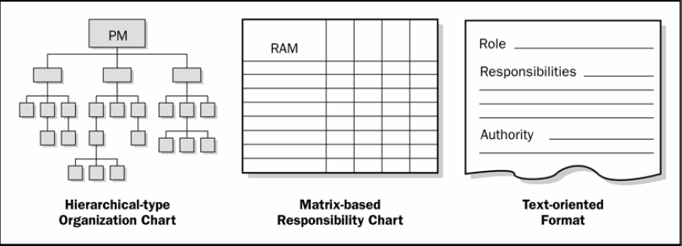
Develop Human Resource Plan: Tools and Techniques
Organization Charts and Position Description

Slide 9
Responsibility Matrix
Organization Charts and Position Description
Hierarchical-type charts
Matrix-based charts
RACI Format
 | Team Member
Activity | Jack | Chloe | Michelle | Ann
Design | Primary |  |  | Support
Install | Support |  | Primary
Program |  | Primary |  | Support
Primary – Primary responsibility for a task.
Support – Responsible to assist in the task completion

Slide 10
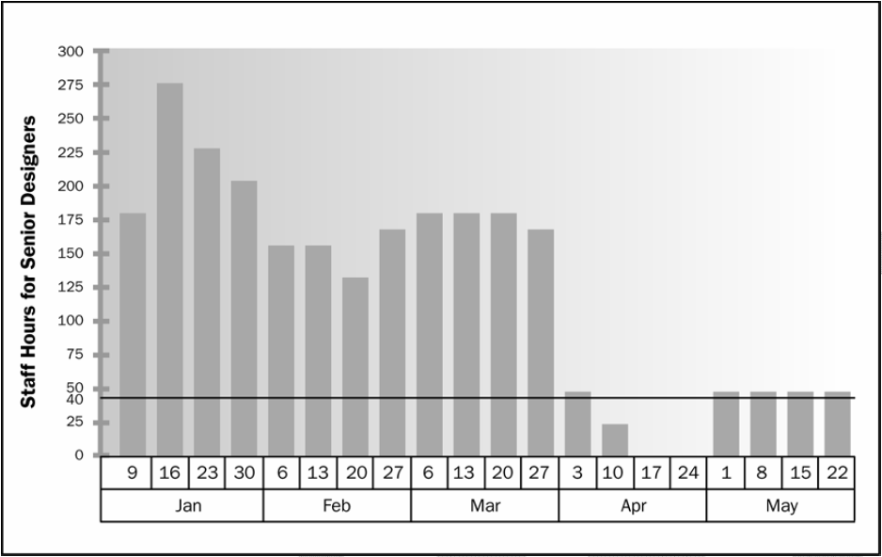
Resource Histogram

Slide 11
Plan Human Resource Management - Outputs
Outputs
Human Resource Management Plan

Slide 12
Thank you !

